Slide 1

2026 Budget Information
November 2024

Slide 2

Gearing up for the 2026 Budget

Slide 3

Budget: General Information
LiRN is accountable for ensuring that the funds are used as intended: to provide law library services and programs to lawyers in Ontario.

Slide 4
Budget: General Information
All associations are required to submit a budget in support of their grant request.
Budgets requests should reflect all anticipated costs for the upcoming year insofar as possible.

Slide 5
Budget: Timeline (Dates to be confirmed)
January 27 | Financial reports for Q4 2024 Due from Associations.
March 28 | On or before March 28, LiRN sends EFB Calculations / Notifications to Associations.
May 9 | Business cases for 2026 budget expenditures / proposals to use 2025 EFB funds due.
End of May (TBC) | LiRN’s Board of Directors considers business cases and EFB proposals. The Board may provisionally approve, ask for more details, or deny the requests. Often, the Board will wish to consider the expenses in context of the overall budget before making a final decision.
June 13 | LiRN informs Associations of the Board’s response to businesses cases and EFB proposals. If accepted, the expenses should be included in the Associations’ 2026 grant request as outlined below. These grant requests form part of the overall LiRN budget put before Board of Directors for approval.
June 30 | Associations send Grant Request and Supporting Budget to LiRN.
July (TBC) | LiRN’s Audit and Finance Committee considers an early draft of the Budget and Explanatory (including proposed grants to associations).
August (TBC) | LiRN’s Audit and Finance Committee considers the final draft of the Budget and Explanatory Notes (including proposed grants to associations).
Last Week of August | LiRN’s Board of Directors votes on the Budget and Explanatory Notes.
September – October | The Law Society of Ontario’s Audit and Finance Committee holds two meetings: one to consider the LSO’s overall budget (including LiRN’s Budget and Explanatory Notes) and one to invite Benchers not on this Committee to review and ask questions about the budget. Usually, the committee meets in the first week of September and again in later September / early October. Convocation considers the budget. This meeting usually occurs on the last Thursday in October.
November 28 | On or before November 28, LiRN sends grant letters to associations based on the results of Convocation’s vote.

Slide 6

How to Create Your Grant Request and Budget
Consider upcoming needs. How’s your equipment? Will staff receive merit / cost of living increases? What are the collection needs?
Determine whether you will need to submit a business case. Circumstances requiring a business case are outlined below.
Ensure your submissions signed and are complete.
Review the timeline. We ask that you time any committee or board meetings necessary to approve your budget to meet the LiRN’s deadlines. If an extension is necessary, please let us know as soon as possible so we can work with you.
Review the available information! Check our website or reach out to accounting [at] lirn.ca for templates, tips, and copies of this presentation.
Scan for more info
↓

Slide 7
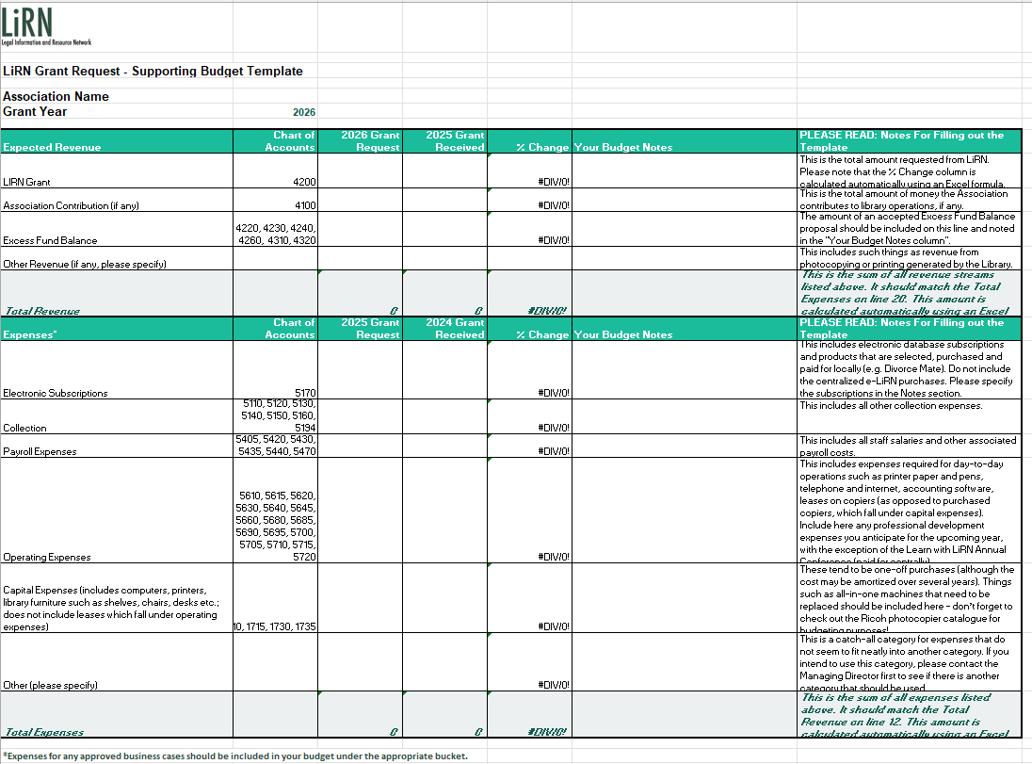
Budget Template

Slide 8
Budget Template Elements: Revenue
LiRN Grant is the bulk of the revenue. This is the amount you are requesting from LiRN.
Association Contribution (if any). Some associations contribute to the cost of operating the library – this amount, if any, and what it pays for should be noted.
Other revenue includes things like photocopier or printer revenue.
Use of Excess Fund Balance (if any). The amount of an accepted Excess Fund Balance proposal should be included on this line.

Slide 9

Budget Template Elements: Revenue
The total of these four sources of revenue will be added and should match the total expenses.

Slide 10
Budget Template Elements: Expenses
The Chart of Accounts ("COA") sets out the General Ledger account numbers used in the network library system of accounting. Use the COA to determine the “bucket” in which to put an expense.
Consistency across the network is important for accurate accounting and reporting and allows LiRN to track trends in spending that can help provide data supporting LiRN’s budget requests to its funder.
The current COA was introduced in 2023, with a slight revision in 2024. No revisions have been made for 2025 as yet.

Slide 11

Budget Template Elements: Expenses
The expenses can be categorized into buckets:
Electronic Subscriptions
Collection Expenses
Payroll Expenses
Operating Expenses
Capital Expenses
The rarely-used “Other”

Slide 12
Budget Template Elements: Expenses
Include all anticipated expenses – including approved business case and excess fund balance proposal expenses – in the appropriate buckets.

Slide 13

Electronic Subscriptions
Include electronic subscriptions such as Divorcemate and note your subscriptions.
Include subscriptions that have a print and electronic element like Proview.
This helps us identify opportunities to save money across the network and understand the overall spend on such resources.
In determining whether to invest in an electronic subscription, keep in mind the Collection Development and Maintenance Policy, the Core List, and your community’s specific needs.

Slide 14

Collection
This bucket is for the rest of your collection.
When developing this entry, consider the Collection Development and Maintenance Policy, the Core List from OCLA, and your community’s specific needs.

Slide 15

Payroll Expenses
This bucket is for staff salaries and other associated payroll costs.
Consider any planned salary adjustments (such as COLA / merit increases) and upcoming staffing changes that you are aware of.
For incoming staff, associations may wish to review the role description matrix and salary bands and use these tools to find the right level of pay for new hires.

Slide 16

Operating Expenses
These are expenses required for day-to-day operations.
Think printer paper and pens, telephone and internet, accounting software, leases on copiers (as opposed to purchased copiers, which fall under capital expenses).
Include here any professional development expenses you anticipate for the upcoming year, with the exception of the Learn with LiRN Annual Conference (paid for centrally).
Notes:
Conferences like CALL and even AALL are commonly attended

Slide 17

Notes on Professional Development Expenses
Professional Development for Library Staff should be included in your annual budget except for the Learn with LiRN Annual Conference.
Why?
Practical reason: Ad hoc requests to LiRN throughout the year creates uncertainty as to the amount we would need to budget for.
Philosophical reason: It’s part of the Association’s role as employer to approve professional development for its staff.
There is no need for a business case, with one exception – bursaries for Library Technician Diplomas.

Slide 18
Notes on Professional Development Expenses
Learn with LiRN Annual Conference – Don’t include in your grant request
Expenses for the Conference do not need to be included in your annual budget unless you intend to send more than one staff person.
All staff are encouraged to attend the Annual Conference in person or virtually. LiRN will cover the cost for one attendee from each Association to attend in person.
The conference is a centralized service provided to network library staff. Costs are therefore included in that part of LiRN’s operating budget. The Association, as the employer, still approves attendance.

Slide 19
Notes on Professional Development Expenses
Library Technician Program Bursaries – Do include in your grant request, but please provide a business case
LiRN may grant bursaries for staff to enroll in library technician diploma or certificate programs from accredited colleges.
Funds for attendance should be requested in your budget along with a business case.
A business case is requested in this instance because of the greater length and cost of the commitment.

Slide 20

Capital Expenses
These tend to be one-off purchases (although the cost may be amortized over several years).
Things such as all-in-one machines that need to be replaced should be included here – don’t forget to check out the Ricoh photocopier catalogue for budgeting purposes!
Anticipate your upcoming needs. Take stock of the equipment you have. Consider its state of repair and age. Reflect on whether you need new items, such as an additional computer for an influx of new users. Include these items under Capital Expenses, along with a business case.

Slide 21

Other
This item is included for expenses that don’t fall neatly into another category.
It should be rarely used (if ever). If you do use it, please reach out to LiRN first to see if the expense better fits somewhere else.
If it is used, include a note about why the expense does not fall under another bucket.

Slide 22

Excess Fund Balance Primer

Slide 23

What is a Fund Balance?
A fund balance develops when there is an excess of grant funding that has not been spent on operating the library.
Fund balances are included in the required financial reporting provided by Associations.

Slide 24
What is an EFB?
LiRN’s Board of Directors approved a Grant Administration Policy in 2021 on the advice of its auditor, which caps the amount of fund balance in the library’s account at 10% of their annual grant from LiRN.
In other words, the association can carry over up to 10% of its library grant.
An excess fund balance, or EFB, exists where the fund balance is higher than cap.

Slide 25
EFB Recovery
In 2023, the Board approved an annual process for recovering EFBs:
Calculate the EFB for the previous year;
Provide an opportunity for proposals to use EFBs; and
Deduct EFB amounts remaining after approved proposals from the following year’s grant.

Slide 26
How Are EFBs Calculated?
FUND BALANCE: As recorded in financial reports provided by Associations
MINUS:10% of the Current Year’s Grant
EQUALS: Excess Fund Balance

Slide 27
How Are EFBs Calculated?
For example:
An association’s annual grant for the current year is $500.
10% of $500 is $50.
Under the Grant Administration policy, the association can carry over up to $50 of grant funds.
If the fund balance is $75, then, the excess fund balance is $25:
Fund Balance: $75
Less: (500*10%) or $50
Equals: $25

Slide 28
How Are EFBs Calculated?
Let’s assume the association in our example submitted a proposal for using $10 of its excess funds in 2024. The proposal was approved and confirmed as part of their budget after Convocation voted on LiRN’s budget.
The association may not have spent these funds prior to submitting their financial reports for Q4 of 2024.
Since the fund balance is a cumulative total, those earmarked funds will make up part of the fund balance as at December 2024 when calculated in the first quarter of 2025.

Slide 29
How Are EFBs Calculated?
LiRN has a record of approved proposals.
When the Excess Fund Balances are calculated in March of 2025, the association will be asked to confirm the amount of earmarked funds in the fund balance.
In our example, the association will be asked whether any of the approved $10 has been spent or if some/all of those funds are still in the fund balance and earmarked for spending.
Assuming that the funds have not yet been spent, the EFB slated for recovery / further proposal for use would be $15 ($25 EFB less $10 approved for spending).
This way, we avoid recovering funds that are already approved for spending.

Slide 30
What Happens if you have an EFB?
Q1: LiRN’s accountants calculate EFBs for the previous year.
End of March: LiRN notifies associations that have EFBs.
May 9: Associations may submit a proposal to use EFBs. These are submitted with any other business case as part of the budget process.
End of May: The Board reviews proposals.
Mid-June: Associations notified of the decision.

Slide 31
What Happens if you have an EFB?
Accepted Proposal:
Include approved EFB proposal expenses in the budget as you would for any accepted business case.
In the Revenue section, include the amount of the accepted proposal under “Use of Excess Fund Balance.” Do not include the amount in the line for “LiRN Grant.”
The total revenue will then equal the expenses in your budget.
When the proposal expenses are incurred, the fund balance is reduced and brought into compliance with the policy.

Slide 32
What Happens if you have an EFB?
Caveat:
EFB Proposals will generally be approved for spending in the following fiscal year. For example, LiRN would anticipate expenses in an EFB Proposal accepted in 2024 to be incurred in 2025, although some exceptions may be made.
The Unanimous Shareholders Agreement between the LSO, FOLA, and the TLA states that, if the LSO does not approve LiRN’s budget, LiRN’s Board and the LSO will cooperate to develop a mutually acceptable budget.
EFB Recovery is part of LiRN’s funding sources in its overall budget.
In the event that LiRN’s budget is not approved, we may be asked to reconsider the recovery amount.

Slide 33
What Happens if you have an EFB?
Declined Proposal:
Do not include proposal expenses in the budget.
The total revenue will equal the expenses in your budget.
The requested grant will be reduced by the amount of the EFB.
This creates a shortfall between the grant and the expenses listed in the budget.
This shortfall is covered by the EFB, thereby reducing it and bringing it into compliance with the Grant Administration Policy.
In other words – you'll spend more than your grant amount and the funds to pay for the overspend will come from your fund balance.

Slide 34

Business Case Primer
Business cases are required for:
Capital expenses.
Library Technician Program Bursaries.
Unusually high grant requests.
Requests to use Excess Fund Balances ("EFB"). This is also known as an EFB Proposal.

Slide 35
Business Case Primer
Accepted Business Case: include expenses in budget.
Declined Business Case: do not include expenses in budget.

