Slide 1
LiRN Update Learn with LiRN 2024 November 2024
Vicki Whitmell, Chair

Slide 2

Update Agenda
Message from the Managing Director
Call for Applications for LiRN’s Board
2025 LiRN Budget: News from Convocation
Gearing up for the 2026 Budget
2025 Priorities
Innovation and Equity of Access to Legal Information Update
Q & A

Slide 3


Message from the Managing Director

Slide 4

Call for Applications to Join LiRN’s Board of Directors
The Nominations Committee, which includes representatives from all of LiRN's shareholders, continues its work.
Neil Guthrie and Sarah McCoubrey’s final terms as directors end in June.
The Committee is looking for board members to fill their slots.
The Committee is also looking for individuals with financial expertise.
Please contact Sarah McCoubrey for details on applying: sarah [at] calibratesolutions.ca

Slide 5

2025 LiRN Budget: News From Convocation
Convocation considered LiRN’s 2025 budget at its meeting of October 31.
Results.
Grant letters will be sent to associations by November 29.

Slide 6

Gearing up for the 2026 Budget

Slide 7
Budget: Timeline (Dates to be confirmed)
January 27 | Financial reports for Q4 2024 Due from Associations.
March 28 | On or before March 28, LiRN sends EFB Calculations / Notifications to Associations.
May 9 | Business cases for 2026 budget expenditures / proposals to use 2025 EFB funds due.
End of May (TBC) | LiRN’s Board of Directors considers business cases and EFB proposals. The Board may provisionally approve, ask for more details, or deny the requests. Often, the Board will wish to consider the expenses in context of the overall budget before making a final decision.
June 13 | LiRN informs Associations of the Board’s response to businesses cases and EFB proposals. If accepted, the expenses should be included in the Associations’ 2026 grant request as outlined below. These grant requests form part of the overall LiRN budget put before Board of Directors for approval.
June 30 | Associations send Grant Request and Supporting Budget to LiRN.
July (TBC) | LiRN’s Audit and Finance Committee considers an early draft of the Budget and Explanatory (including proposed grants to associations).
August (TBC) | LiRN’s Audit and Finance Committee considers the final draft of the Budget and Explanatory Notes (including proposed grants to associations).
Last Week of August | LiRN’s Board of Directors votes on the Budget and Explanatory Notes.
September – October | The Law Society of Ontario’s Audit and Finance Committee holds two meetings: one to consider the LSO’s overall budget (including LiRN’s Budget and Explanatory Notes) and one to invite Benchers not on this Committee to review and ask questions about the budget. Usually, the committee meets in the first week of September and again in later September / early October. Convocation considers the budget. This meeting usually occurs on the last Thursday in October.
November 28 | On or before November 28, LiRN sends grant letters to associations based on the results of Convocation’s vote.

Slide 8
Budget: More Information
For more information, please refer to the materials or scan the QR code above to visit LiRN’s grant request information page online.
For specific questions about your individual association, email accounting [at] lirn.ca or tleitch [at] lirn.ca

Slide 9

2025 Priorities

Slide 10

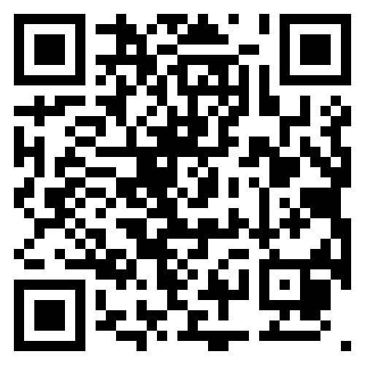
Improving Communications
Communications audit results are available on our website: Communications Strategy – LiRN
The Board will develop a Communications Strategy in 2025
The intention is to:
Fill communication gaps
Better engage stakeholders
Establish clear goals and objectives, messaging priorities, target audiences, and preferred communication channels

Slide 11


Improving Communications
Implementing the Key Network Processes Project Recommendations
We will focus on the “Improve Communication” recommendations from the consultant’s report (available on our website along with updates on all recommendations from the report: Key Network Processes – LiRN
Refine the system to update and manage contact information: in progress using LibConnect to better maintain communication lists
Initiate a team management software system (eg Teams) to allow library staff from all associations to communicate with each other: to be considered as a project for 2026
Several specific suggestions from the consultations relate back to this recommendation and could be implemented through team management software / ‘intranet-like’ communications vehicle.

Slide 12

Strategic Planning
LiRN’s inaugural strategic plan is coming to an end.
We are embarking on creating a strategic plan for the next five years.
The planning process will include:
A user needs analysis survey aimed at end users and potential end users
A white paper on modern law libraries
Consultations with shareholders, associations, library staff, other legal organizations such as the Law Foundation of Ontario, and other stakeholders
A Board Retreat to finalize the plan

Slide 13

Marketing
We need to get the word out about the great things that are happening at courthouse libraries. As we wrote in one flyer … it’s worth the drive to the library!
To that end, LiRN is working with a marketing firm under the Innovation and Access to Legal Resources project funded by The Law Foundation of Ontario
The first step: Creating a newsletter
Next step: Upping our social media game
We have also arranged a special rate for associations who want to work with marketing professionals. Contact Theresa (tleitch [at] lirn.ca) for more info

Slide 14

Marketing
Each edition of the newsletter features a different courthouse library
We also have a section for upcoming education events – let us know if you’d like to include any upcoming CPDs you are offering!
Share widely!

Slide 15

e-LiRN Evaluation
In just a few years since we established e-LiRN in 2022 …
Electronic resource costs continue to grow
Demand for remote access is increasing
AI products are flooding the market
The user needs survey mentioned above as part of our strategic planning will also help us determine the next steps for e-LiRN

Slide 16

Network Policy Conversations
Two years ago, LiRN’s board adopted policies intended to clarify library services and management responsibilities
The policies included a two-year transitional period followed by a review
We determined that the most effective way to collect information necessary for the review is one-on-one meetings with association presidents
Watch for the LiRN update coming in December – it will include a link to schedule a meeting between the association president (or their delegate) and LiRN’s Managing Director to discuss the policy
LiRN’s board has extended the transitional period for these policies to three years to allow time for these meetings to take place

Slide 17

Innovation and Equity of Access to Legal Information Project

Slide 18

Innovation and Equity of Access to Legal Information Project
Thanks to The Law Foundation of Ontario for funding this project!

Slide 19

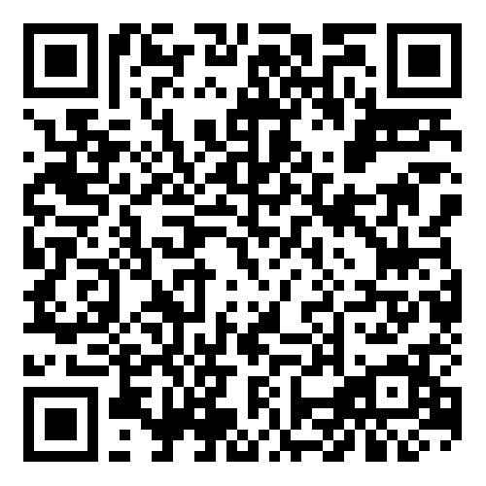
Innovation Sandbox
The Innovation Sandbox allows libraries to experiment with ways to expand the traditional courthouse library service model.
We invite you to propose ideas any time before May 15, 2025.
We’ve created a menu of innovation projects to get you started – or send us your new ideas!
Scan for more information and application forms ➔

Slide 20


Collection Enhancement
In year one, libraries were invited to acquire essential print resources to provide consistent access to titles most essential to meeting access to justice needs of their communities.
In year two, we are piloting the popular criminal law resource rangefinder.ca. It is now available — remotely and in your nearest courthouse library — to all lawyers and articling students in Ontario.
Learn more and get your login credentials through our website at rangefindr.ca – LiRN or scanning the QR code.

Slide 21

Questions

Slide 22


