Slide 1

The Art of Collection Development

Slide 2


Slide 3

Collection Analysis
Collection-Centered
User-Centered

Slide 4
Slices of the Pie
Legal Community
Assessment
Maintenance
Outreach
Selection

Slide 5


Slide 6
Piracy, Weeding, De-Selection
Space
Access
Gems
Problems
Familiarity

Slide 7

Typical Questions to Ask?
Newer edition?
Is the text used?
What do your users think?
Electronic?
Owned by someone else?
Still relevant / Condition?
Oversaturation?

Slide 8
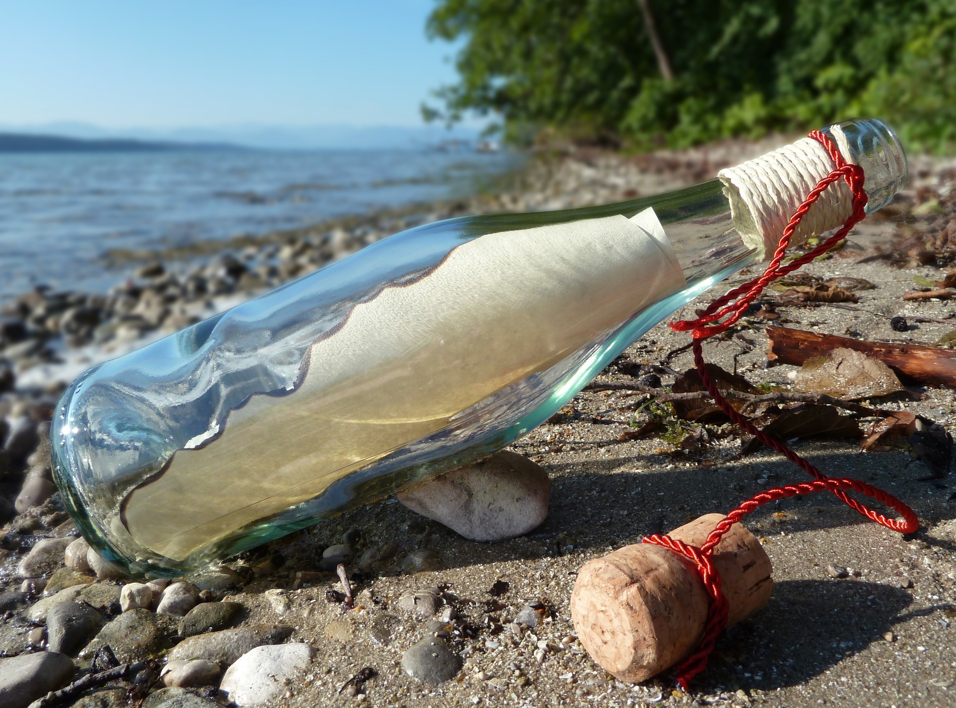

Slide 9
New Book Request Form
Library purchases depend on the relevance to a research area, funds available, costs, etc. You might try to obtain the required item through Interlibrary Loan. Please email staff.
Use this form to request a book not held in our collection.
Check Infolocate before requesting the purchase.
For best results be sure to fill in as much information as possible.
Your Name
Email
Would you like to be notified of the decision to purchase? Yes ⃝ No ⃝
Title
Author(s)
Edition
Year (YYYY)
Publisher
ISBN

Slide 10
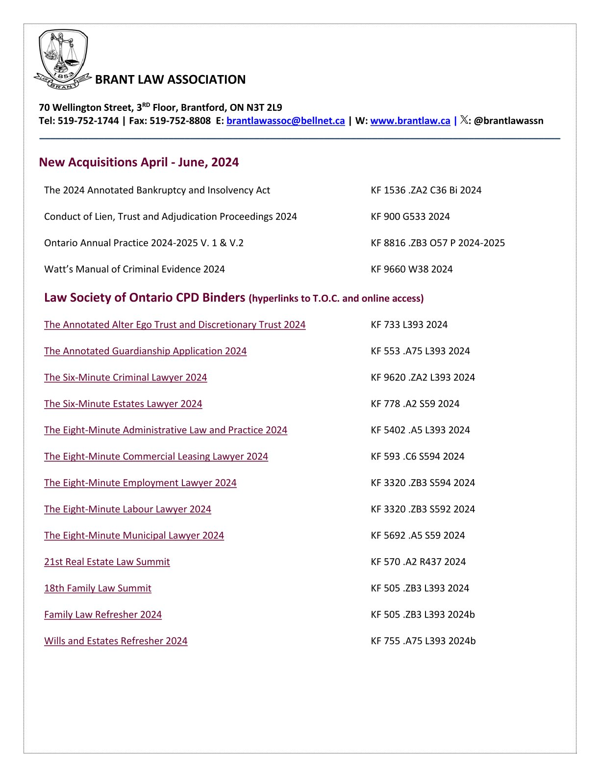

Slide 11
Proposition
Should we as a system share collection decisions, specifically new resources/titles that we purchase, and perhaps include the benefit to the user?

Slide 12
Thank You! Questions / Comments
Learn with LiRN Conference 2024
Christiane (Chris) Wyskiel,
Library Manager 1
Brant Law Association

