Slide 1


Searching for Commentary
USING E-LIRN RESOURCES
Megan McDonnell
Toronto Lawyers’ Association
7 May 2024

Slide 2

01
What is e-LiRN?
02
Lexis Advance Quicklaw
03
Practical Guidance
AGENDA
04
Westlaw Canada
05
vLex Canada
06
In Practice (Example Questions)
07
Tips & Tricks

Slide 3
Secondary sources often explain legal principles more thoroughly than a single case or statute, so using them can help you save time.
- Harvard Law School Library

Slide 4

What is e-LiRN?

Slide 5




E-LIRN OVERVIEW
Lexis Advance Quicklaw
Practical Guidance
Westlaw Canada
vLex Canada
Case Law (Canada, UK, USA)
Legislation
Current
Historical
Secondary Sources
Halsbury’s Laws of Canada
Forms & Precedents
Covers 13 Practice Areas
Forms & Precedents
Commentary & Practice Notes
Checklists, Toolkits, & Guides
CriminalSource
Estates&TrustsSource
FamilySource
All Include:
Case Law
Legislation
Secondary Sources
Case Law
Legislation
Secondary Sources
Irwin Law e-Library
Law Journals
Law Blogs
Vincent AI

Slide 6

The Resources

Slide 7
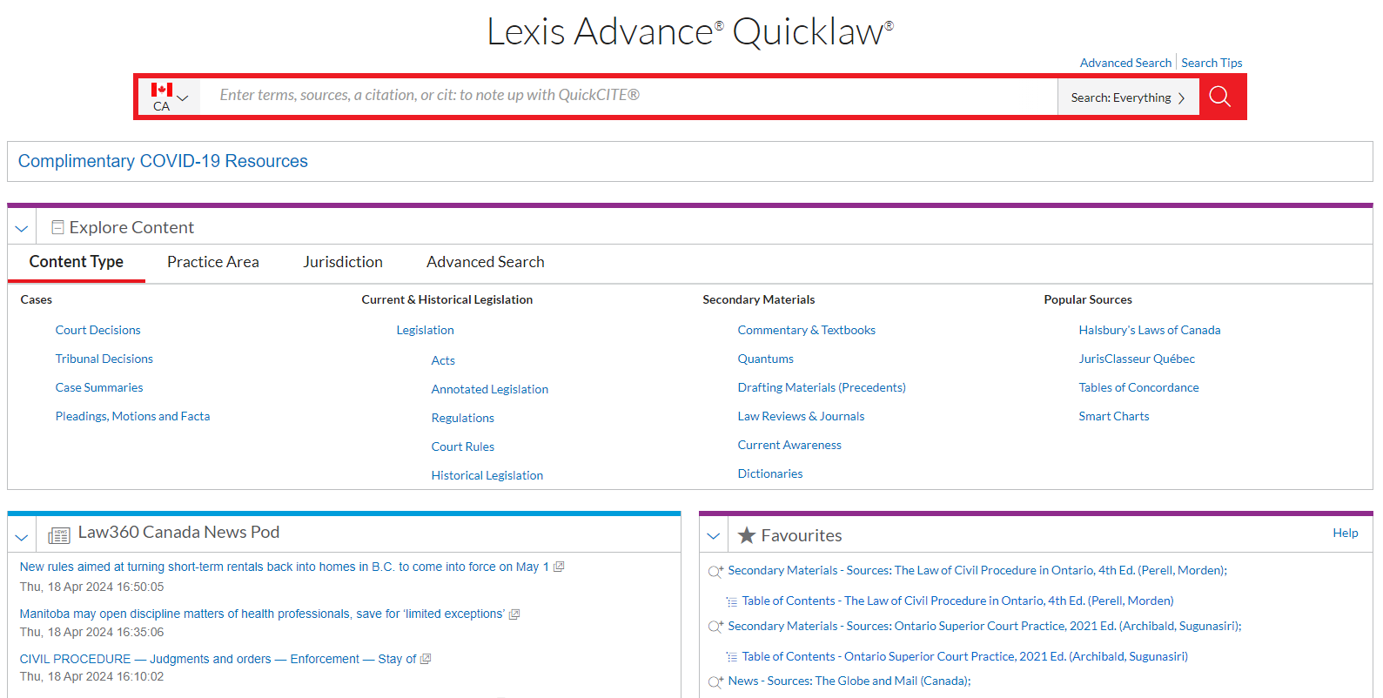
LEXIS ADVANCE QUICKLAW
Comprehensive coverage:
Case Law (Canada, UK, USA)
Legislation
Textbooks & Looseleafs
Halsbury’s Laws of Canada
Forms & Precedents
Dictionaries
News & Current Awareness
Quantums

Slide 8
LEXIS ADVANCE QUICKLAW

Slide 9
LEXIS ADVANCE QUICKLAW

Slide 10

LEXIS ADVANCE QUICKLAW

Slide 11

LEXIS ADVANCE QUICKLAW

Slide 12
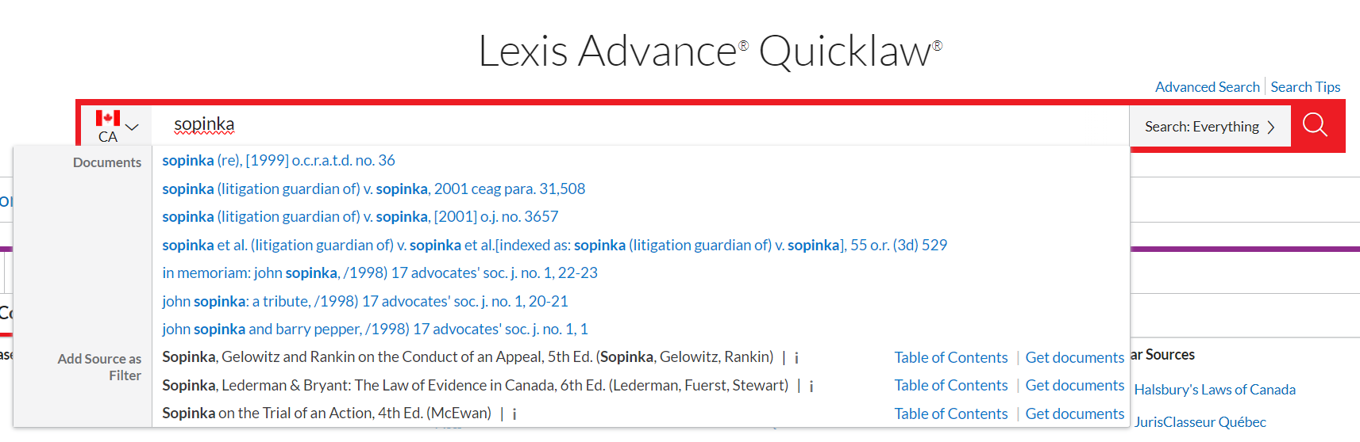
FINDING A RESOURCE - OPTION 1

Slide 13
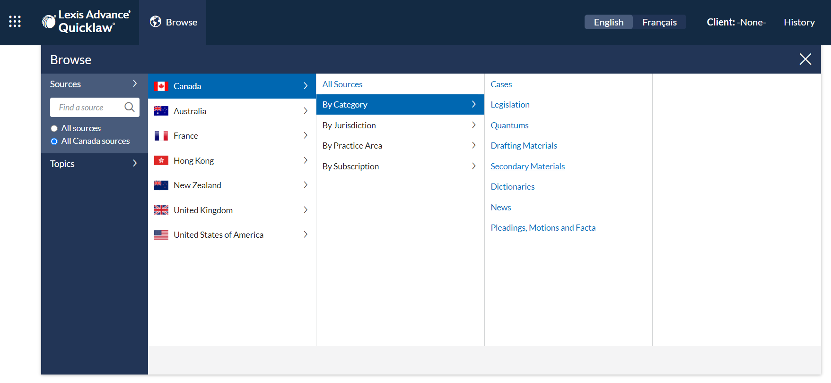
FINDING A RESOURCE - OPTION 2A

Slide 14
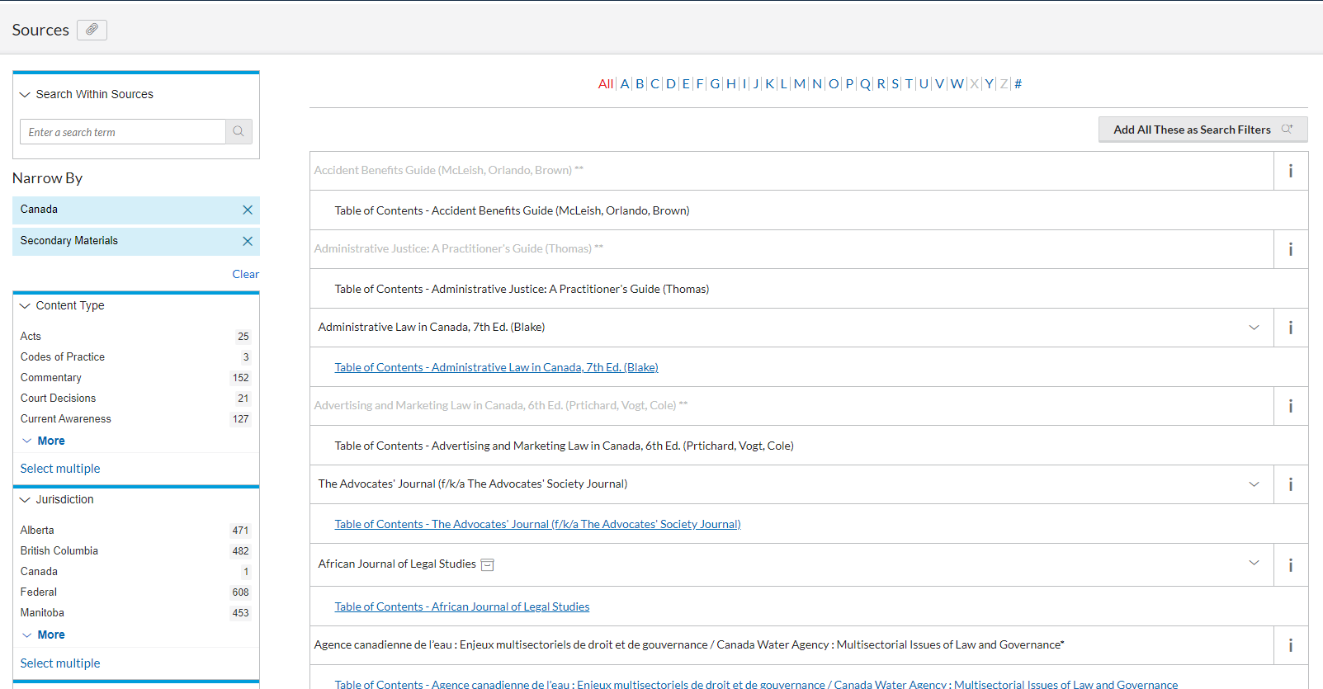
FINDING A RESOURCE - OPTION 2A

Slide 15
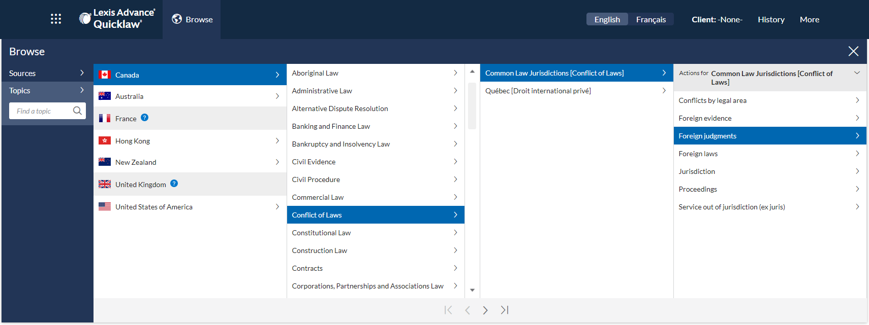
FINDING A RESOURCE - OPTION 2B

Slide 16
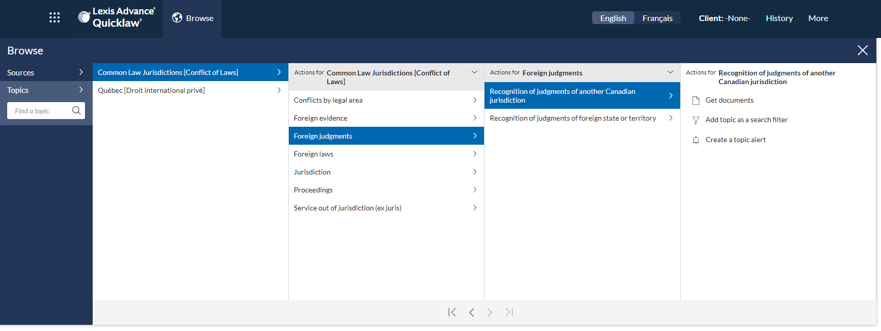
FINDING A RESOURCE - OPTION 2B

Slide 17
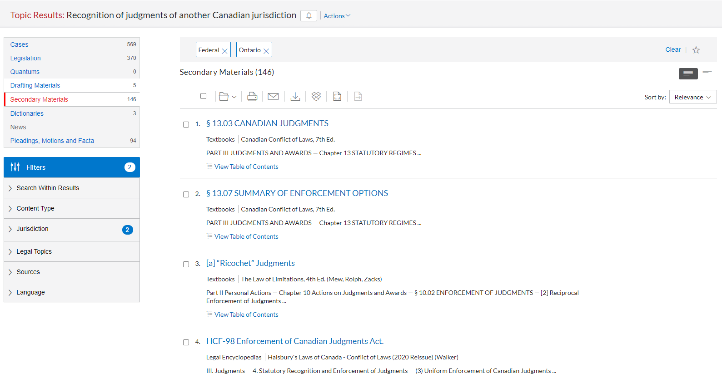
FINDING A RESOURCE - OPTION 2B

Slide 18
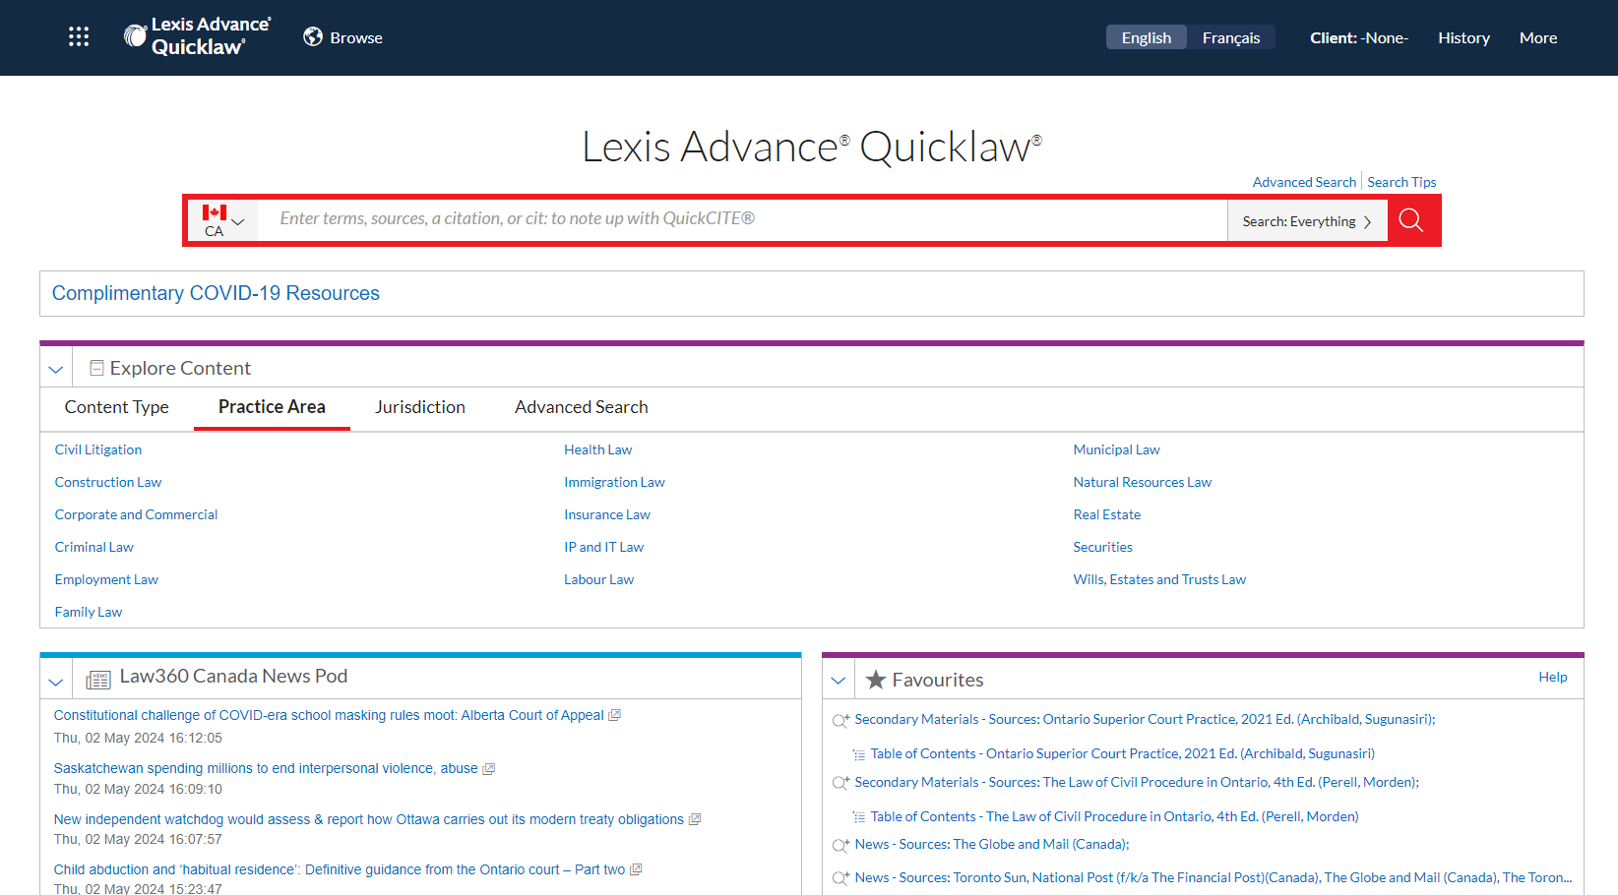

FINDING A RESOURCE - OPTION 3

Slide 19
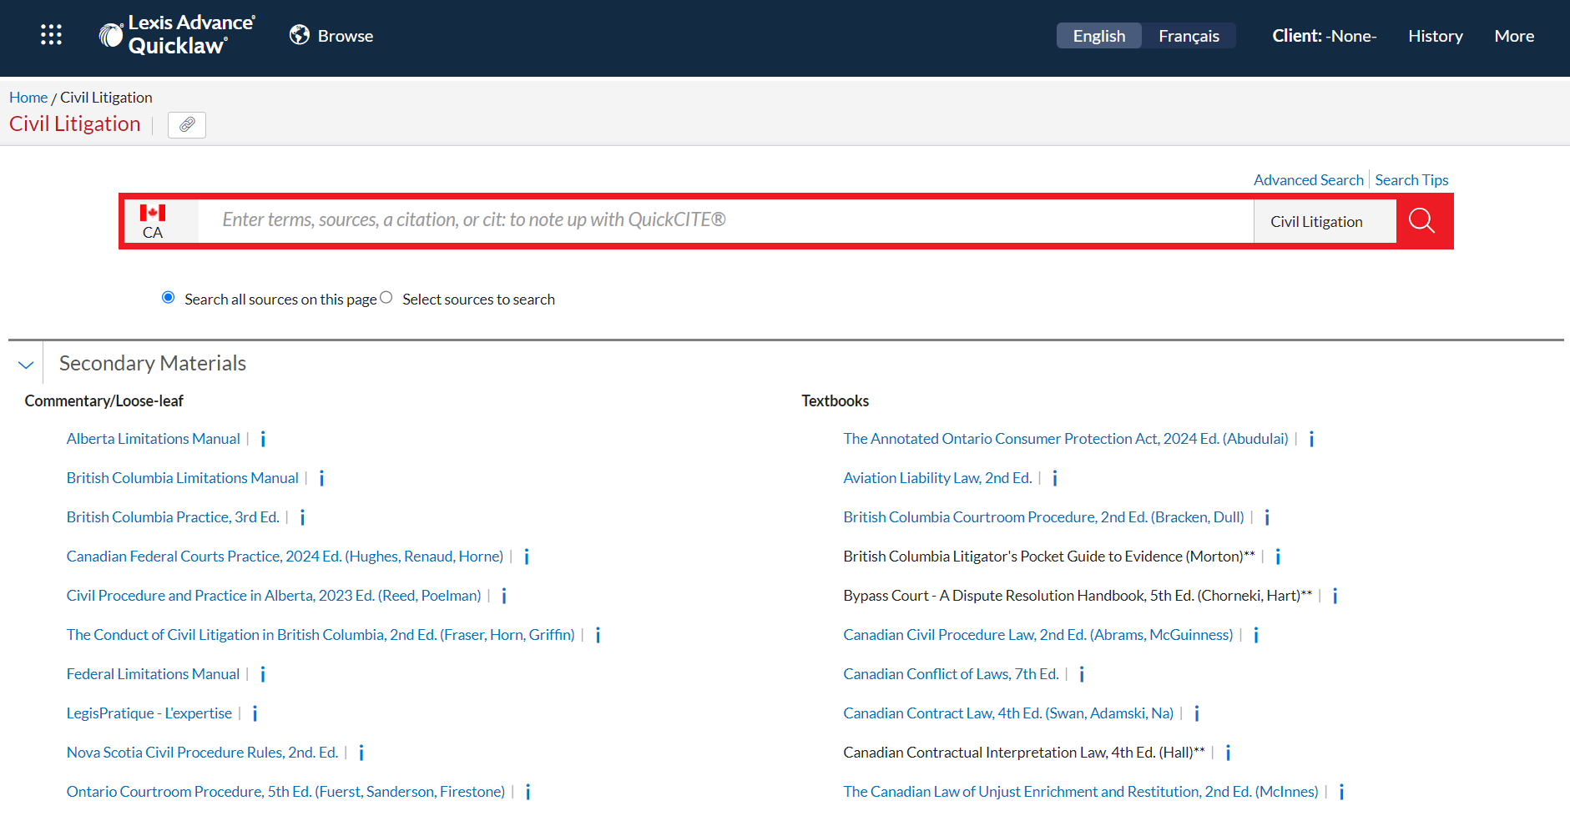
FINDING A RESOURCE - OPTION 3

Slide 20
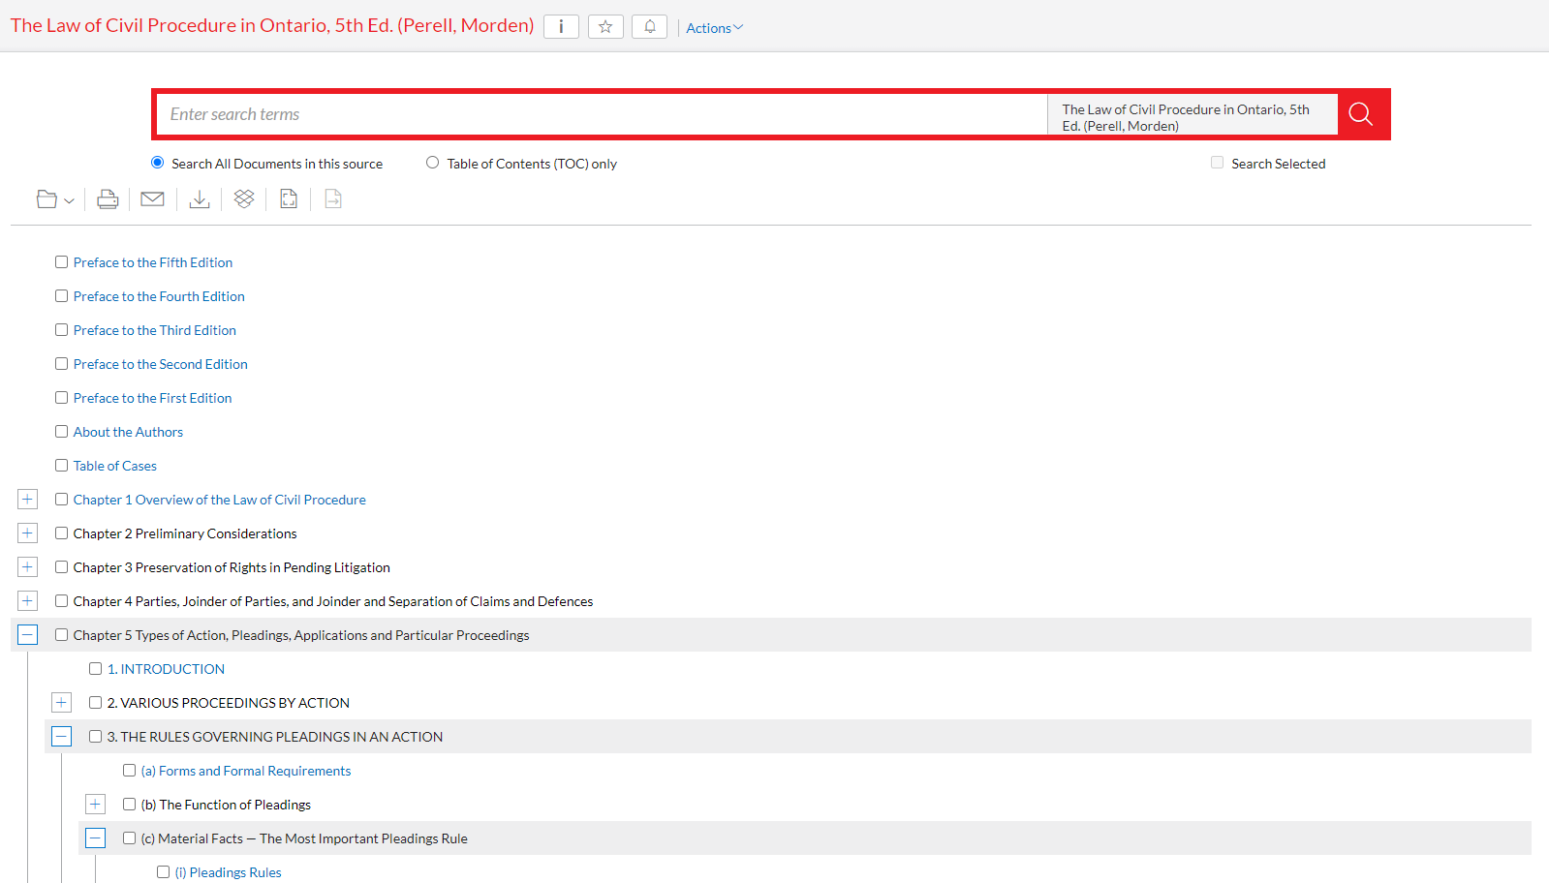

Slide 21


Slide 22
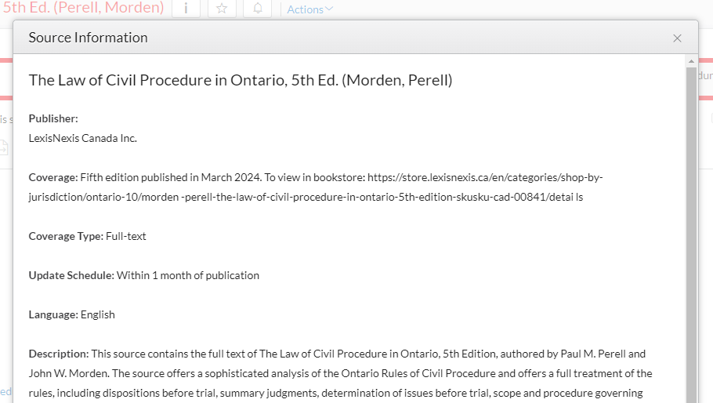

Slide 23

HALSBURY’S LAWS OF CANADA

Slide 24

HALSBURY’S LAWS OF CANADA- ON QUICKLAW!

Slide 25
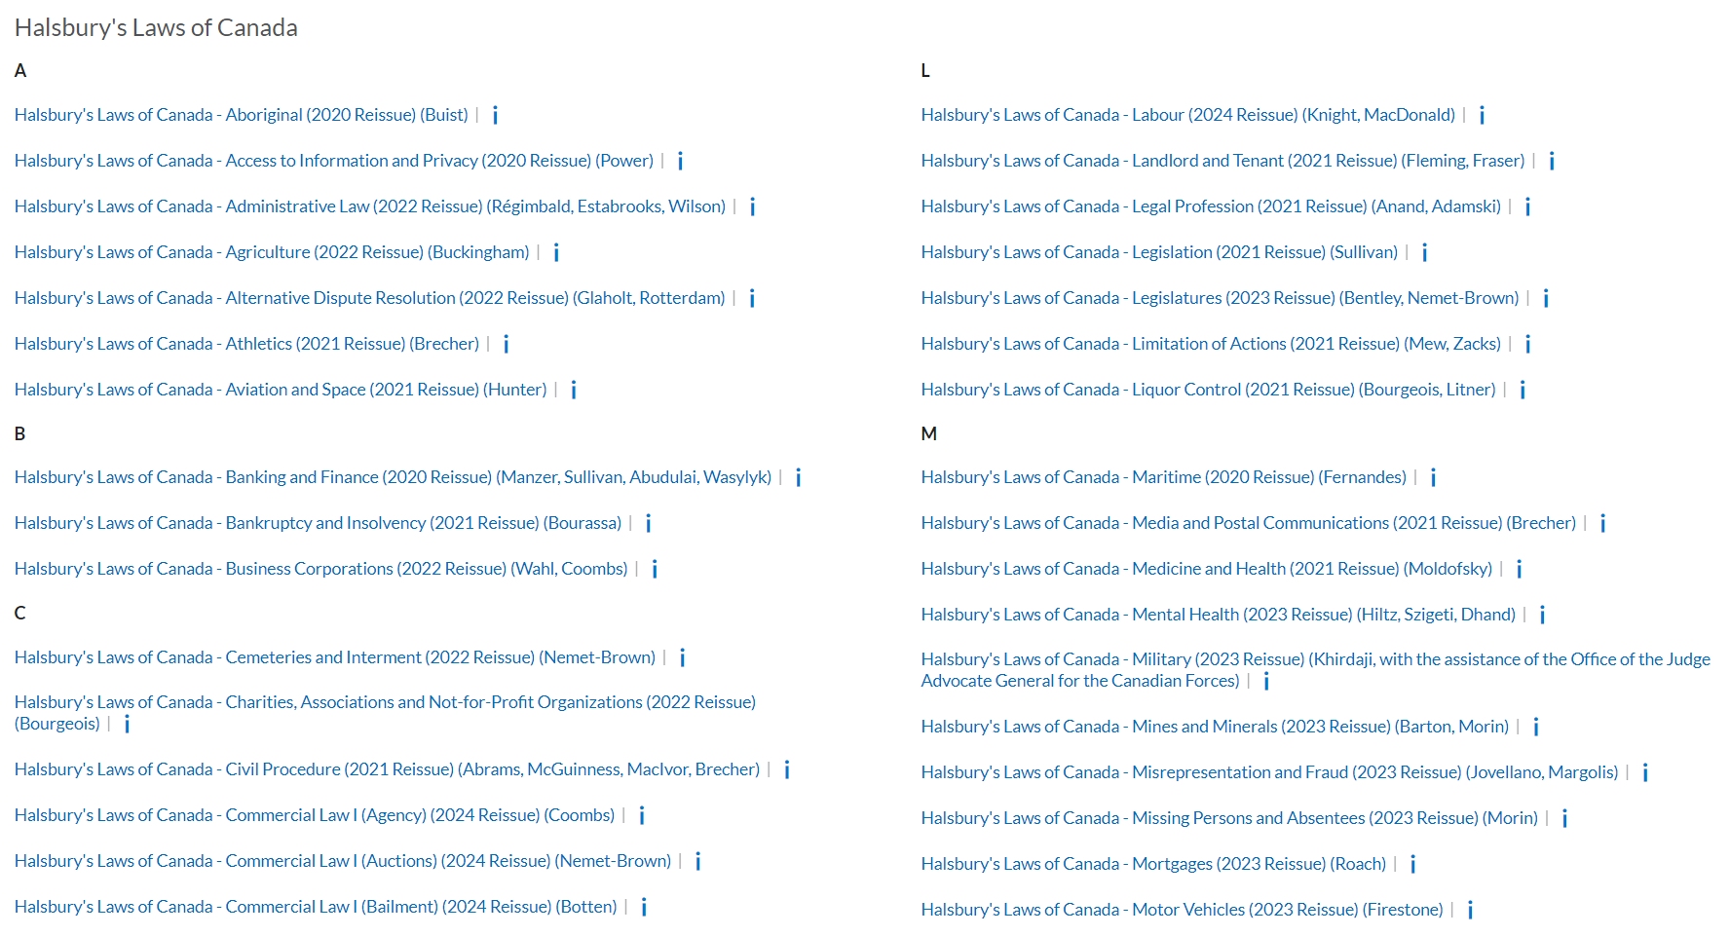

Slide 26
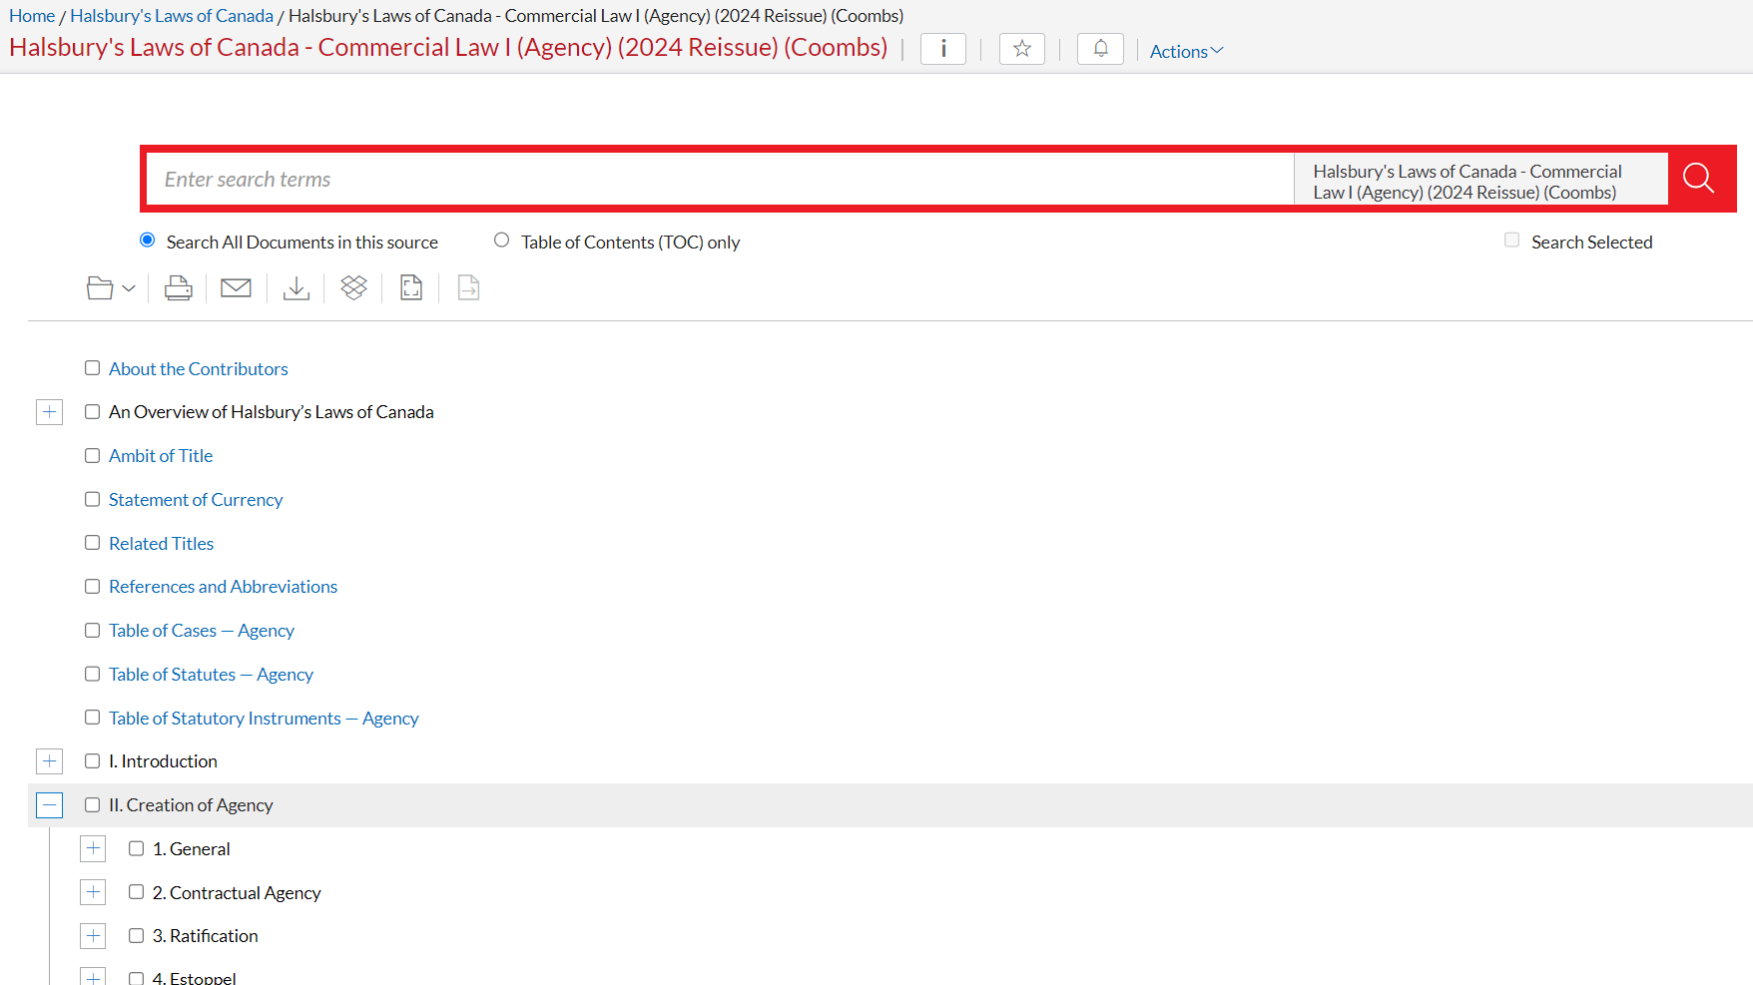

Slide 27
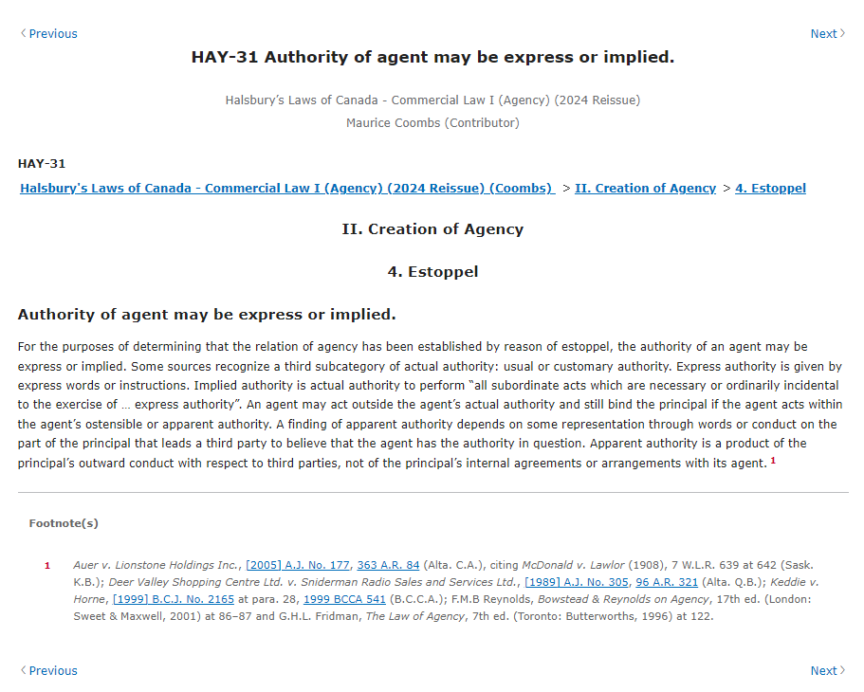
Notes:
Agency question as example

Slide 28
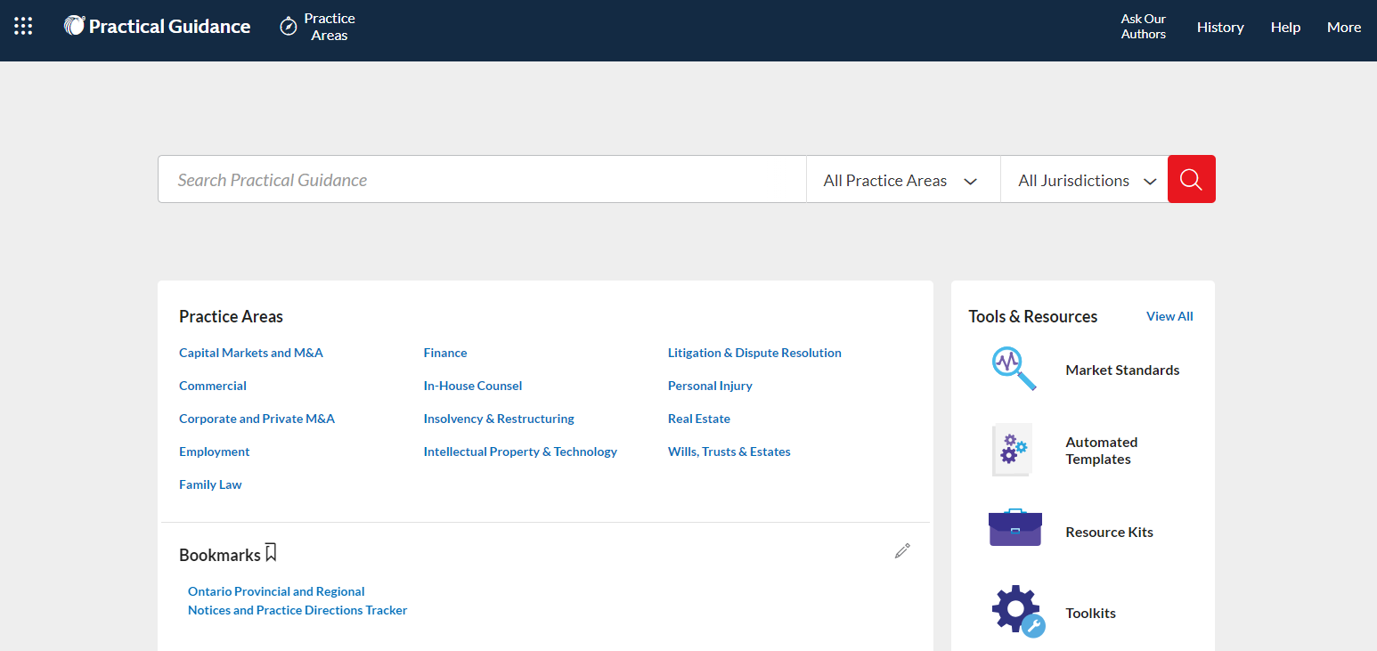
PRACTICAL GUIDANCE
Practice Notes
Forms & Precedents
Checklists, Tables and Flowcharts
Tools & Toolkits
Automated Templates
Market Standards
Find guidance for 13 practice areas that reflect the latest practice trends

Slide 29
PRACTICAL GUIDANCE

Slide 30

PRACTICAL GUIDANCE

Slide 31
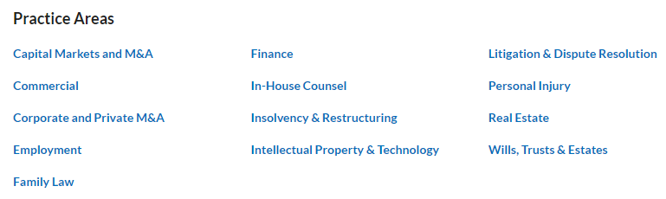

Slide 32
PRACTICAL GUIDANCE

Slide 33
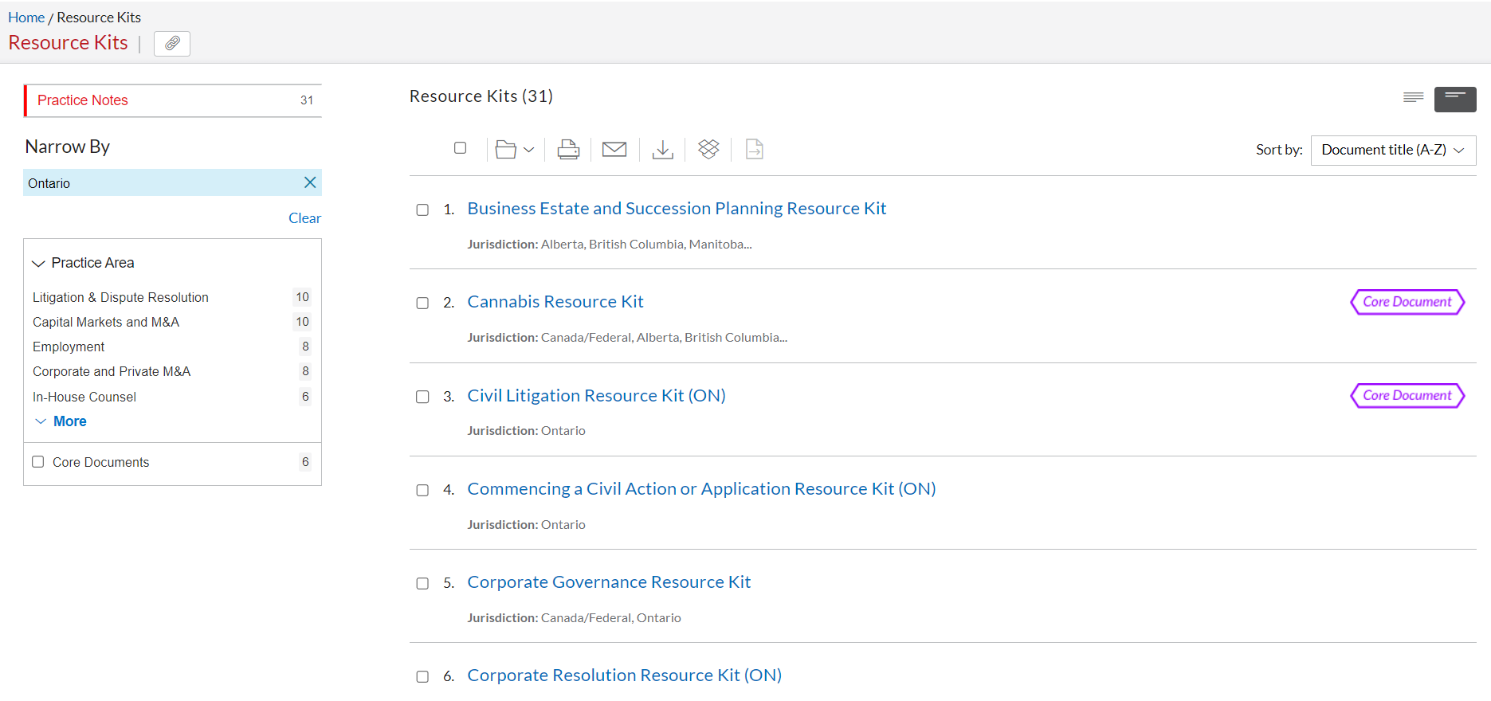
RESOURCE KITS

Slide 34
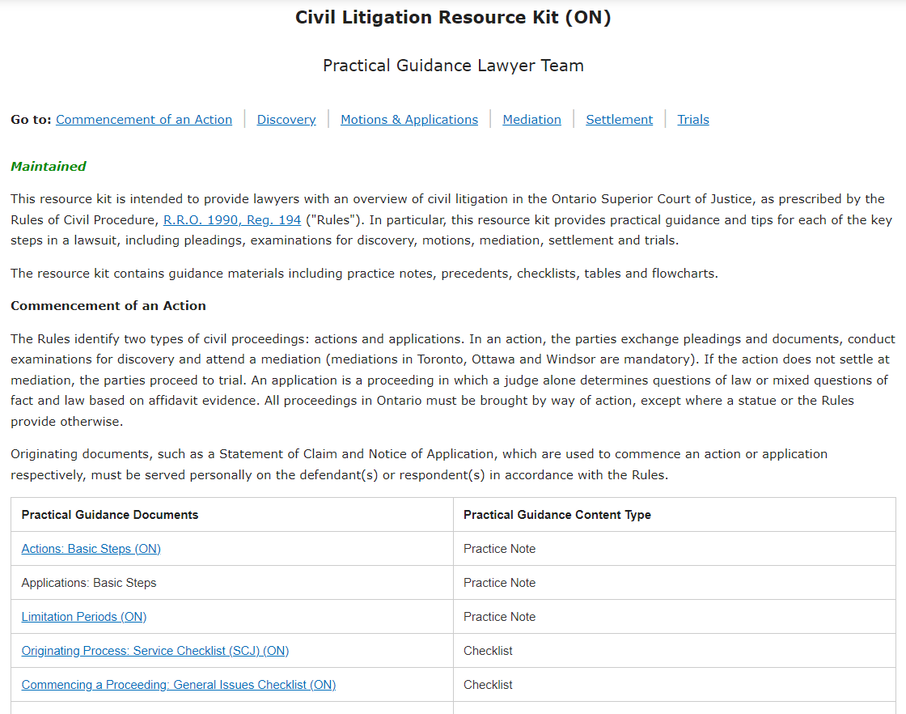

Slide 35
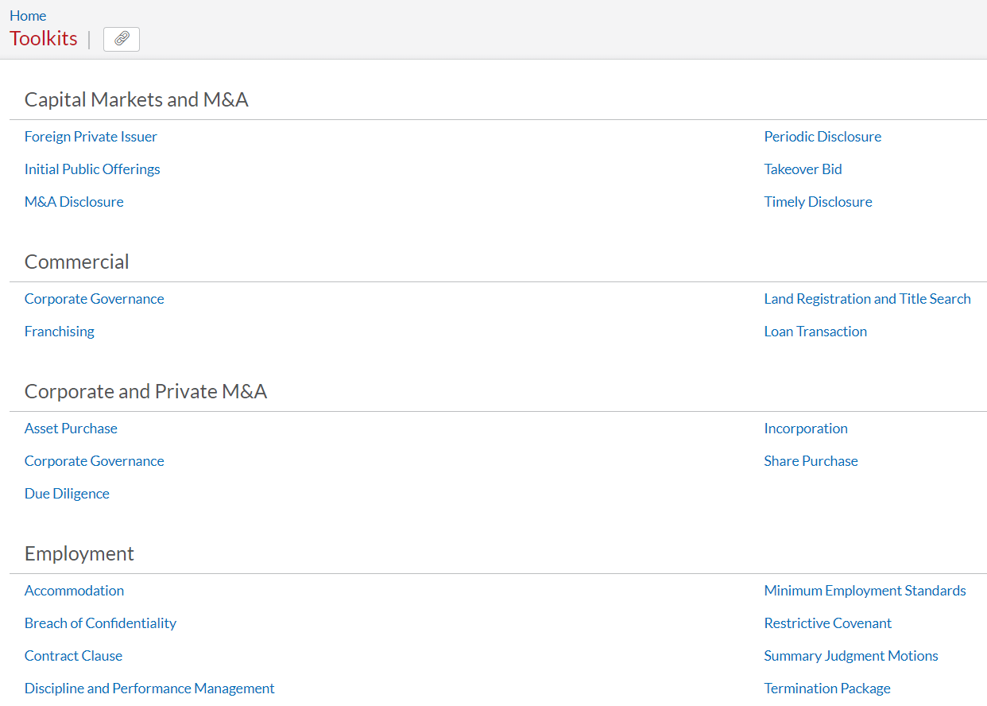
TOOLKITS

Slide 36
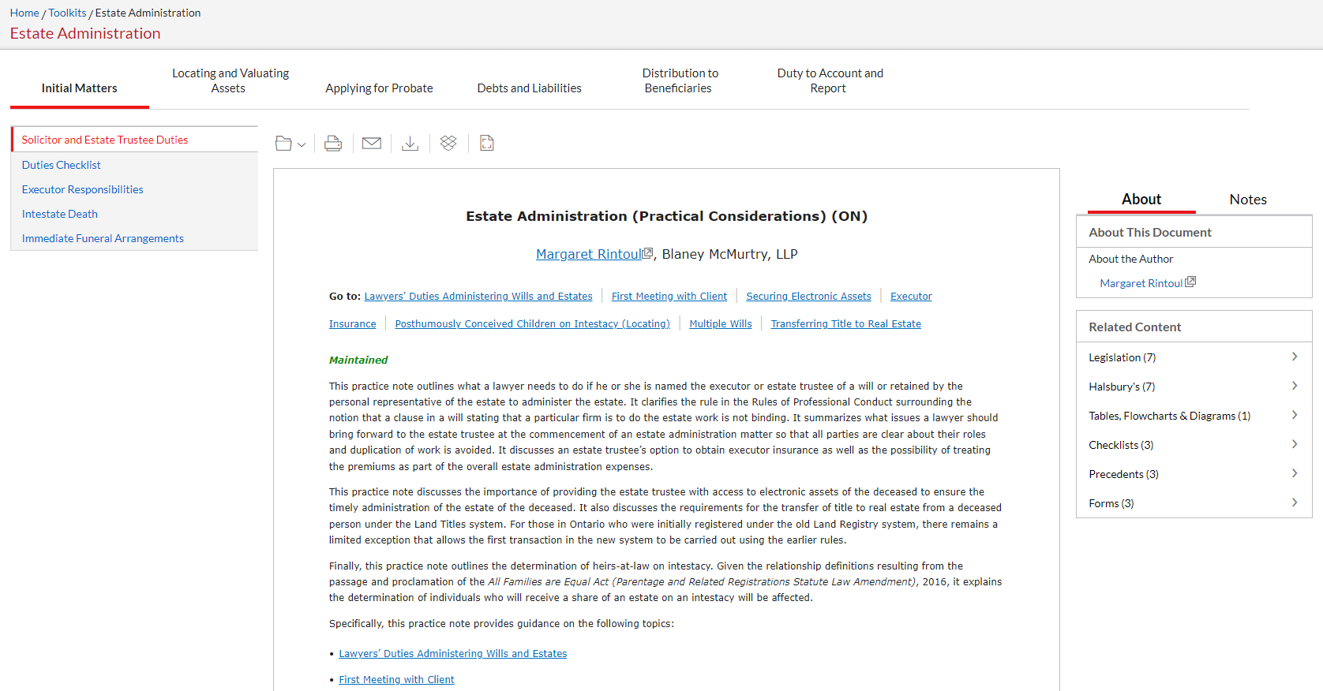

Slide 38
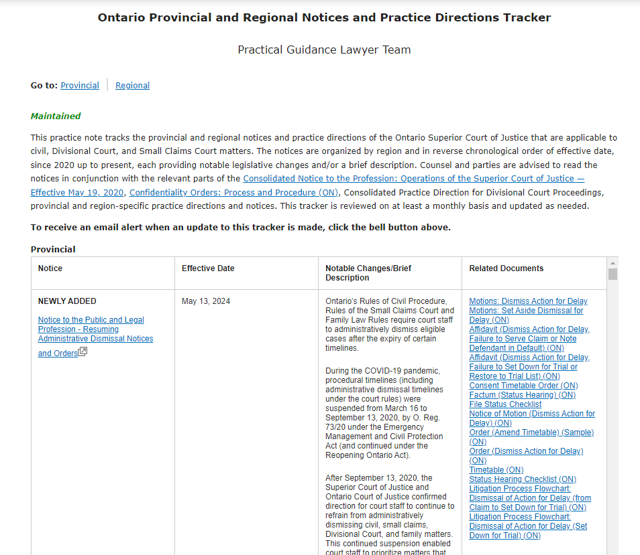

Slide 39
FINDING A PRECEDENT

Slide 40
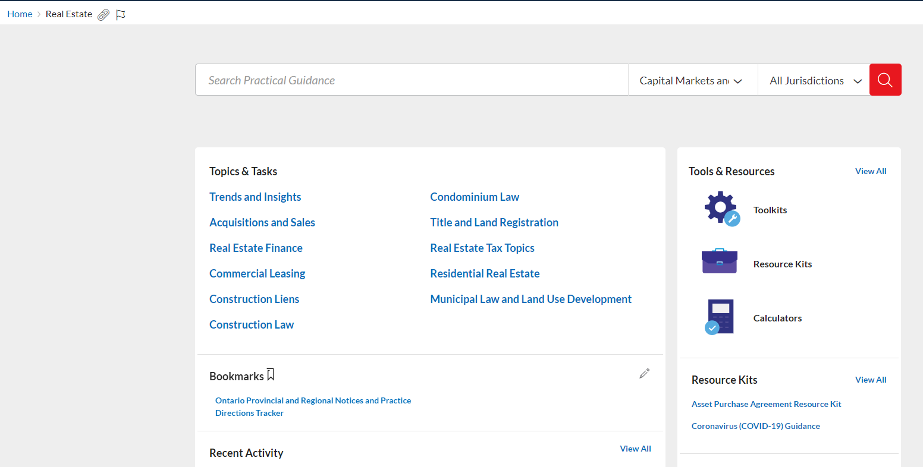
FINDING A PRECEDENT

Slide 41

FINDING A PRECEDENT

Slide 42
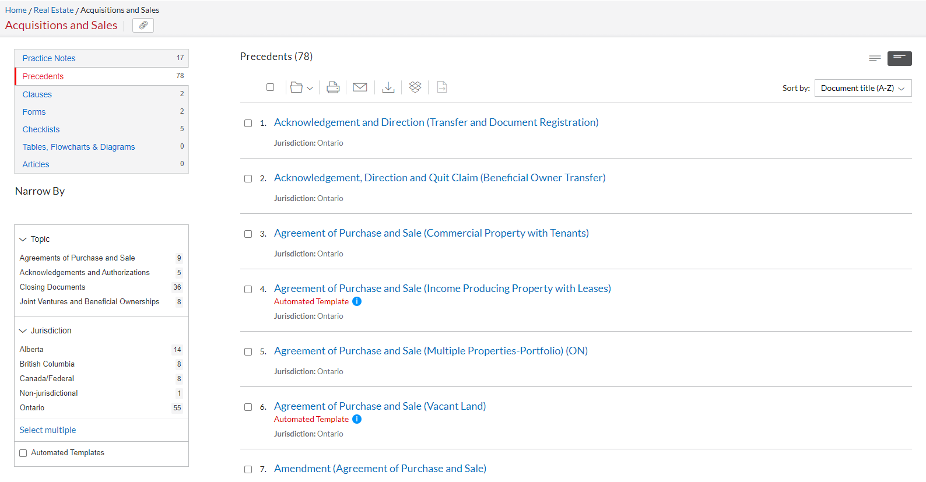
FINDING A PRECEDENT

Slide 43
FINDING A PRECEDENT

Slide 44
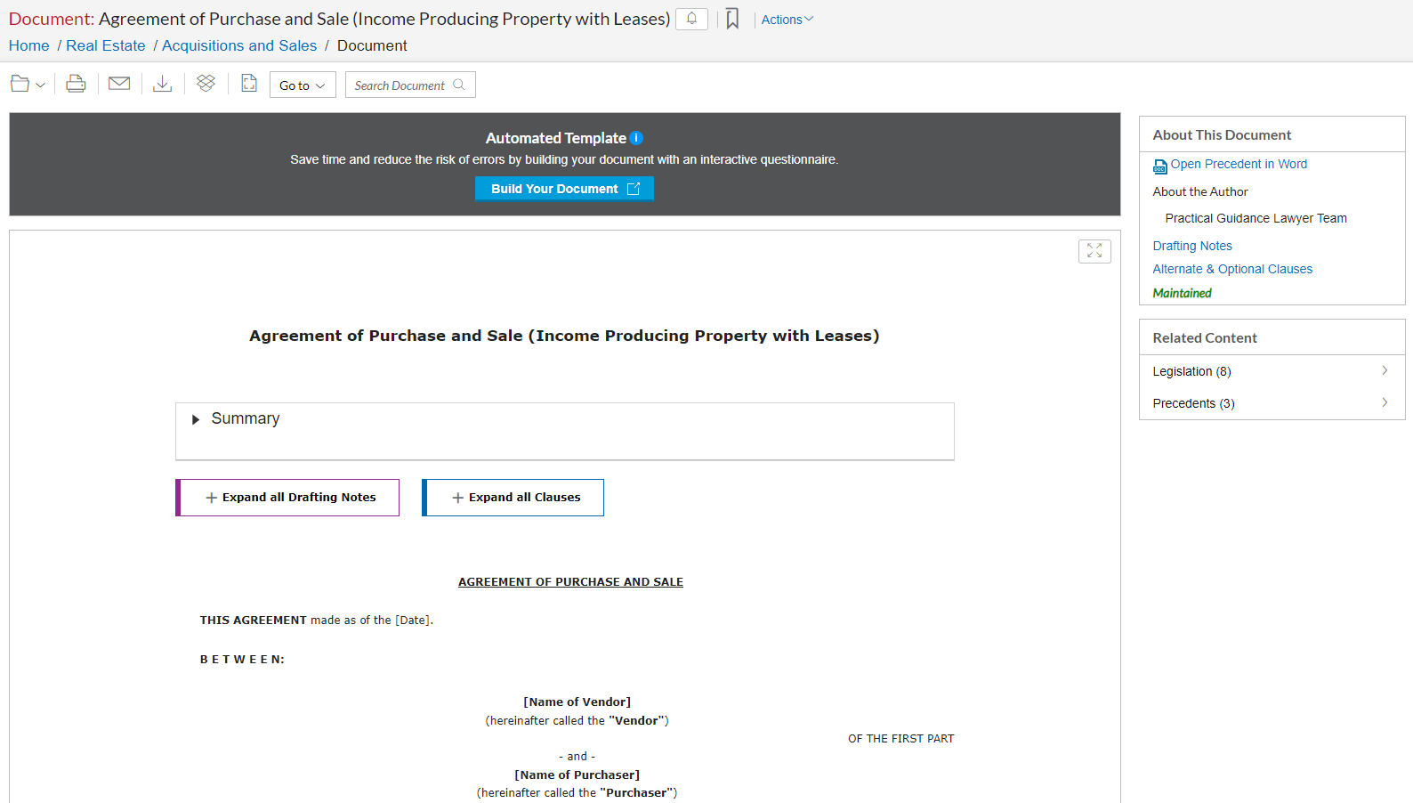
FINDING A PRECEDENT

Slide 45

FINDING A PRECEDENT

Slide 46

FINDING A PRECEDENT

Slide 47
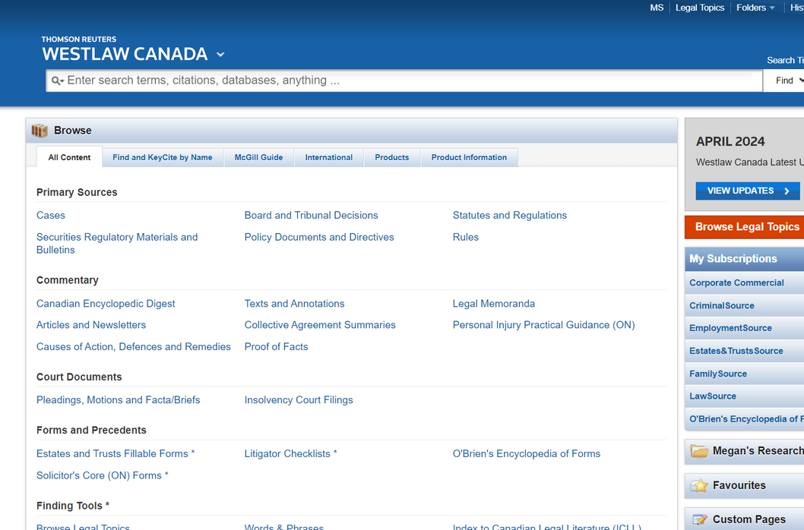
WESTLAW CANADA
3 Source Products:
CriminalSource
Estates&TrustsSource
FamilySource
All include:
Case law
Legislation
Secondary sources

Slide 48
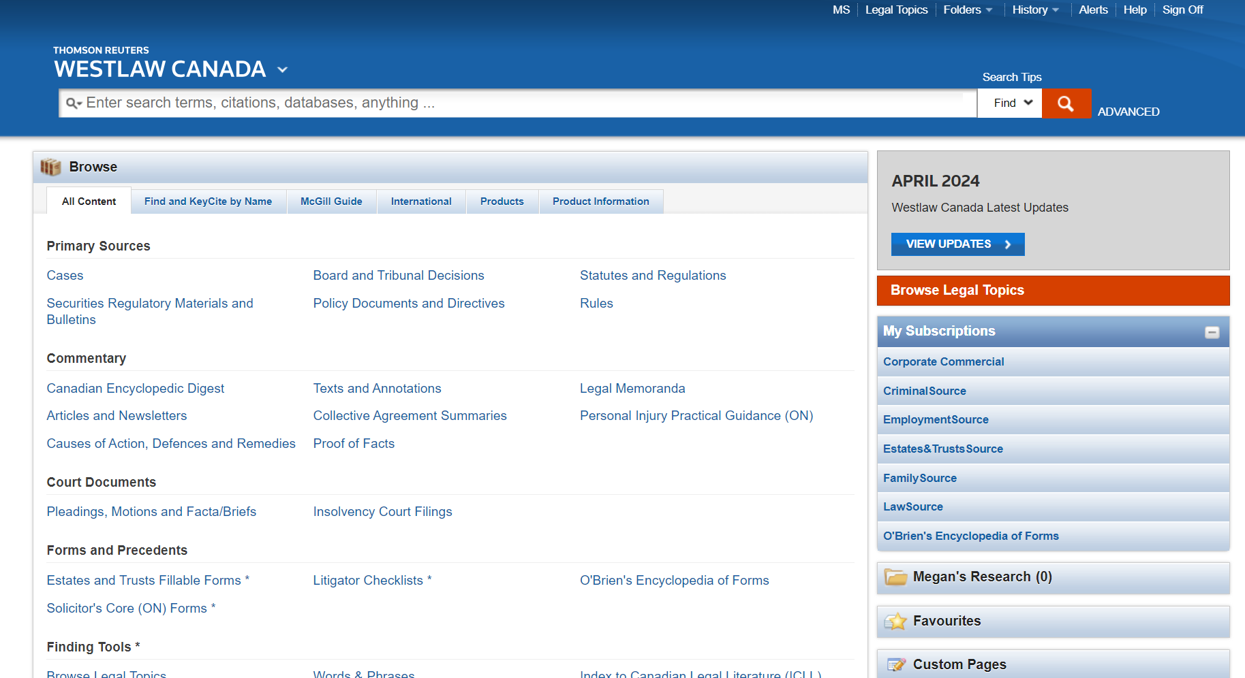
WESTLAW CANADA

Slide 49
WESTLAW CANADA

Slide 50
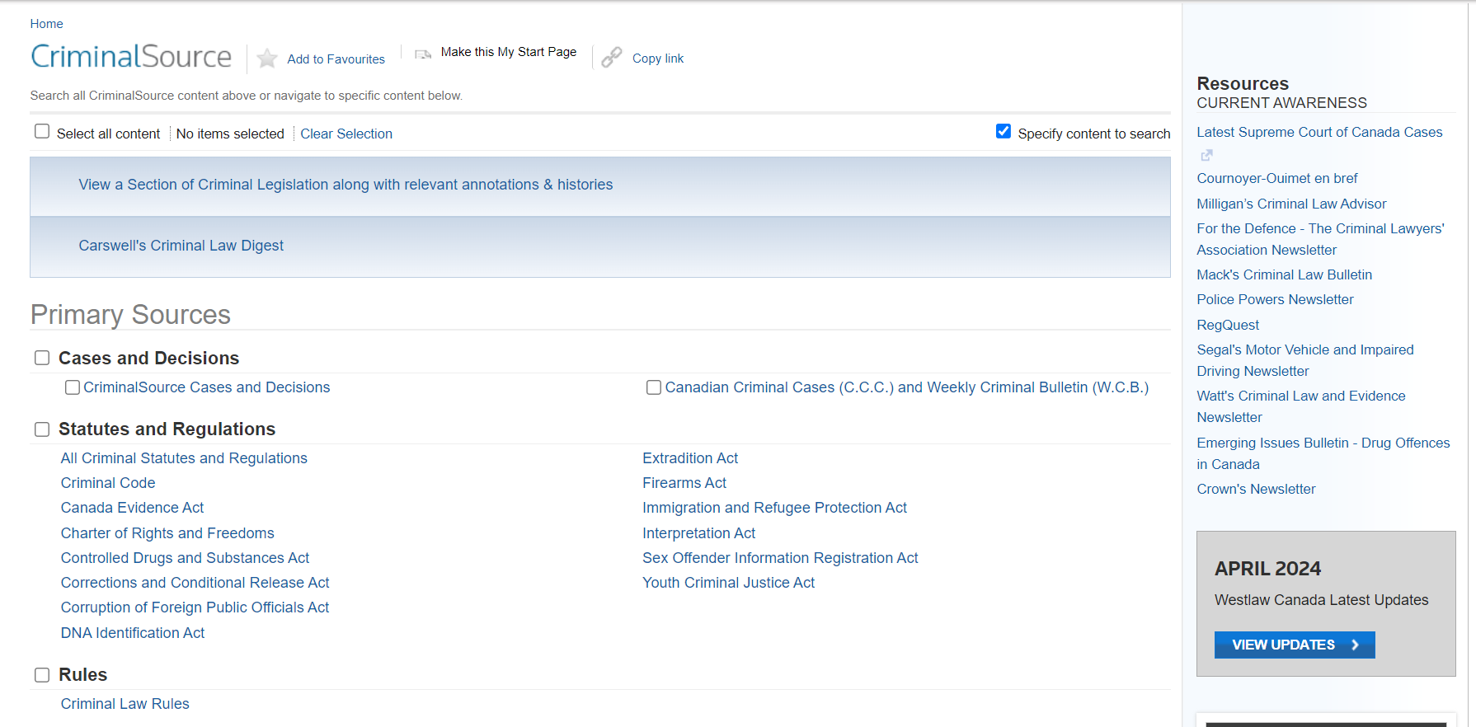
CRIMINALSOURCE

Slide 51
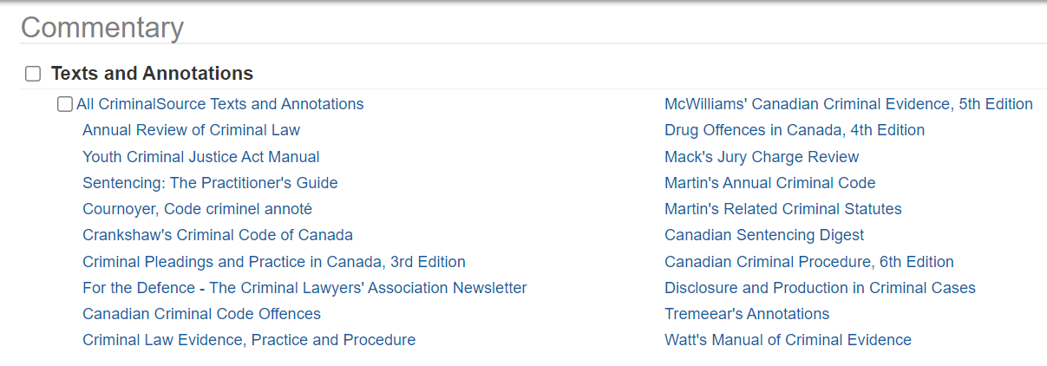
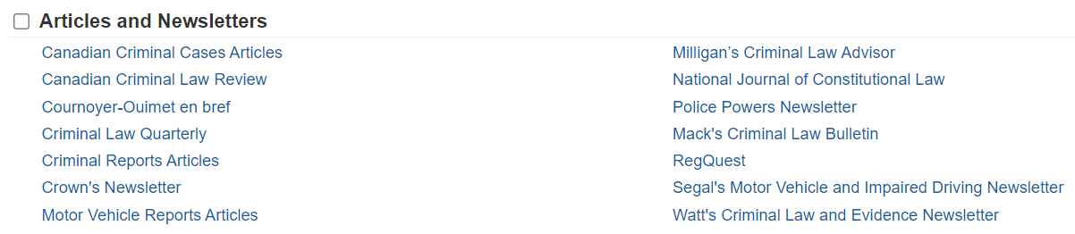
CRIMINALSOURCE

Slide 52

CRIMINALSOURCE

Slide 53
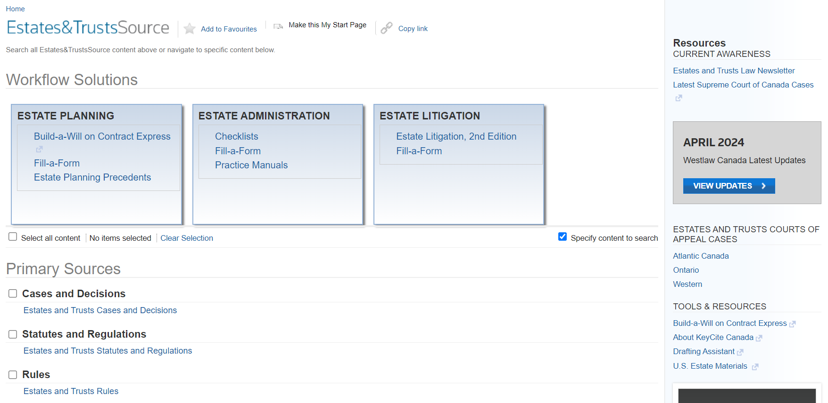
ESTATES&TRUSTSSOURCE

Slide 54
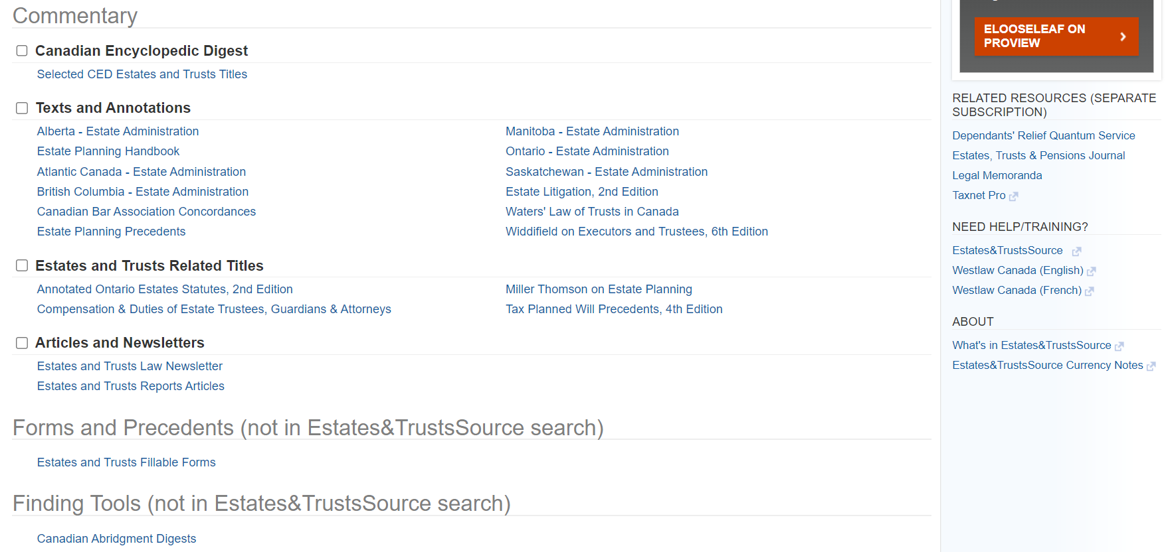
ESTATES&TRUSTSSOURCE

Slide 55

ESTATES&TRUSTSSOURCE

Slide 56
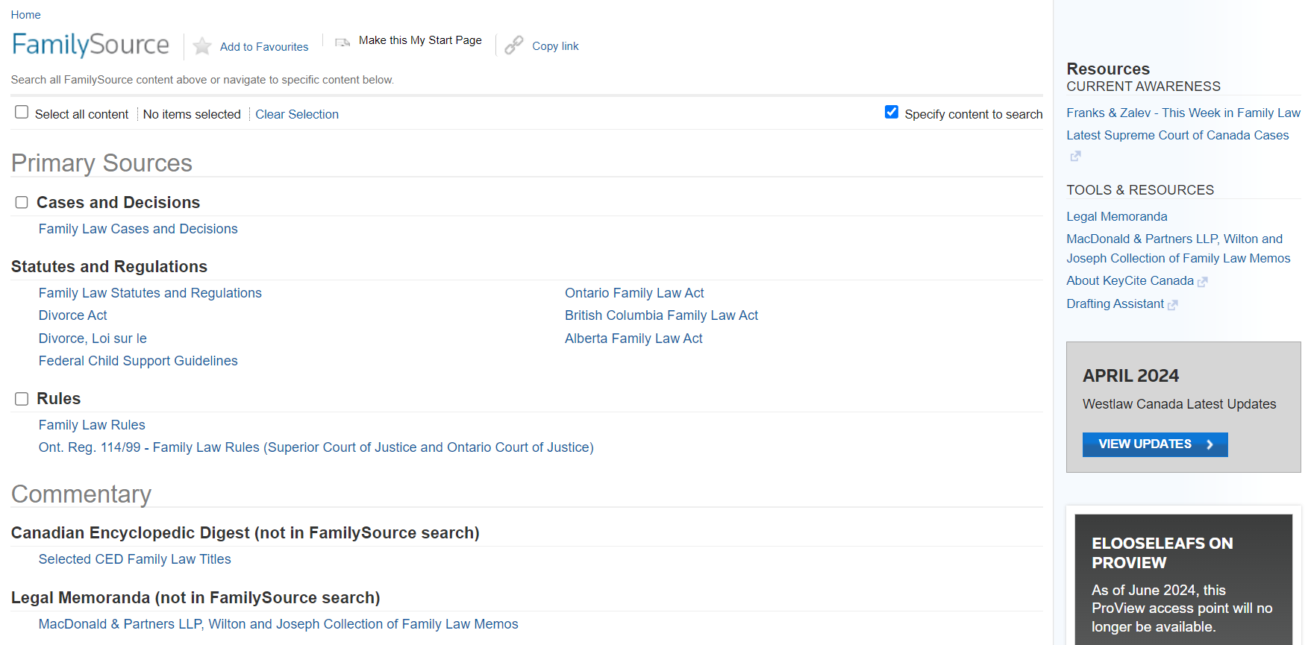
FAMILYSOURCE

Slide 57
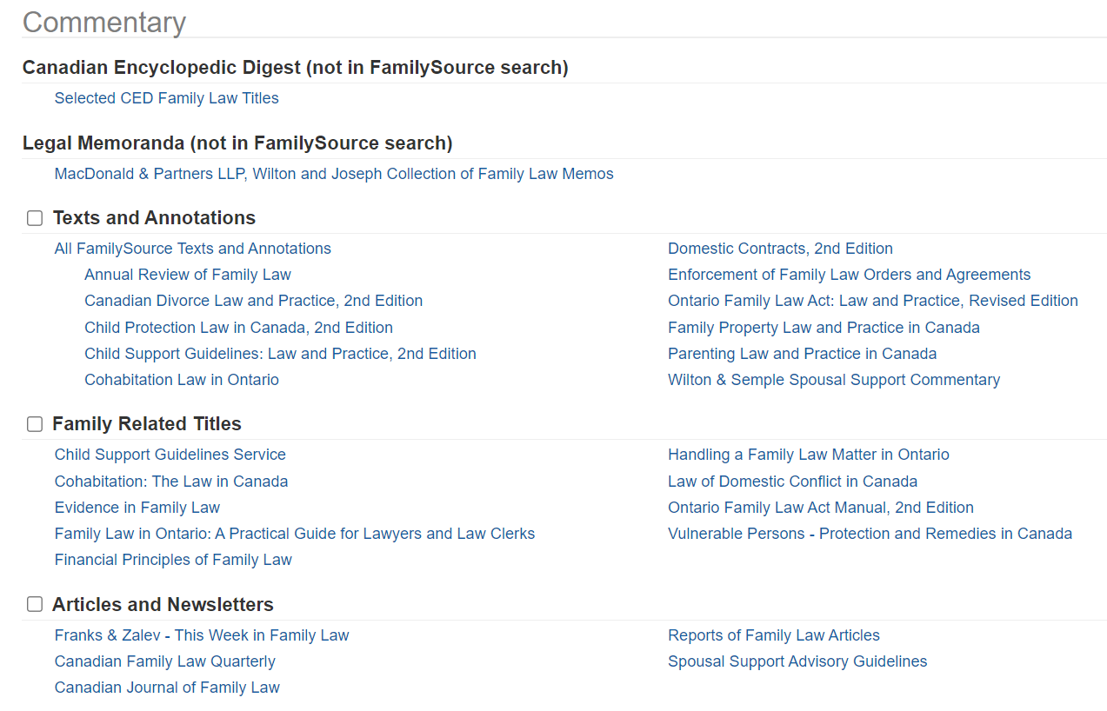
FAMILYSOURCE

Slide 58
FAMILYSOURCE

Slide 59
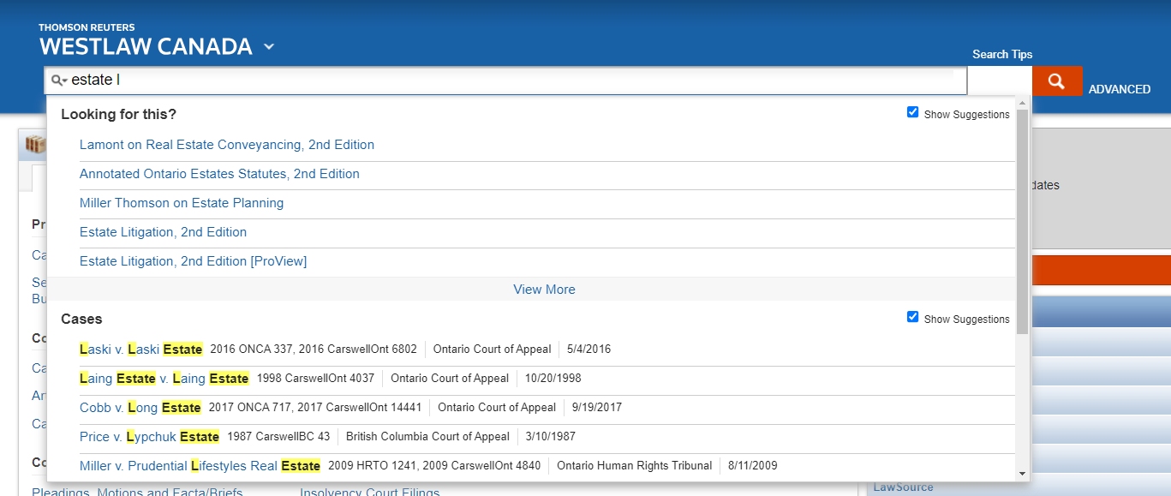
FINDING A RESOURCE- OPTION 1

Slide 60
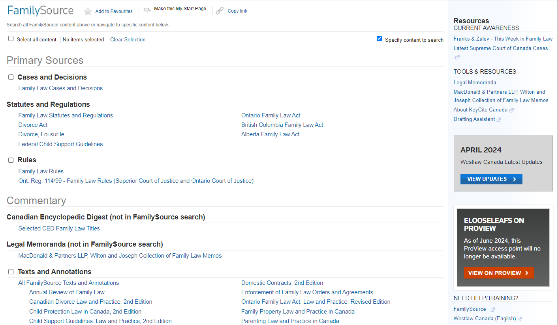
FINDING A RESOURCE- OPTION 2

Slide 61
FINDING A RESOURCE- OPTION 3

Slide 62

FINDING A RESOURCE- OPTION 3

Slide 63
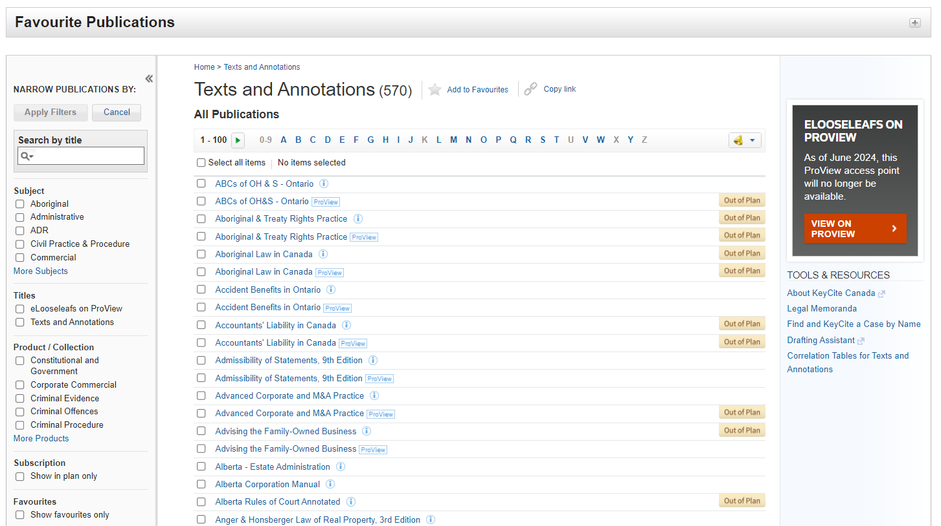
FINDING A RESOURCE- OPTION 3

Slide 64

FINDING A RESOURCE- OPTION 3

Slide 65
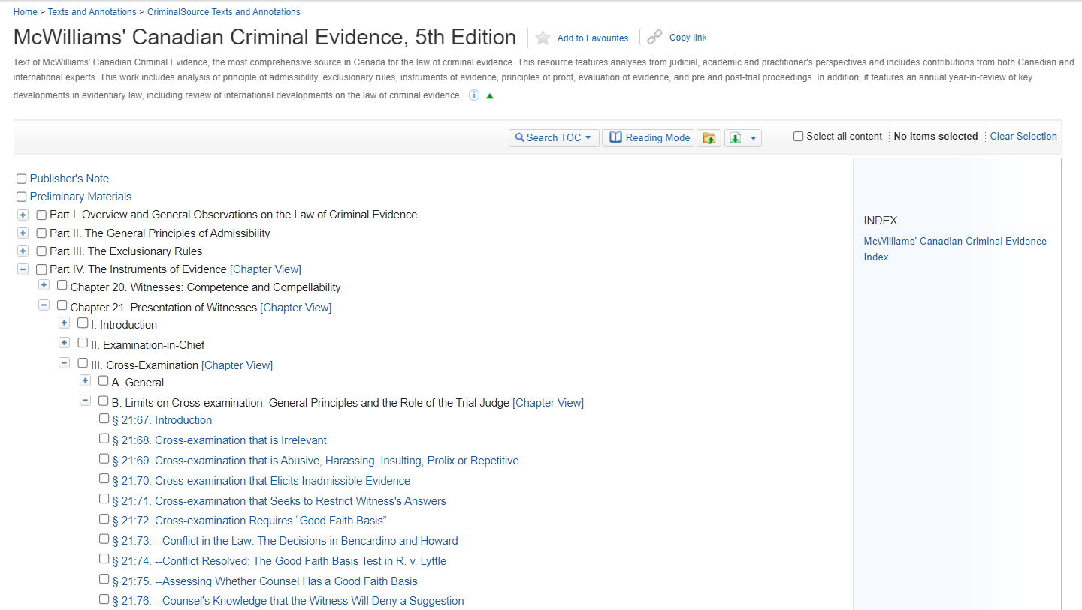

Slide 66


Slide 69
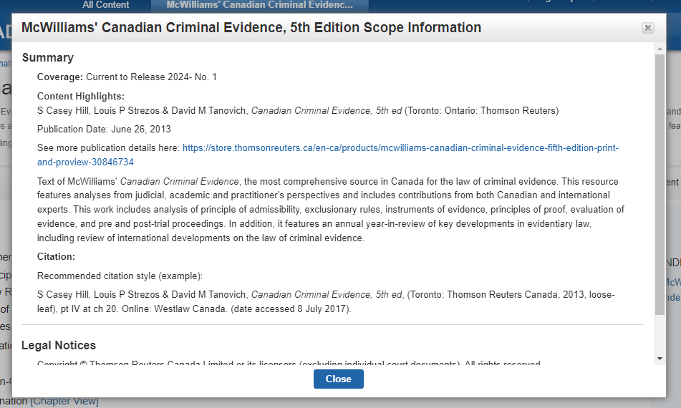

Slide 70


Slide 71
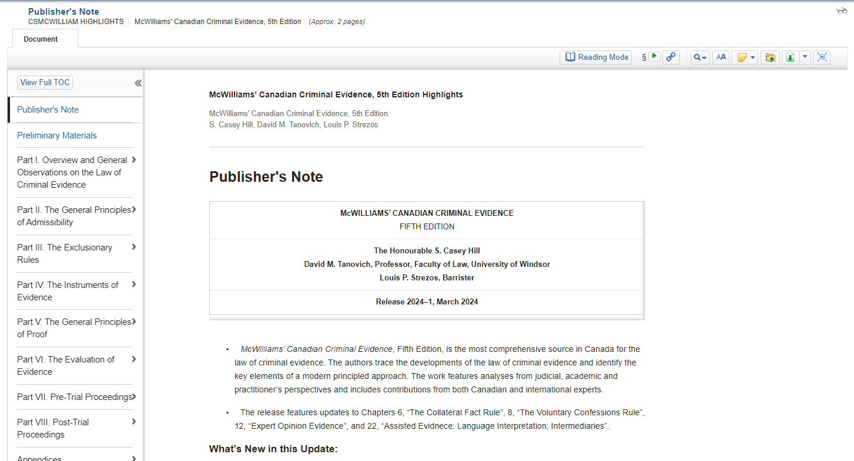

Slide 72
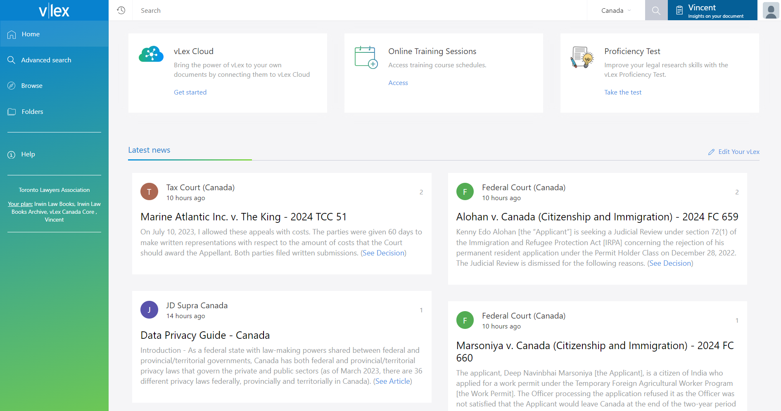
VLEX CANADA
Case Law
Legislation
Textbooks & Journals
Law Blogs & News
Vincent AI
* Includes Irwin Law e-Library!

Slide 73
VLEX CANADA

Slide 74
VLEX CANADA

Slide 75
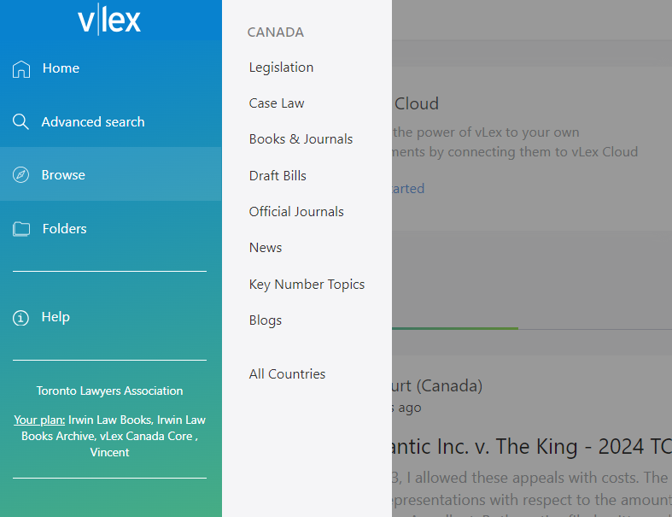

Slide 77
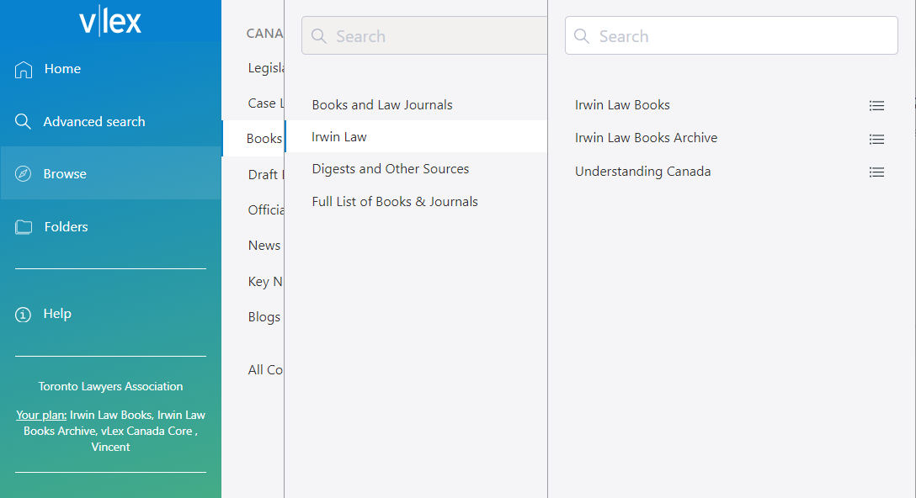

Slide 78
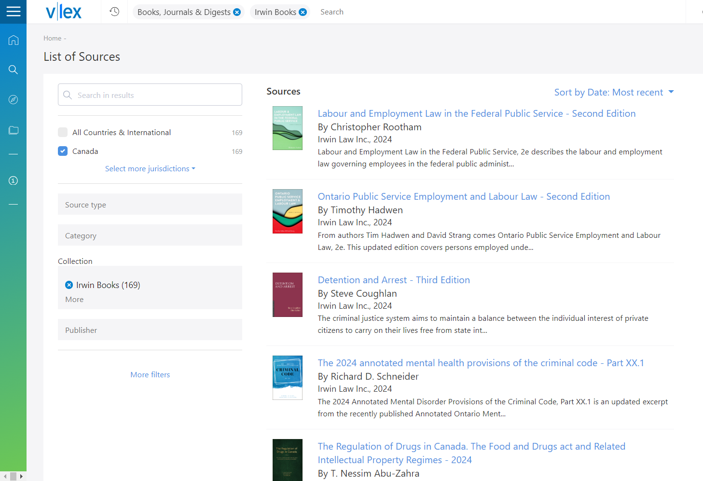

Slide 79
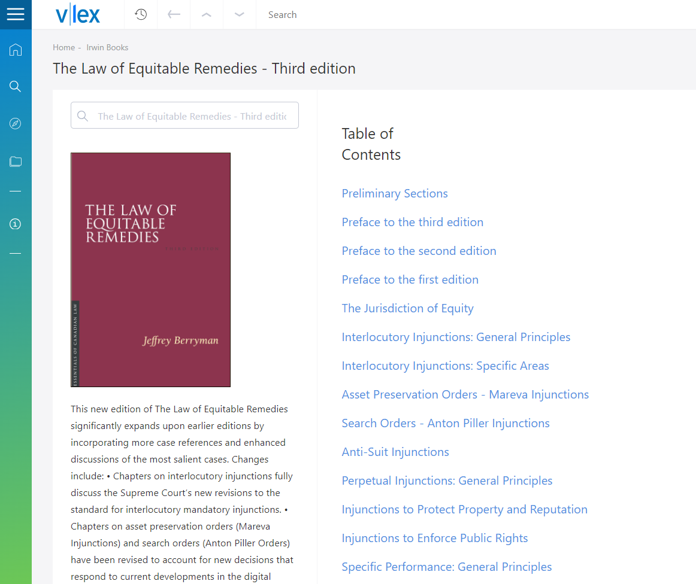

Slide 80
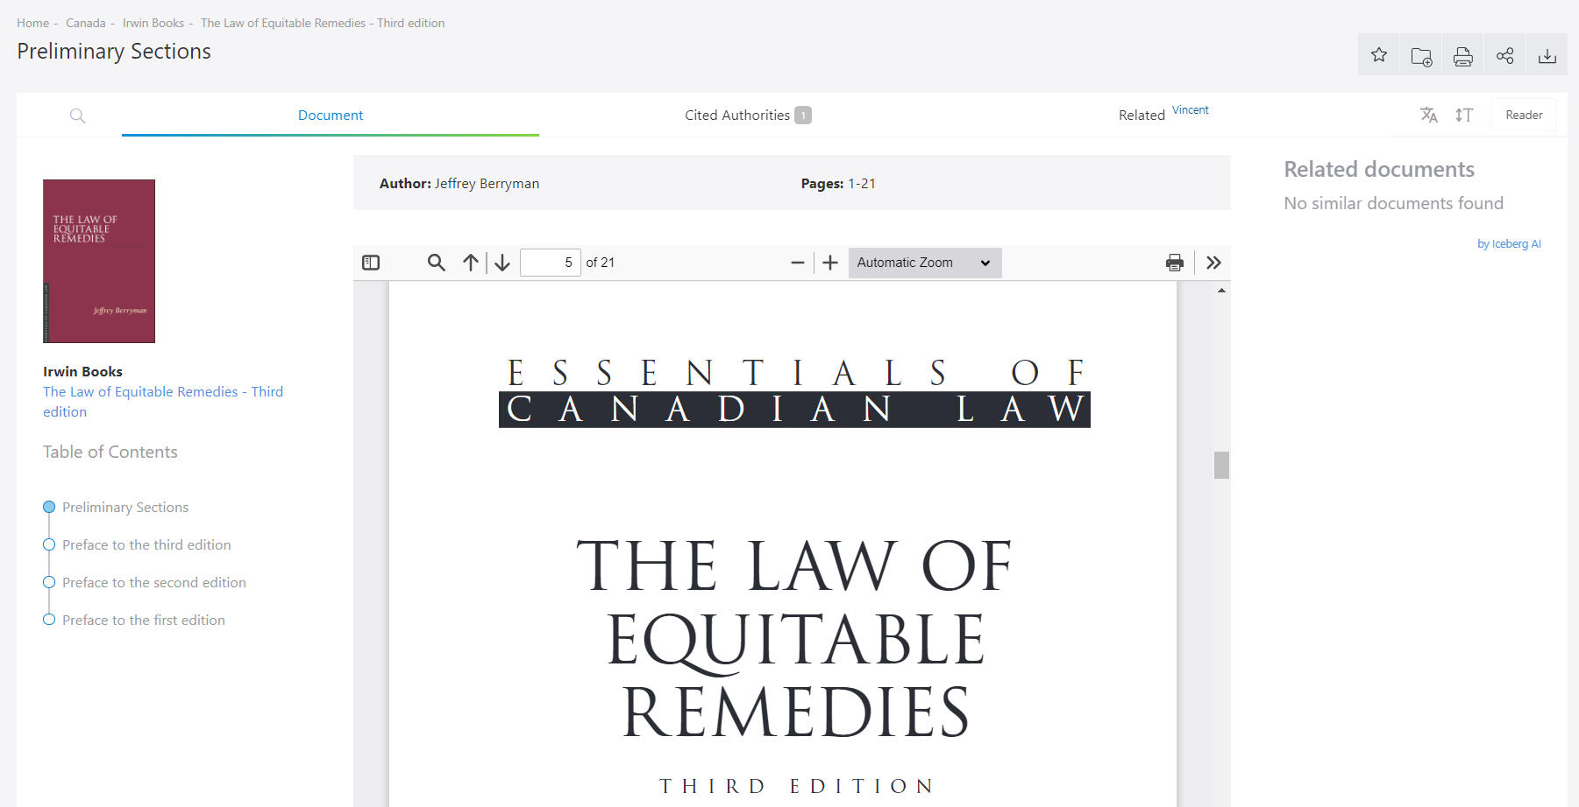

Slide 82
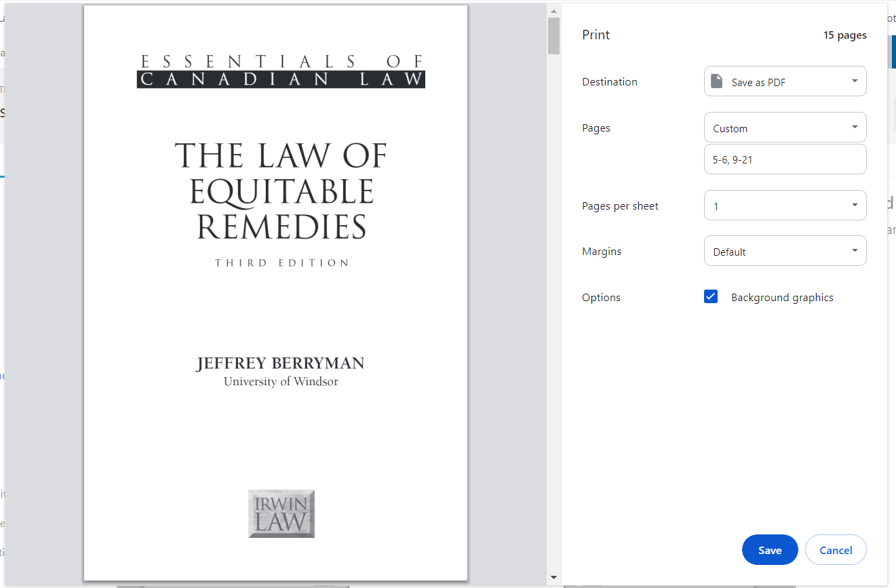

Slide 84
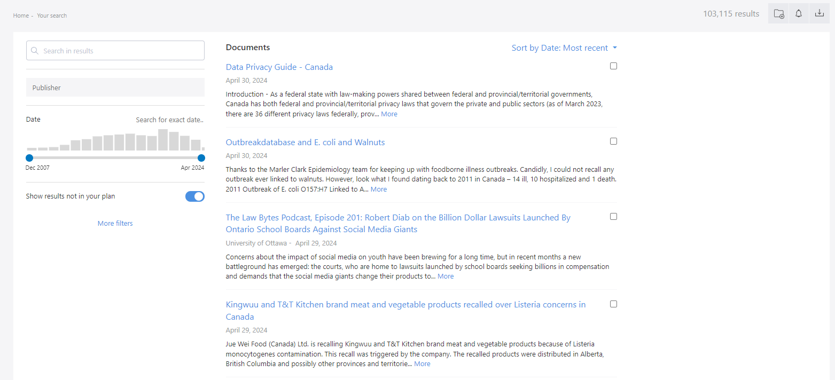

Slide 86
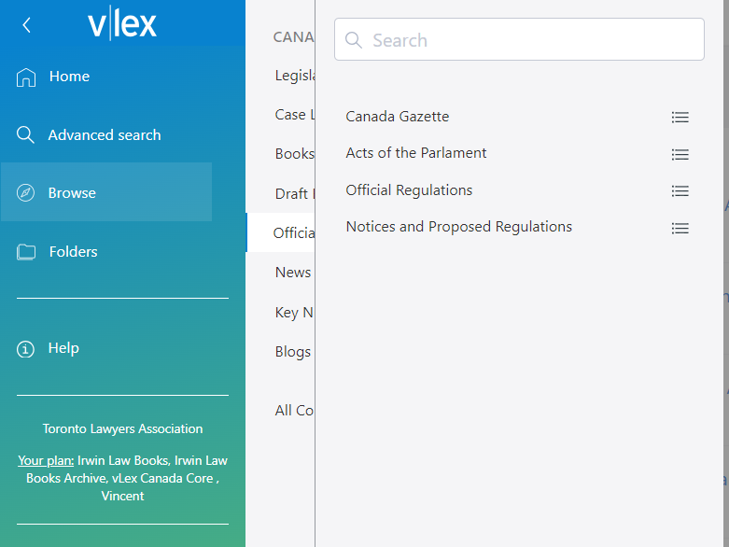

Slide 87
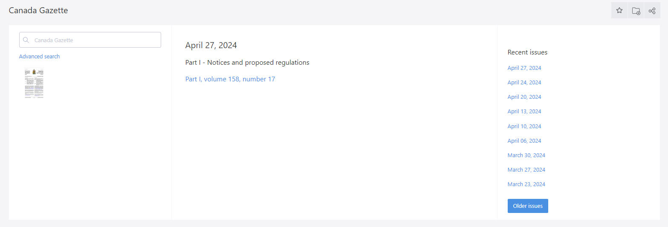

Slide 88

In Practice

Slide 89
QUESTION 1 - CORPORATE ROLLOVERS
I am looking for a precedent for a purchase agreement in a s. 85 corporate rollover from an operating company to a holding company.
I wonder if you have any source of recent Section 85(1) Rollover precedents/discussion?
I am looking for a precedent share exchange agreement under section 86 of the Income Tax Act. I have looked in O’briens but don’t see anything. Do you think you could take a look to see whether you can find something like this?

Slide 90
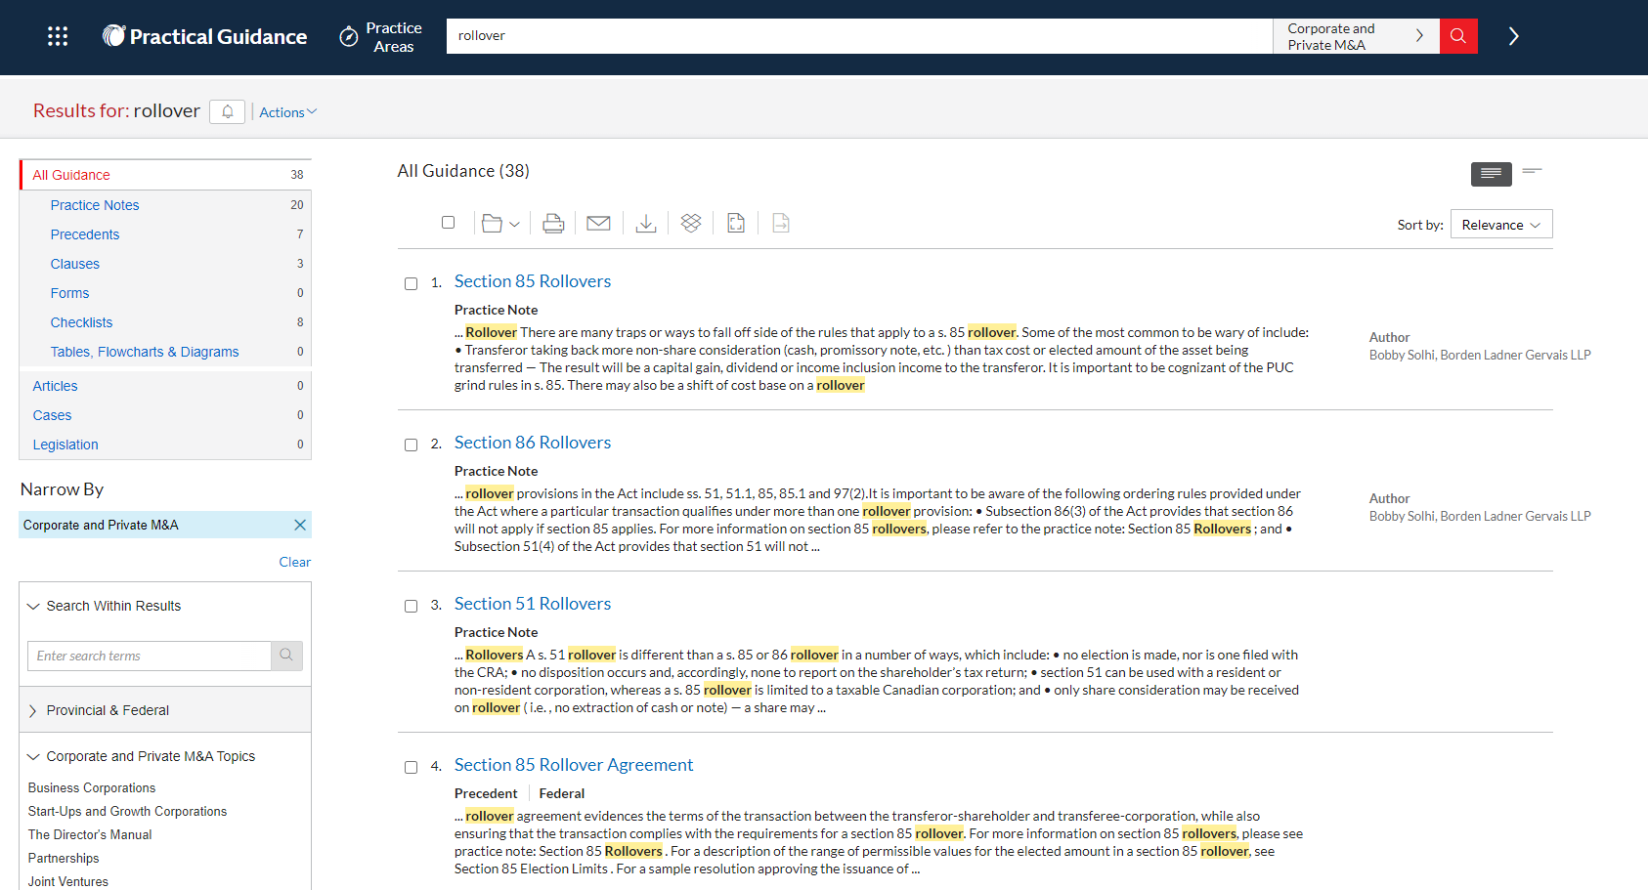

Slide 91


Slide 92


Slide 93


Slide 94
QUESTION 2 - GRANDPARENT ACCESS
Can you provide me with some case law on grandparents having contact time (access). I am looking for cases that support the parent being the one to determine the best interests of the child over the grandparent.
We want to demonstrate via previous decisions that the courts have ruled the parent has the ability to determine a contact schedule over the grandparent. (Chapman v. Chapman is a good example).

Slide 95
KEYWORDS & LEGAL TOPICS:
Contact / Access
Grandparent / Non-Parent
Best Interests of the Child
Determine / Discretion / Decide / Right

Slide 96


Slide 97


Slide 98


Slide 99


Slide 100
WHAT WE SENT:
§ 1:33. Access by Non-Parents in Annual Review of Family Law 2023 (WL)
Excerpts on best interests & contact orders from Parenting Law and Practice in Canada (WL)
Excerpts on third party access from Handling a Family Law Matter in Ontario (ProView)
Annotations under s.24 of the CLRA in Ontario Family Law Practice, 2024 Ed. (QL)
Note up of Chapman v. Chapman (WL)
Case law search results (WL & QL)

Slide 101
QUESTION 3 - PARTIAL SUMMARY JUDGMENTS
Can you please send me a secondary source or two that discuss the problems/courts dislike of partial summary judgements (ie where, for example, a plaintiff seeks sjm but the defendant/plaintiff by counter claim does not seek to have their matter heard by sjm)?

Slide 102


Slide 103


Slide 104


Slide 105

Tips & Tricks

Slide 106

STAY CURRENT
Know what is available and check regularly for any updates or changes
InfoLocate isn’t always the most current information - sometimes a subscription’s coverage will change without warning

Slide 107

CREATE & USE A CHEAT SHEET
Keep a list of what is available & where
Use a checklist or log when conducting research
Remember what you have checked
Remember what search strings you have tried
Check everywhere!

Slide 108



Slide 109

USE INFOLOCATE
Check a title’s location & availability
Is it on Quicklaw? ProView? Westlaw? vLex?
Is it available for Interlibrary Loan? At which library?
Currency notes - who has a current edition?

Slide 110

USE YOUR PHYSICAL STACKS
Add a marker to your stacks to indicate books available online
A spine label on books you have in print
A book dummy for titles that are only available online

Slide 111



Slide 112

REMEMBER THE LIMITATIONS
Differences between print and online
No title page (WL/QL)
No Index (QL)
No page numbers (WL/QL)
Hard to download Table of Contents (QL)
Differences in layout and search functionality

Slide 113

STUCK?
“Help us help you!”
Ask follow up questions
Send a Table of Contents or the Index

Slide 114
Thank you!

