Slide 1



A George & Betty Presentation
Look what’s growing

Slide 2

New Participants
From the original 5, we have grown to 11 regular participants and have 2 other libraries who have joined on an ad hoc basis

Slide 3
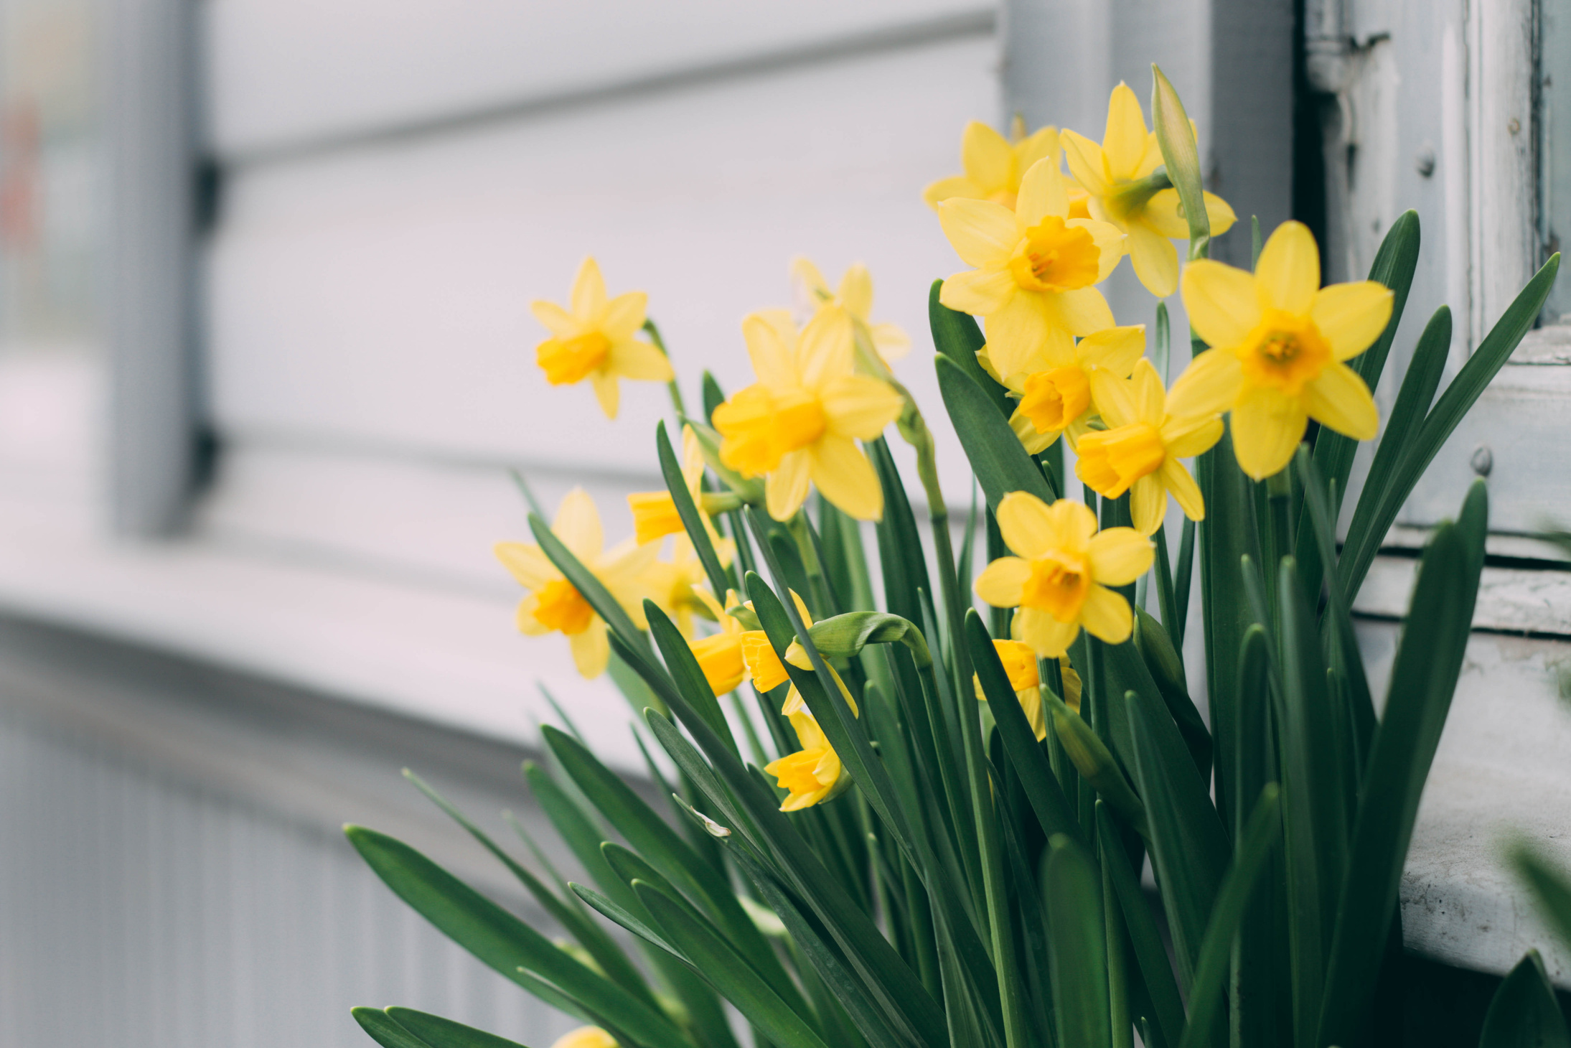
Feedback
“It has been incredibly helpful! I really appreciate being a part of the collaborate CPD group. My members appreciate it too!”

Slide 4

Value to Members
In 2023, York saved their members $37,754 in reduced rates for CPD
In 2024, we saved our members $15,818. Other libraries report significant savings as well

Slide 5

“A great way to demonstrate value to your employer”
This is an additional library service, not association work- Additional Library Services and Responsibilities, para. 14-17

Slide 6
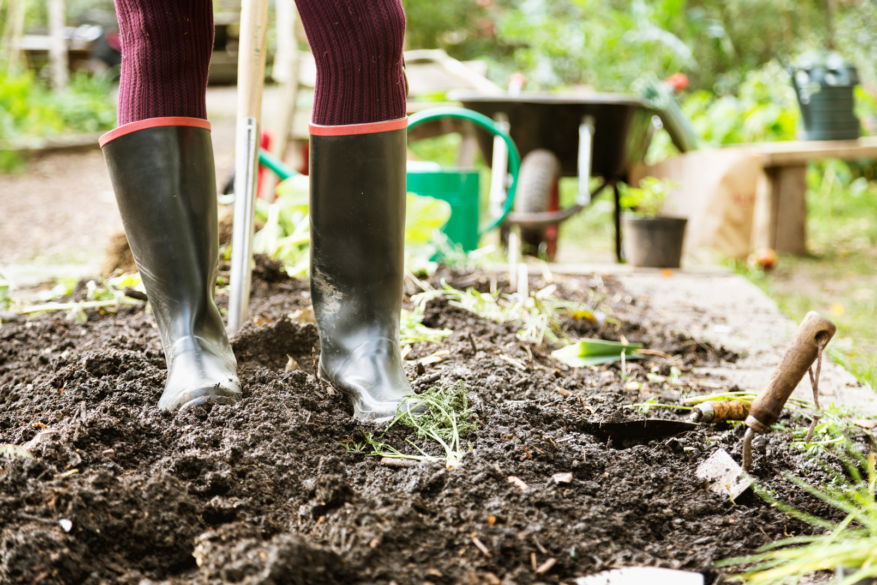
Next Steps
Grouping libraries to ease registration #s
Offer direct registration & payment options
Adjustments & policies
Grow, Grow, Grow

