Slide 1
LiRN Payroll FAQs
Presented by:
Stephanie Vass, Manager, Welch LLP
January 23, 2024

Slide 2
Agenda
Payroll Source Deductions
  Net Taxable Income and Income tax
  Canada Pension Plan Contributions
  Employment Insurance Premiums
  Payroll Deductions Online Calculator
Vacation Time and Vacation Pay
Other Earnings Types
T4 Slips & T4 Summary
  Filing deadline
  Completion
Payroll Resources

Slide 3
Payroll Source Deductions:
Federal and Provincial Income Tax
Tax is calculated on Net Taxable Income
Net Taxable Income equals income and benefits subject to tax, less permitted deductions and exemption amounts

Slide 4
Payroll Source Deductions:
Federal and Provincial Income Tax
Taxable Income Includes:
Taxable Income is Reduced by:
Salary / wages
Bonuses
Vacation Pay
Value of taxable benefits and allowances
Other income sources as applicable
RRSP / Pension Plan Contributions
Union Dues
Other deductions authorized by CRA
Federal and Provincial exemption amounts (annual TD1 and TD1ON forms)

Slide 5
Federal and Provincial Income Tax Calculation: Tax Table Method
Determine/confirm Net Taxable Income for the pay period
Confirm exemption amounts per TD1 and TD1ON for current year
Determine Claim Code based on TD1 and TD1ON exemption amounts
Refer to Federal/Ontario Tax Tables for current calendar year, based on applicable payroll type (frequency)

Slide 6
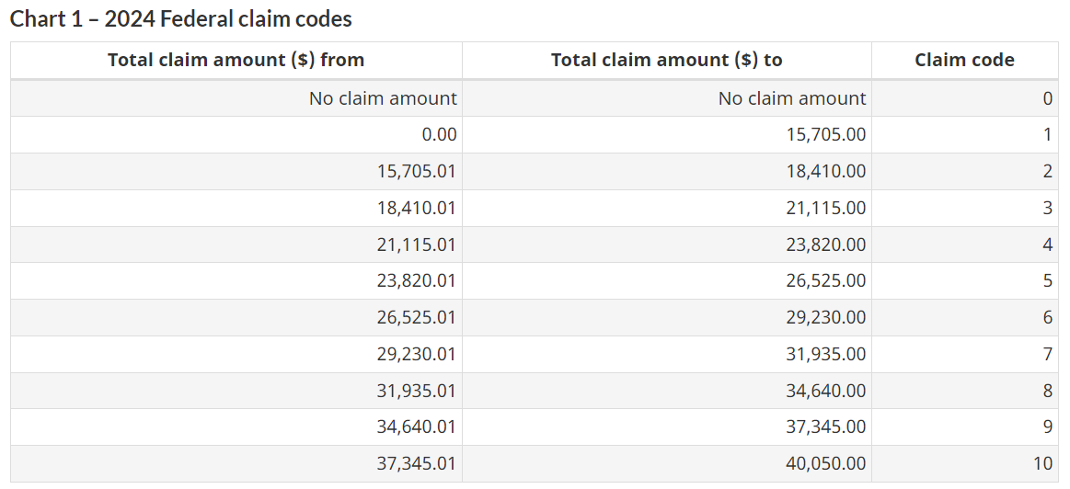
Federal and Provincial Income Tax Calculation: Tax Table Claim Codes
Claim Code 1 (15,705.00) = 2024 Basic Personal Exemption (default amount)

Slide 7
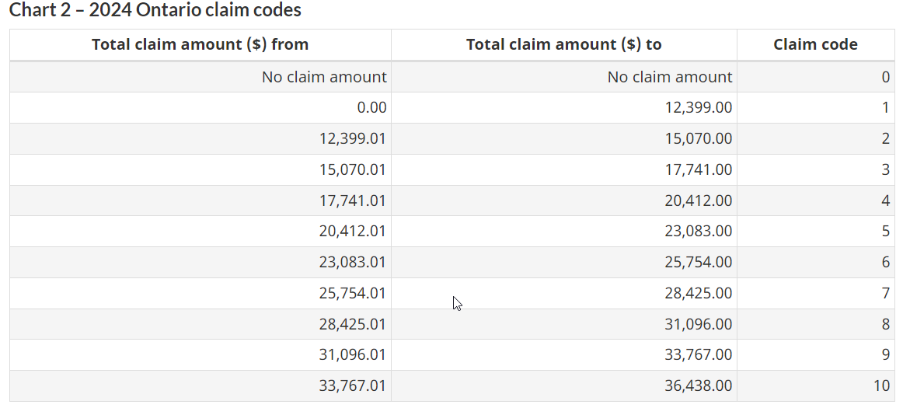
Federal and Provincial Income Tax Calculation: Tax Table Claim Codes
Claim Code 1 (12,399.00) = 2024 Basic Personal Exemption (default amount)

Slide 8
Federal and Provincial Income Tax Calculation: Tax Table Method Example 1
Payroll Frequency: Biweekly
Biweekly Salary Rate: $2,175.00
Taxable Benefits/Allowances: Nil
Permitted Deductions: Nil
Net Taxable Income: $2,175.00
TD1 2024: Basic Exemption only $15,705.00 (=Claim Code 1)
TD1ON 2024: Basic Exemption only $12,399.00 (=Claim Code 1)

Slide 9
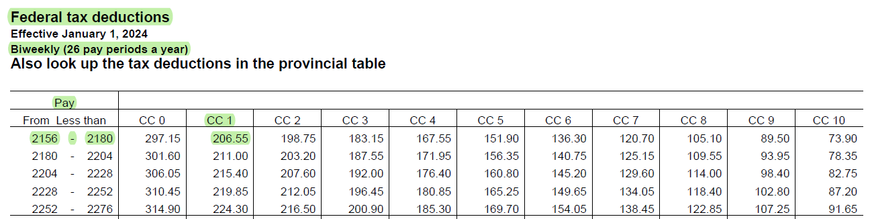
Federal and Provincial Income Tax Calculation: Tax Table Method Example 1
Federal Income Tax to be deducted = $206.55

Slide 10
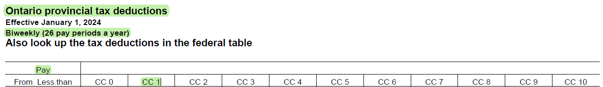
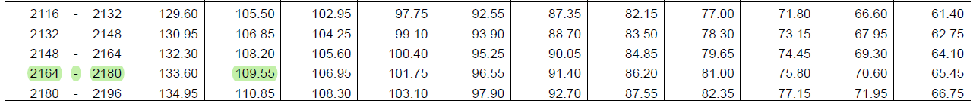
Federal and Provincial Income Tax Calculation: Tax Table Method Example 1
Provincial Income Tax to be deducted = $109.55
Total Income Tax Deduction:
Federal $206.55
Provincial $109.55
Total $316.10

Slide 11
Federal and Provincial Income Tax Calculation: Tax Table Method Example 2
Payroll Frequency: Monthly
Monthly Salary Rate: $5,000
Taxable Benefits/Allowances: Employer Paid Group Term Life Insurance Premium, $20.00 per month (including PST)
Permitted Deductions: RRSP Contribution, $100 per month
Net Taxable Income: $4,920 ($5,000 + $20.00 - $100.00)
TD1 2024: Basic + Full Amount for Spouse $31,410.00 (=Claim Code 7)
TD1ON 2024: Basic + Full Amount for Spouse $22,927 (=Claim Code 5)

Slide 12
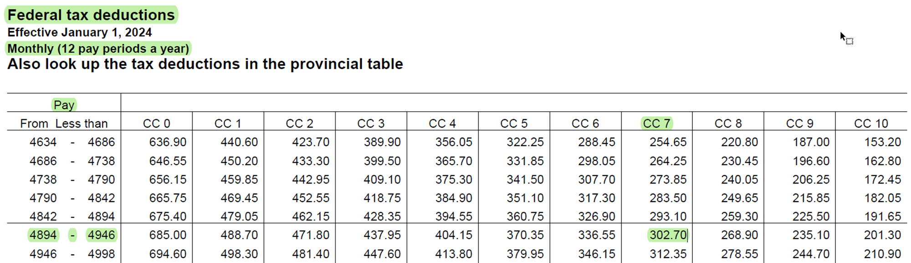
Federal and Provincial Income Tax Calculation: Tax Table Method Example 2
Federal Income Tax to be deducted = $302.70

Slide 13
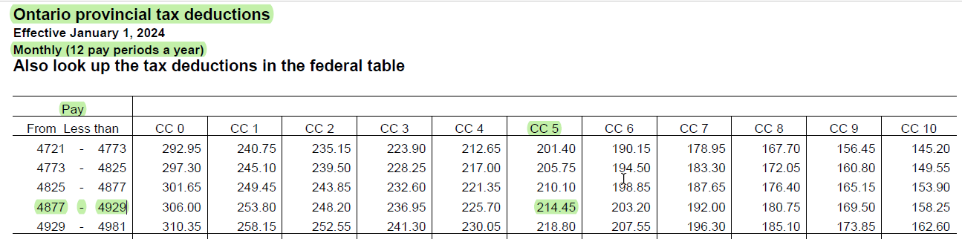
Federal and Provincial Income Tax Calculation: Tax Table Method Example 2
Provincial Income Tax to be deducted = $214.45
Total Income Tax Deduction:
Federal $302.70
Provincial $214.45
Total $517.15

Slide 14
Payroll Source Deductions:
Canada Pension Plan (CPP)
CPP is calculated on Pensionable Earnings, less Basic Exemption amount, subject to annual maximum values set by CRA each year
Common Pensionable Earnings:
  Salary / wages
  Bonuses and other earnings received from employer
  Value of taxable benefits and allowances
Some common amounts not subject to CPP (not Pensionable):
  Pension payments and retiring allowances
  Severance payments (not to be confused with termination pay/pay in lieu of notice)
  Payments made following death of an employee

Slide 15
Canada Pension Plan (CPP):
Contributors
Employees between ages 18 and 70 who receive pensionable wages and/or benefits
Exceptions and other considerations:
  Employees deemed disabled under CPP
  Employees who turn age of 18 during the year don’t start to contribute until 1st pay in the month that follows their 18th birthday
  Deductions stop with the first pay of the month that follows the employee’s 70th birthday
  Employees aged between 60 to 70 years of age who continue to work must continue to contribute to CPP, even if collecting CPP benefits
  Employees aged between 65 to 70 years of age can make an election to stop contributing to CPP, provided both of the following conditions are met:
    They are receiving CPP retirement benefits
    Employee completes form CPT30 (original to CRA; copy to employer). CPP deductions stop on the first pay of the month following date CPT30 form is supplied to employer

Slide 16
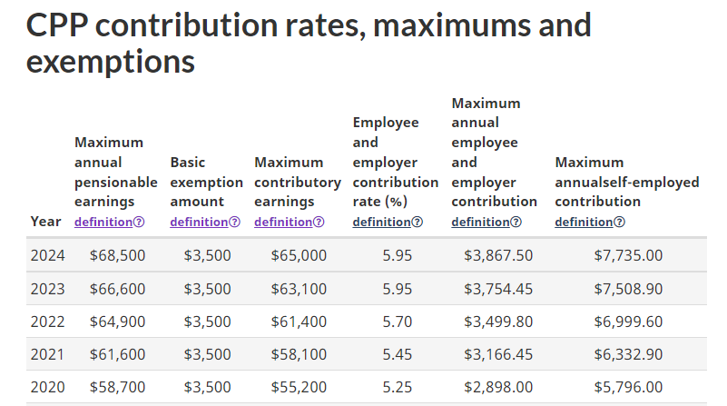
Canada Pension Plan (CPP):
Rates, Maximums and Exemptions

Slide 17
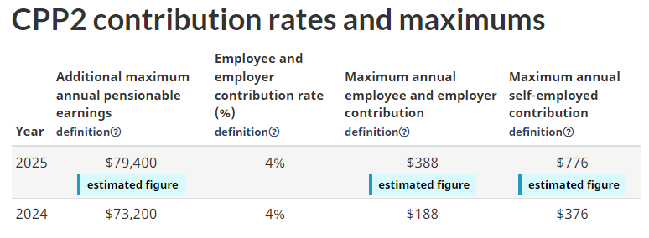
Canada Pension Plan (CPP):
New CPP2
Beginning January 1, 2024, you must deduct the new second additional CPP contribution (CPP2) on earnings, once the standard annual pensionable earnings ($68,500 for 2024) has been exceeded
Maximum additional pensionable earnings and contribution rates are in effect

Slide 18
Canada Pension Plan (CPP):
Calculation Example 1
Payroll Frequency: Biweekly
Pensionable Biweekly Salary Rate: $2,175.00
Pensionable Taxable Benefits/Allowances: Nil
Total Pensionable Earnings: $2,175.00
2024 Basic Exemption Amount: $3,500.00 ($134.61 biweekly)
2024 CPP Employee/Employer Contribution Rate: 5.95%

Slide 19
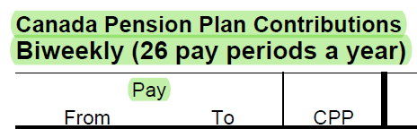
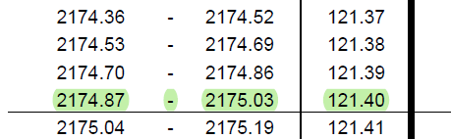
Canada Pension Plan (CPP):
Calculation Example 1
Manual Calculation Example
CPP Table Example
Pensionable Earnings: $2,175.00
Less Biweekly Exemption: $134.61
Total Contributory Earnings: $2,040.39
CPP Rate: 5.95%
CPP Contribution – Employee: $121.40
CPP Contribution – Employer: $121.40
Total CPP Remittance Amount: $242.80

Slide 20
Canada Pension Plan (CPP):
Calculation Example 2
Payroll Frequency: Monthly
Pensionable Monthly Salary Rate: $5,000
Pensionable Taxable Benefits/Allowances: Employer paid Group Term Life Insurance Premium $20.00
Total Pensionable Earnings: $5,020.00
2024 Basic Exemption Amount: $3,500.00 ($291.66 monthly)
2024 CPP Employee/Employer Contribution Rate: 5.95%

Slide 21
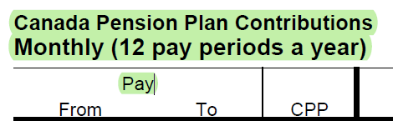
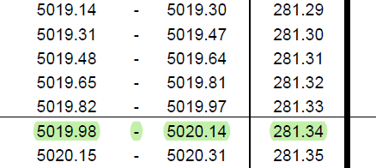
Canada Pension Plan (CPP):
Calculation Example 2
Manual Calculation Example
CPP Table Example
Pensionable Earnings: $5,020.00
Less Monthly Exemption: $291.66
Total Contributory Earnings: $4,728.34
CPP Rate: 5.95%
CPP Contribution – Employee: $281.34
CPP Contribution – Employer: $281.34
Total CPP Remittance Amount: $562.68

Slide 22
Payroll Source Deductions:
Employment Insurance (EI)
EI is calculated on Insurable Earnings, subject to annual maximum values set by CRA each year; no exemption applied
The general principle underlying the Employment Insurance (EI) system is that each hour worked, for which remuneration is received, is insurable.
Most forms of compensation provided to employees are insurable and are tied to hours worked
The following forms of compensation are insurable, even though no hours worked are recorded:
    Bonuses
    Vacation pay without leave taken (e.g. 4% vacation pay is calculated on regular earnings and paid with each payroll)
    Cash taxable benefits/allowances
    Pay in lieu of notice (termination pay)
    Retroactive pay

Slide 23
Payroll Source Deductions:
Employment Insurance (EI)
Some common amounts not subject to EI (not Insurable):
    Severance pay and retirement allowances
    Non-cash benefits (e.g. employer paid group term life insurance premiums)
    Payment in kind
    Supplements for maternity/parental leave benefits
    Directors’ fees
    Employment earnings for persons who control more than 40% of corporate shares

Slide 24
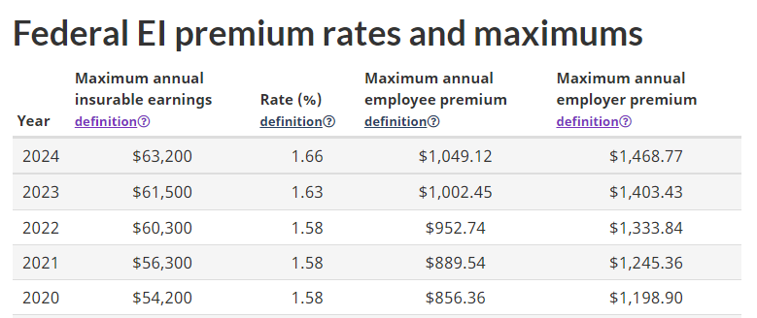
Payroll Source Deductions:
Employment Insurance (EI)

Slide 25
Employment Insurance (EI): Calculation Example 1
Insurable Biweekly Salary Rate: $2,175.00
Insurable Taxable Benefits/Allowances: Nil
Total Insurable Earnings: $2,175.00
2024 EI Employee Contribution Rate: 1.66%
2024 EI Employer Contribution Rate: 1.4 times the Employee amount

Slide 26
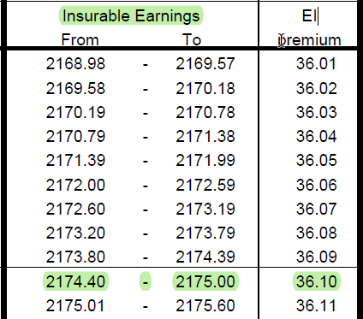
Employment Insurance (EI):
Calculation Example 1
Manual Calculation Example
EI Table Example
Insurable Earnings: $2,175.00
EI Employee Rate: 1.66%
EI Contribution – Employee: $36.10
EI Contribution – Employer: $50.54
Total EI Remittance Amount: $86.64

Slide 27
Employment Insurance (EI): Calculation Example 2
Insurable Monthly Salary Rate: $5,000.00
Insurable Taxable Benefits/Allowances: Nil; employer paid Group Life Insurance Premium is a non-cash benefit and therefore not insurable
Total Insurable Earnings: $5,000
2024 EI Employee Contribution Rate: 1.66%
2024 EI Employer Contribution Rate: 1.4 times the Employee amount

Slide 28
Employment Insurance (EI):
Calculation Example 2
Manual Calculation Example
EI Table Example
Insurable Earnings: $5,000.00
EI Employee Rate: 1.66%
EI Contribution – Employee: $83.00
EI Contribution – Employer: $116.20
Total EI Remittance Amount: $199.20
Employment Insurance tables end at 3,458.13
Use manual calculation or CRA’s Payroll Deductions Online Calculator
Stop deducting EI once total EI for the year reaches the maximum ($1,049.12 for 2024)

Slide 29
Payroll Deductions Online Calculator (PDOC)
Web-based calculator issued by CRA
Provides more accurate calculation results for income tax amounts vs. results from tax tables
User-friendly online form prompts entry of various details needed to help ensure correct calculation, including:
    Pay frequency and applicable year
    Various forms of pay, benefits and other deductions (e.g. RRSP contributions)
    YTD CPP pensionable earnings/deductions, and EI insurable earnings/deductions to help track and ensure deductions are discontinued once annual maximum is reached
Payroll Deductions Online Calculator - Demonstration

Slide 30
Vacation Time and Vacation Pay
In accordance with the Employment Standards Act (Ontario), all employees earn vacation time, based on the length of service with the employer, and completion of a 12-month vacation entitlement year (or prorated for stub year). Vacation pay is earned (accrued) as wages are also earned/paid, at a rate based on years of service with the employer.
Years of Service | Minimum Vacation Time | Minimum Vacation Pay
<5 years | 2 weeks | 4% of wages (other than vacation pay)
5 years or more | 3 weeks | 6% of wages (other than vacation pay)
Employers who choose to offer additional vacation time/pay through the employment agreement/contract, must adhere to the details of the agreement. Exceptions, such as loss of additional vacation time if untaken, can be implemented, but should be documented /communicated to the employee.
Depending on the employment type, vacation time and pay may be used/paid together or separately.

Slide 31
Vacation Time and Vacation Pay: Accruals
Vacation time and pay accrues during the vacation entitlement year. Accrued vacation pay is typically entered in the employer’s bookkeeping records/system as an expense and liability, with each pay period. As vacation pay is provided with other earnings, the liability is reduced.
Annual Vacation Time | Monthly Vacation Time Accrual | Daily Vacation Time Accrual | Accrual Rate
2 weeks (10 days) | 0.83 days per month | 0.04 | 4%
3 weeks (15 days) | 1.25 days per month | 0.06 | 6%
4 weeks (20 days) | 1.67 days per month | 0.08 | 8%
5 weeks (25 days) | 2.08 days per month | 0.10 | 10%
Daily Vacation Time and the Accrual Rate is based on number of annual vacation days, divided by 260 days in the year for which an employee is paid (52 weeks x 5 days per week).

Slide 32
Vacation Time: Deadline for Taking Vacation
Per the ESA, the deadline for taking earned [minimum] vacation time is 10 months following the vacation entitlement year (or after end of stub/partial period)
Employers have the right to schedule vacation as well as the obligation to ensure vacation time is scheduled before the end of the 10-month period

Slide 33
Other Earnings Types: Retroactive Pay
Scenario:
  Annual wage increase was not finalized or communicated until February 16, 2024.
  Effective date of wage increase was January 1, 2024
  Payroll is processed biweekly; 3 pay periods have already been processed
Calculate retroactive pay:
  Calculate gross pay at the new rate for the 3 processed pay periods
  Calculate total of gross pay actually paid to employee for the 3 processed pay periods
  Determine difference between values of calculation 1 and calculation 2 (this is the retro pay amount)
  Next payroll: apply new rate for the most recent pay period that ended; include additional lump-sum as retroactive pay

Slide 34
Retroactive Pay: Calculation Example
Year | Annual Salary | Biweekly Rate
2023 | $56,550 | $2,175
2024 | $59,800 | $2,300
Pay Period | Wages Already Paid | Wages at New Rate | Difference (Short)
Jan 1-12 | $2,175 | $2,300 | $125
Jan 15-26 | $2,175 | $2,300 | $125
Jan 29-Feb 9 | $2,175 | $2,300 | $125
Total | $6,525 | $6,900 | $375
Next Pay Period: Feb 12, 2024
Wages Payable at New Rate: $2,300
Plus Retroactive Pay Payable: $375
Total Gross Wages Payable: $2,675

Slide 35
Other Earnings Types: Lump-Sum Payments
Lump-sum payments, such as bonuses, pay in lieu of notice (termination pay) and vacation paid with no time taken, do not represent regular pay period earnings
To accurately calculate taxes on these lump-sum payments, an adjustment calculation needs to be completed (the “bonus method”)
The adjustment calculation effectively treats the lump-sum payment as though it were spread over the year, in order to determine the correct tax liability
Scenario:
  Employee is paid regular wages (net taxable income) of $2,175.00 on a biweekly basis (26 pay periods/year)
  TD1 and TD1ON indicate basic exemptions have been elected (Claim Code 1 on Tax Tables)
  The employee is to receive a bonus of $2,500 on the next regular pay date

Slide 36
Lump-Sum Payments: Bonus Method Calculation Example
Divide the bonus being paid by the pay period type (frequency):
  $2,500 / 26 = $96.15 biweekly
Add converted bonus amount to regular net taxable income per pay period:
  $2,175 + $96.15 = $2,271.15
Look up Federal and Ontario tax amounts based on total from step 2 (using Tax Tables):
  Federal Tax: $224.30 Provincial Tax: $118.55
Look up Federal and Ontario tax amounts on the regular net taxable income per pay period:
  Federal Tax: $206.55 Provincial Tax: $109.55
Determine the difference between updated and original tax amounts:
  Federal Tax: $224.30 – $206.55 = $17.75 Provincial Tax: $118.55 - $109.50 = $9.00
Multiply the difference by the pay period type (frequency) to arrive at total Federal and Provincial tax on bonus payment:
  Federal Tax: $17.75 x 26 = $461.50 Provincial Tax: $9.00 x 26 = $234.00

Slide 37
Lump-Sum Payments: Bonus Method Calculation Example
7. Calculate Total Tax for Payroll with Bonus:
  Total Tax on Bonus: $461.50 + $234.00 = $695.50
  Total Tax on Regular Net Taxable Income: $206.55 + $109.55 = $316.10
  Total Income Tax Payable: $1,011.60
If taxes were to be calculated on the full $2,500 bonus without conversion to pay period type (frequency), the tax liability on the bonus would be short by $290.05:
Federal Tax: $268.80
Provincial Tax: $136.65
Total: $405.45

Slide 38
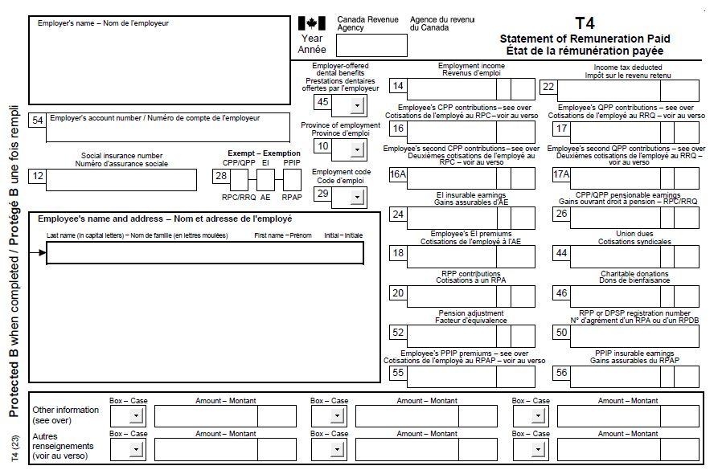
T4 Slips
Annual deadline for filing T4 slips is the last day of February, following the calendar year for which the T4 slip applies
2023 T4 slips are due February 29, 2024

Slide 39
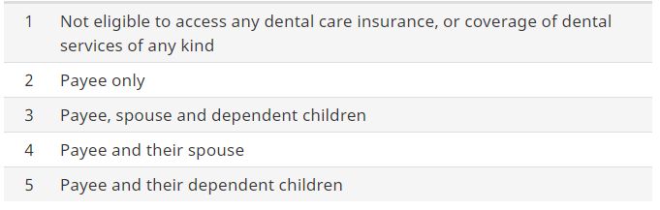
T4 Slips: Completion
NEW! Box 45: For calendar year 2023 and after, it is mandatory to indicate whether the employee or any of their family members were eligible, on December 31 of that year, to access any dental care insurance, or coverage of dental services of any kind, offered by the employer
One of 5 access codes must be inserted:

Slide 40
T4 Slips: Completion
Box 54: The employer’s payroll account number with CRA is made up of the employer’s 9-digit business number, plus 6-digit extension, typically RP0001, unless the employer has registered more then one payroll account with CRA
Do not enter the employer’s account number on employee’s copy of the T4.

Slide 41
T4 Slips: Completion
Box 14: Employment Income
Includes salary, wages and other remuneration including taxable benefits and allowances paid during the calendar year, plus,
Bonuses, retroactive payments
Vacation pay, wages in lieu of termination notice
Retiring allowances / severance pay
Box 22: Income Tax Deducted
Includes total of Federal and Provincial income tax amounts deducted for the year

Slide 42
T4 Slips: Completion
Box 16: Employee’s CPP Contributions
Total CPP contribution deductions from pay for the year
Should not have exceeded maximum for the calendar year ($3,754.45 for 2023)
Box 16A: Employee’s Second CPP Contributions
Total of second CPP contribution deductions from pay for the year
In effect January 1, 2024; reportable on 2024 T4 slips and later years
Maximum 2024 contribution of $188

Slide 43
T4 Slips: Completion
Box 26: CPP Pensionable Earnings
Total of all earnings during the year that were pensionable (subject to CPP)
May or may not equal total income shown in Box 14, depending on the following:
  Box 14 income exceed maximum pensionable earnings for the year ($66,600 for 2023)

Slide 44
T4 Slips: Completion
Box 18: Employee’s EI Premiums
Total EI contribution deductions from pay for the year
Should not have exceeded maximum for the calendar year ($1,002.45 for 2023)
Box 24: EI Insurable Earnings
Total of all earnings during the year that were insurable (subject to EI)
May or may not equal total income shown in Box 14, depending on the following:
  Box 14 income exceed maximum insurable earnings for the year ($61,500 for 2023)
  Box 14 income includes amounts that are taxable, but not insurable, such as employer paid group term life insurance premiums

Slide 45
T4 Slips: Completion
Other Information boxes are used for reportable amounts/codes that are not included in the main section of the T4
Code 40 is used to report taxable benefits and allowances total for the year, that are also included in Box 14
  Value of group term life insurance premiums paid by the employer for the year
  Cash and non-cash allowances/benefits for specified expenses
  Employer contribution to employee’s RRSP

Slide 46
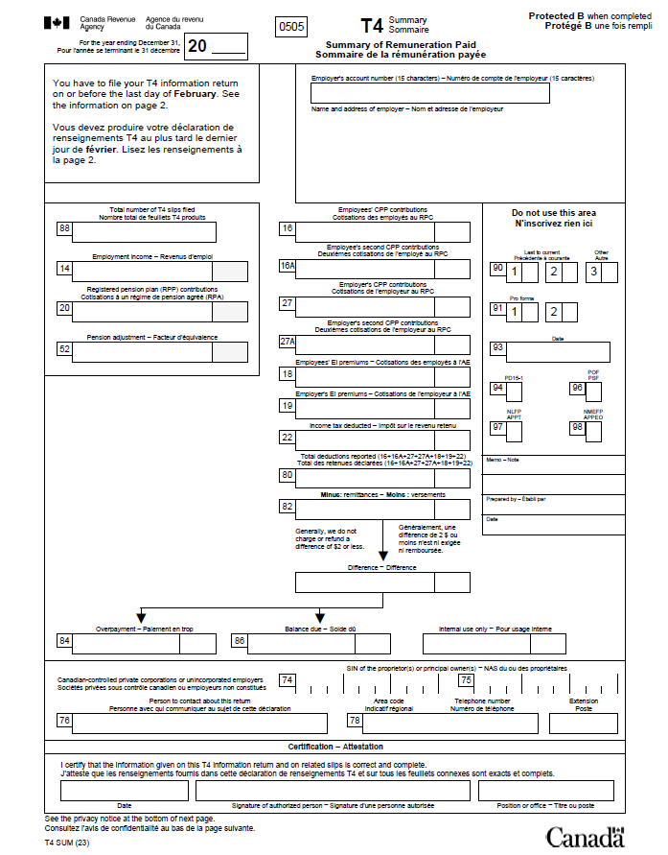
T4 Summary
In addition to filing T4s, the T4 Summary of Remuneration Paid also needs to be filed by the end of February each year
The T4 Summary represents the total of the information reported on all of the T4 slips that the employer prepares for each employee for the calendar year

Slide 47
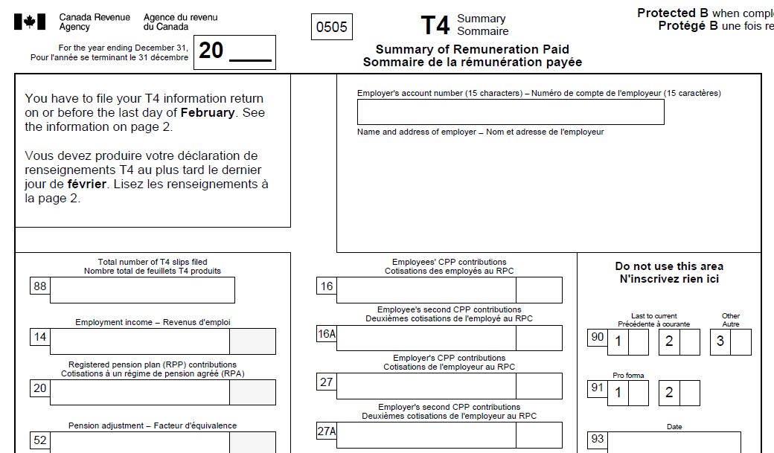
T4 Summary: Completion
Start by filling in the applicable calendar year and the employer’s 15-character payroll account number (9-digit CRA business number plus RP extension)
Box 88: Total number of T4 slips filed
Box 14: Employment Income (total of amounts in box 14 on all T4 slips)

Slide 48
T4 Summary: Completion
Box 16: Employees’ CPP Contributions (total of amounts in box 16 on all T4 slips)
Box 16A: Employees’ Second CPP Contributions (total of amounts in box 16A on all T4 slips; starting 2024)
Box 27: Employer’s CPP Contributions (should be same amount as Box 16)
Box 27A: Employer’s Second CPP Contributions (should be same amount as Box 16A; starting 2024)

Slide 49
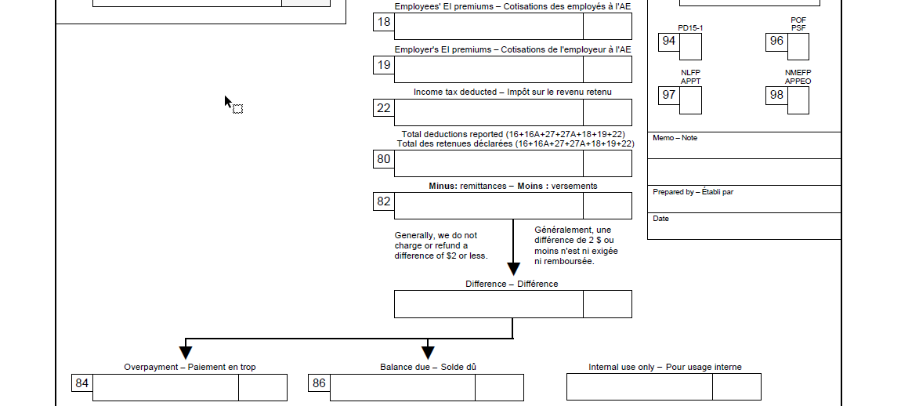
T4 Summary: Completion
Box 18: Employees’ EI Premiums (total of amounts in box 18 on all T4 slips)
Box 19: Employer’s EI Premiums (should equal 1.4 times the amount in box 18)
Box 22: Income Tax Deducted (total of amounts in box 22 on all T4 slips)
Box 80: Total Deductions Reported (sum of boxes 16 to 22)

Slide 50
T4 Summary: Completion
Box 82: Remittances (total amount of payroll deductions and contributions remitted to CRA for your payroll account during the year; available from most recent PD7A statement)
Difference: subtract value of Box 82 from total in Box 80
Box 84: Overpayment (fill in if difference is a negative number)
Box 86: Balance Due (fill in if difference is a positive number)
Generally, CRA does not charge balance owing or provide refunds on differences of $2 or less

Slide 51
Payroll Resources
CPP contribution rates, maximums and exemptions
EI premium rates and maximum
Employers' Guide Taxable Benefits and Allowances
Payroll Deductions Online Calculator
T4 slip – Information for employers
T4 Summary – Information for employers
Ontario Guide to Employment Standards Act

