Slide 1
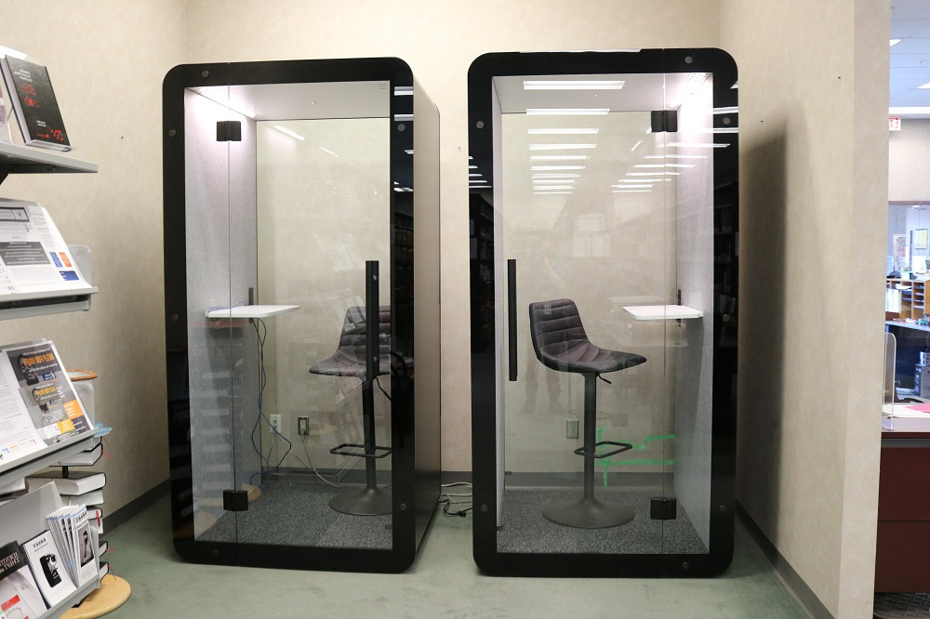

Peel Law Association
We are
Pod People

Slide 2
Quick Background
We have a large lounge and library
We have a lot of out of town lawyers, especially criminal
We have no private spaces, conference, or breakout rooms
There are frequently loud, indiscreet calls happening in high traffic areas
Some lawyers meet with their clients virtually in our space
Some lawyers make virtual court appearances in our space

Slide 3

Booth Research
We considered every booth we could find.
Our criteria included the following:
Soundproof
Affordable (cheap)
Canadian
Quick delivery
Easy installation

Slide 4
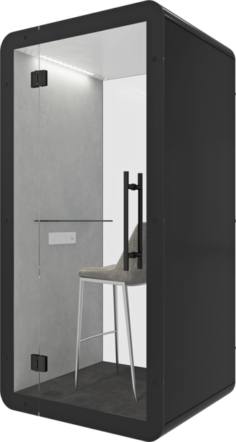
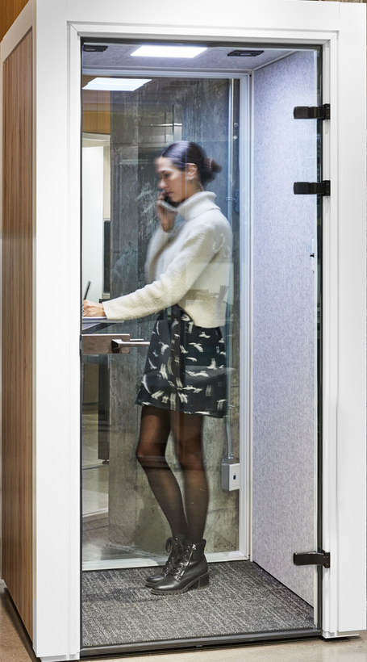
Our Finalists!
Kube versus Mutebox
Kube was less than half the price
It was manufactured locally
It would be ready in 4 weeks
It required no special electrical installation
It had built-in air circulation
It was plug and play
Kube
Mutebox

Slide 5
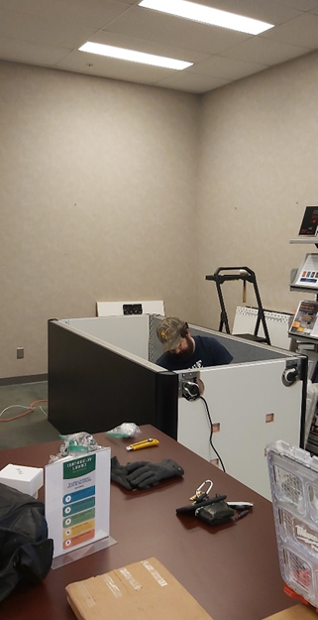
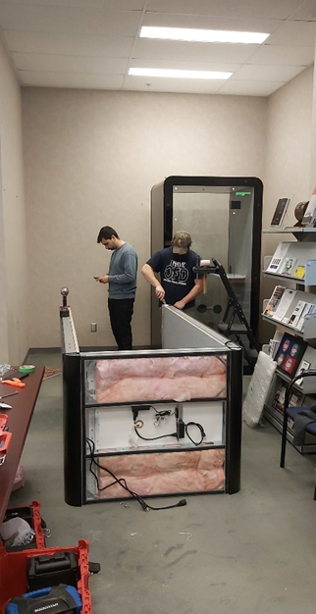
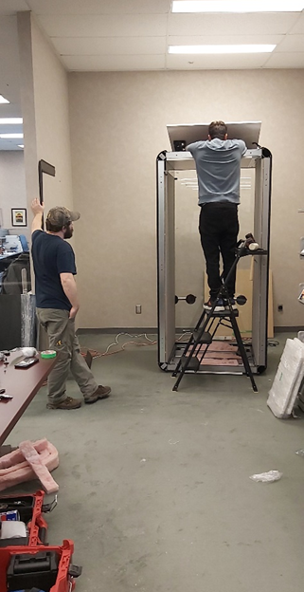
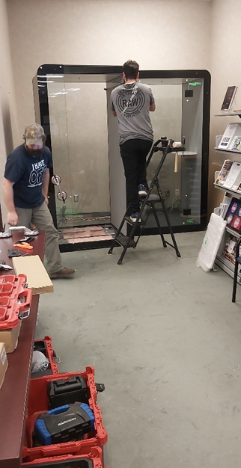
Installation

Slide 6
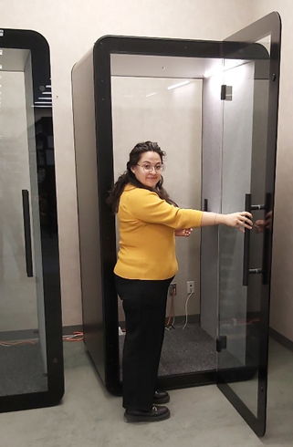
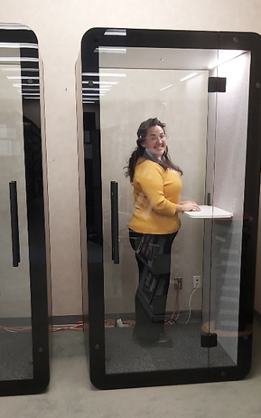
How to use Kube

Slide 7
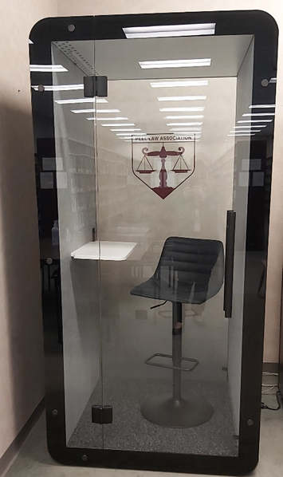
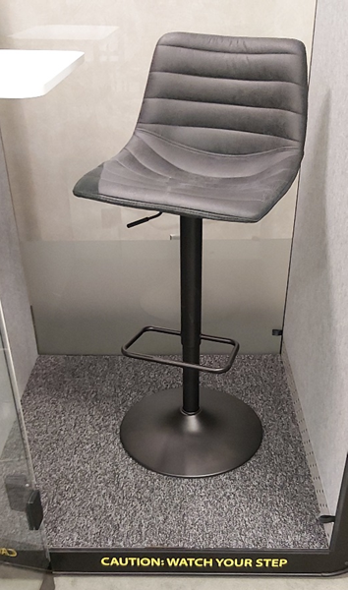
Booth Enhancements
Branding on rear glass
Frosted vinyl to obscure wires
Comfy adjustable stool
Cautionary wording

Slide 8
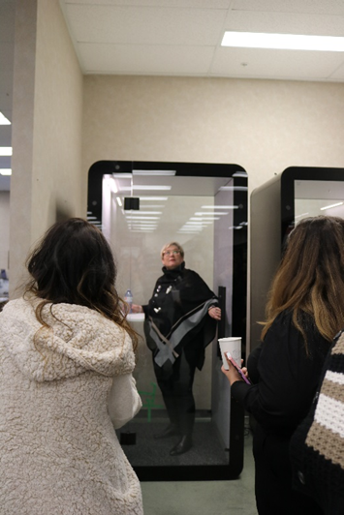
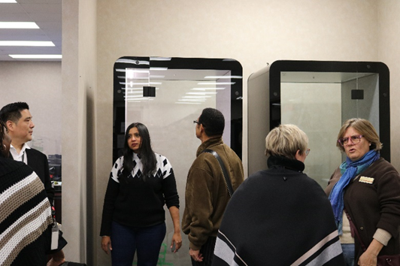
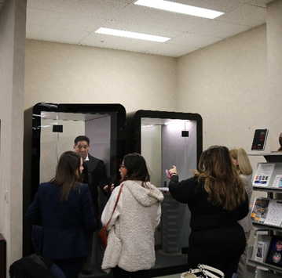
Soft Launch – Part One
Judges and influencers

Slide 9
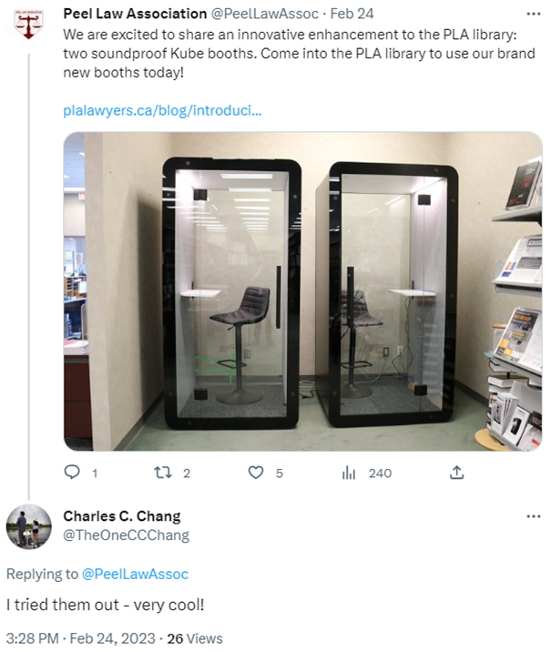
Soft Launch – Part Two
Communications to raise initial awareness
Email to members
Social Media
Website
Peel Briefs
Signage
Brand ambassador

Slide 10

What’s Next?
Wayfinding work

Slide 11




What’s Next?
Pod People campaign

Slide 12
Questions?
Please feel free to email me any time!
Jo-Ann McQuillan
eo@plalawyers.ca

