Slide 1


Take a Paws
Therapy Dog Sessions at the CCLA

Slide 2
Background
In-person HeadStart Legal Research training session for students in August, wanted something for the students mid-year
Also wanted dogs
Finally able to connect with Therapeutic Paws of Canada
They were also looking for a quiet place for the dogs

Slide 3
Therapeutic Paws of Canada
https://tpoc.ca/
Originally based in Hawkesbury, ON
Over 500 volunteers across Canada
Courthouse program started in the Mental Health Court
https://tpoc.ca/team-leaders/

Slide 4
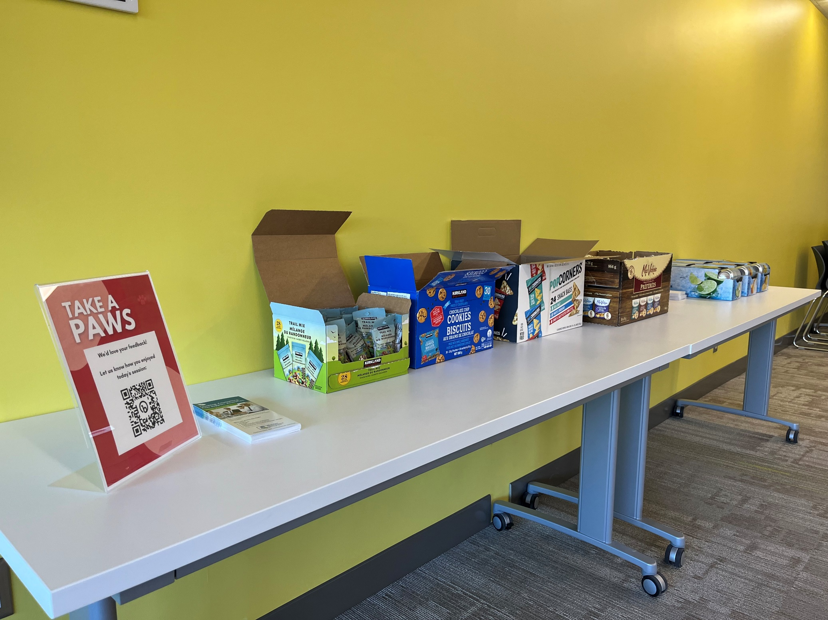
Logistics
Two dogs, one session monthly over lunch hour (12:30-1:30pm), three-month trial period
Drinks / Snacks / Chill Music
Drop-in, no registration required
First session : students only Subsequent : anyone

Slide 5



Slide 6
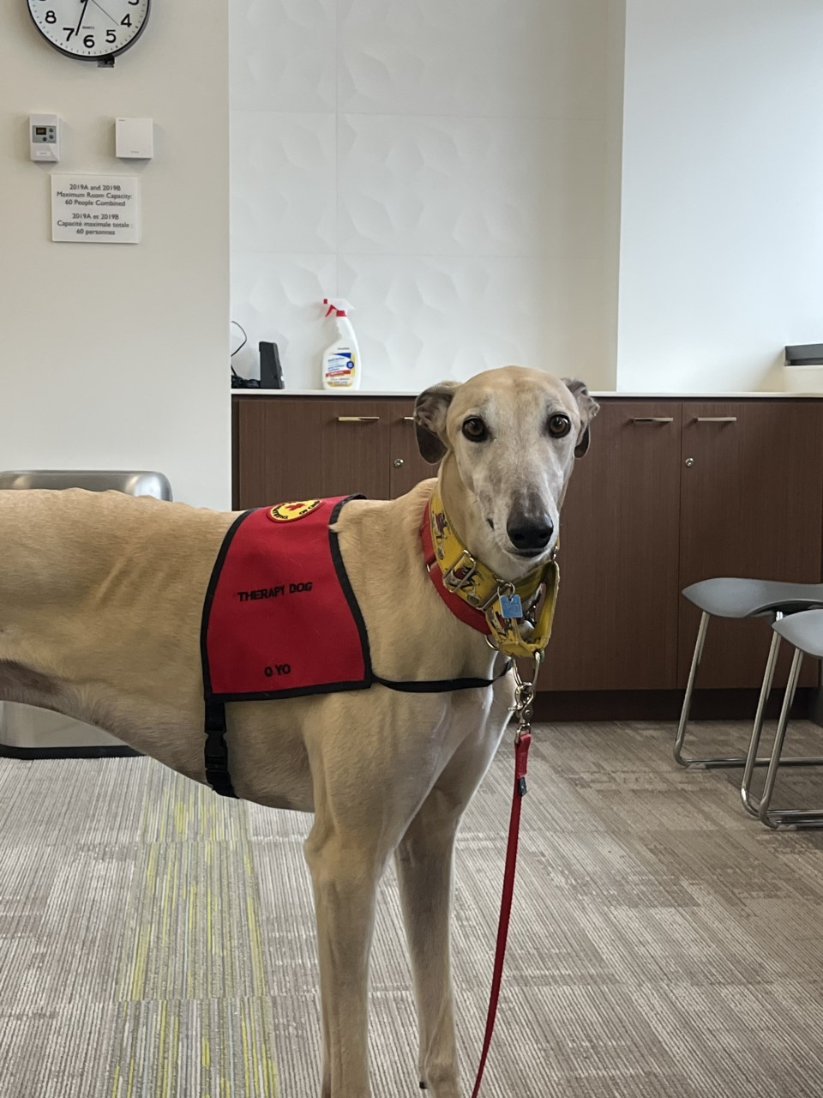
KaBoom

Slide 7
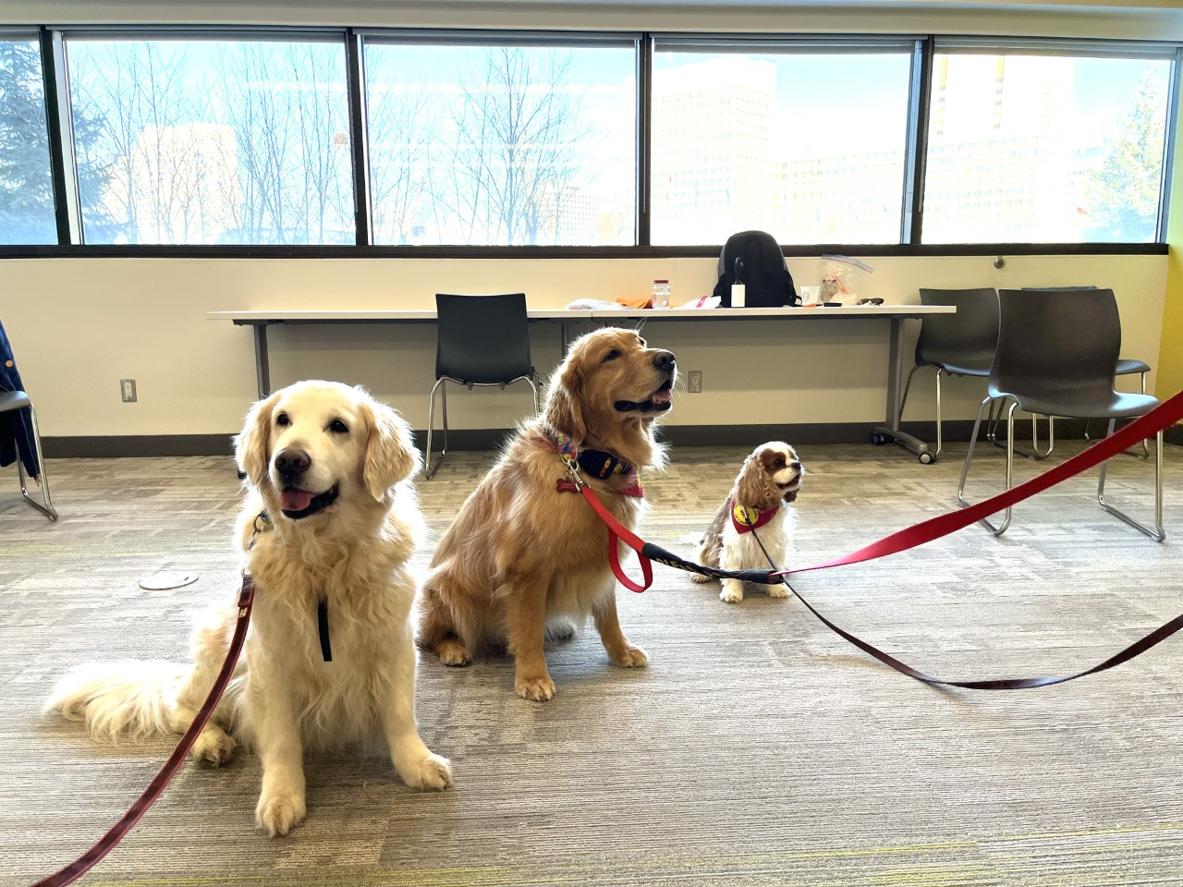
Zoe, Gambit, and Fergus
Notes:
Marie & Zoe (The very light coloured Golden) Suzanne & Ripley (what kind??), Sam (Cav) and Fergus (Cav) Nancy & Gambit (Golden) BJ and KaBoom (Greyhound)

Slide 8
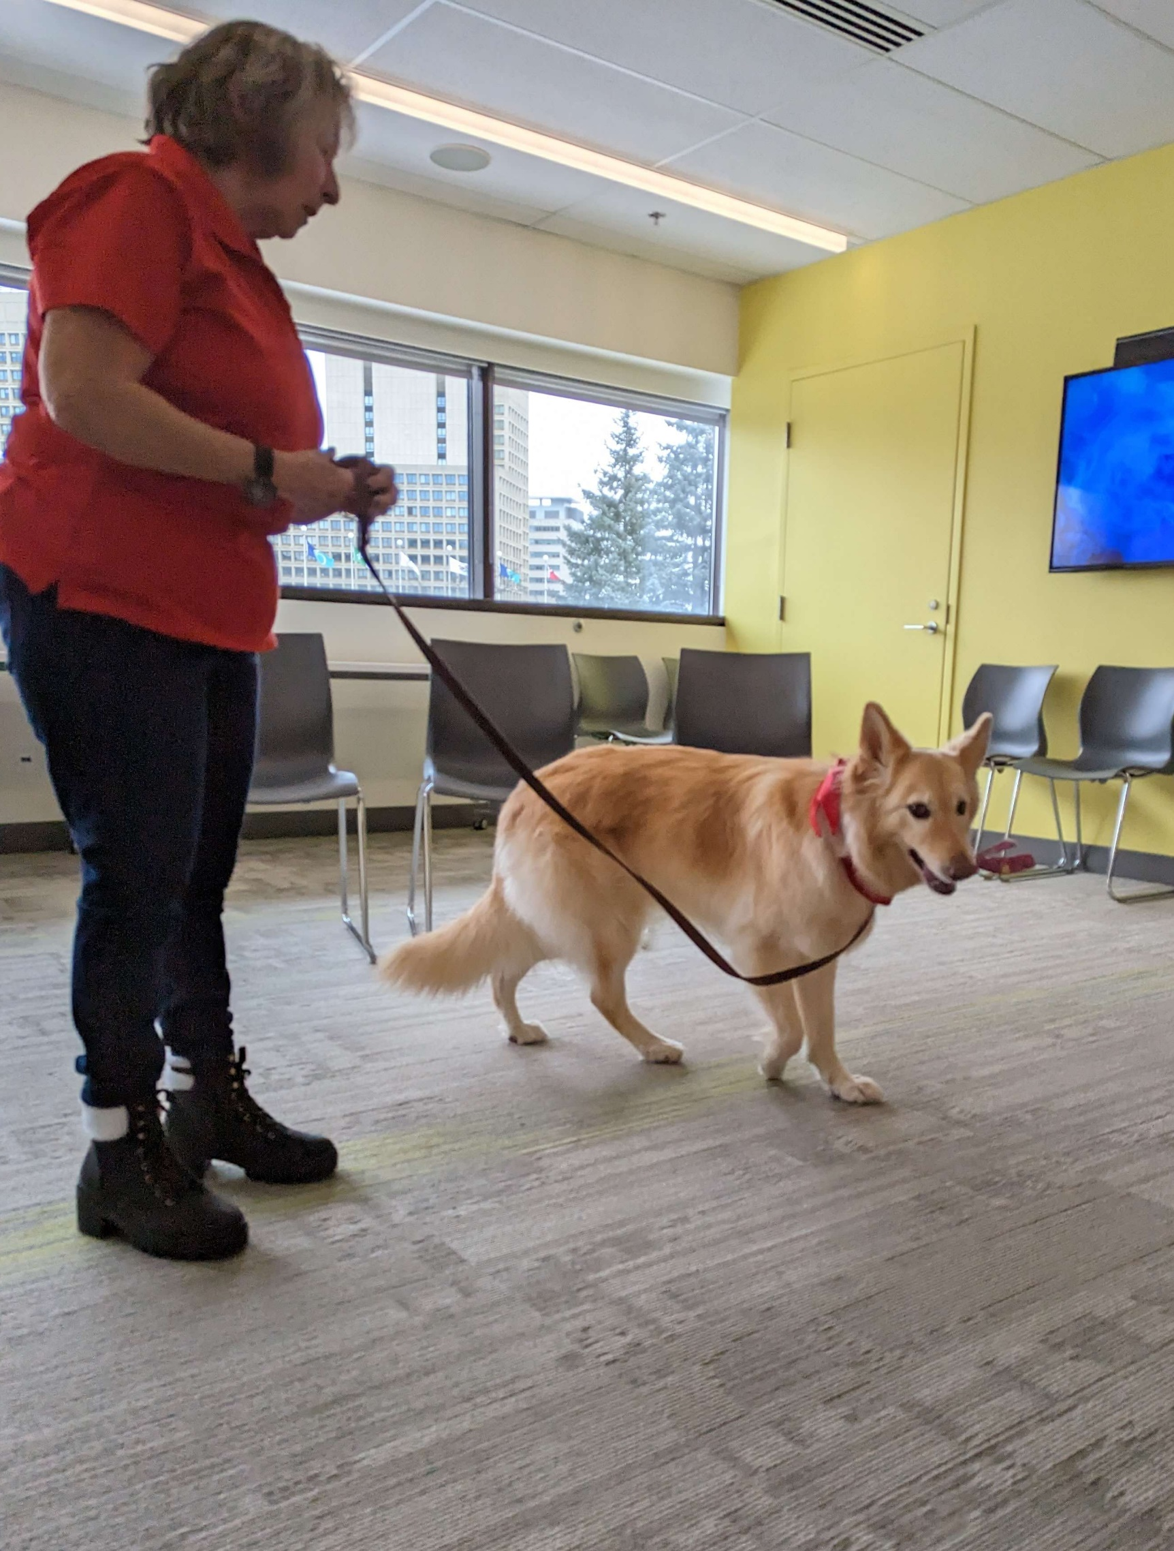
Ripley

Slide 9
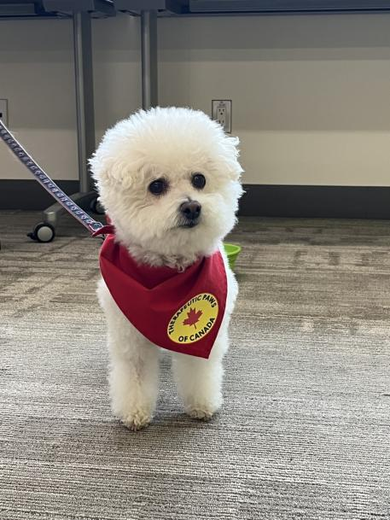
Dani Girl
Notes:
Marie & Zoe (The very light coloured Golden) Suzanne & Ripley (what kind??), Sam (Cav) and Fergus (Cav) Nancy & Gambit (Golden) BJ and KaBoom (Greyhound)

