Slide 1
She Said, She Said:
Maintaining A Board’s Fiduciary Relationship to Its Members
Ashley Gibson, Past-President,
Welland County Law Association
Mary-Jo Petsche, Executive Director, Welland County Law Association
Thursday November 10, 2022

Slide 2


Agenda
Welcome
Introduction
Ashley Gibson
She Said: A President’s Perspective
Mary-Jo Petsche
She Said: An Executive Director’s Perspective
Financial Transparency
Conclusion

Slide 3


Meet Your Presenters
Ashley Gibson, B.A. L.L.B. ​
Mary-Jo Petsche
Gibson and Reitboeck LLP
R. Boak Burns Law Library
Executive Director,
Welland County Law Association
Past-President,
Welland County Law Association

Slide 4
Introduction
Although there is no one correct way to manage an Association’s finances while maintaining the Board’s fiduciary relationship to its members, here are some insights from Welland County.

Slide 5
She Said: A President’s Perspective
“
”
Ashley Gibson B.A., L.L.B., Past-President, Welland County Law Association

Slide 6
Maintaining Fiduciary Duty to Membership
1. Monthly Board Meetings
2. Communication with Staff and Members
3. Expense Transparency

Slide 7
1. Monthly Board Meetings
  Summer Vacation: Break for the months of July and August
  Quorum: Seven members
  Attendance: Refreshments and networking opportunities
Monthly meetings with members
  Draft Statements are sent to the Treasurer for review
  Statements are presented to the board for review
  Statements approval at monthly meetings
Draft Statements prepared by Executive Director

Slide 8
2. Communication with Staff and Members
Constant communication with Executive Director
  Daily written and/or verbal correspondence
  Develop rapport to ensure clarity
  Establish programming and incentives
  Ensure comprehensive disclosure

Slide 9
2. Communication with Staff and Members
Regular Communication with Members
  President provides updates regarding monthly meetings, upcoming agenda items and hot ticket items
  Share information with Membership regarding financials
  Canvas the membership’s opinion on larger incentives
    Paralegal involvement in family law
    Recent letter writing campaign regarding LiRN funding
    By-Law amendments
    Significant expenses

Slide 10
2. Communication with Staff and Members
Expense Transparency
Correctly allocating expenses to the Library or the Association
Ensuring that expenses are reasonable and funds are managed properly
Do you know which expenses belong to the Library or Association?

Slide 11
She Said: An Executive Director’s Perspective
Mary-Jo Petsche, Executive Director, Welland County Law Association

Slide 12
Know Your Accounting: Scheduled Financial Tasks
Collections
Salaries
Operations

Slide 13
Monthly Financial Tasks
Account reconciliation (including Summary and Detailed Reports)
Prepare financial reports for bank accounts and include in your monthly board meetings for approval

Slide 14
Monthly Financial Tasks
Library
  Revenue (E.g. copies/printouts, LiRN grant)
  Expenses (E.g. collections, salary, operations)
Association
  Revenue (E.g. coffee sales, CPD, Membership dues)
  Expenses (E.g. FOLA levy, events, gifts/memorials)

Slide 15
Quarterly Financial Tasks
Review Income Statement and Balance Sheet Reports
Trial balance for LiRN
Useful to run a comparative income statement for actual vs. current budget
Sage has options for this type of report
Ensure all entries are categorized properly within the chart of accounts
Confirm all accounting entries for that quarter are complete before producing and submitting the report.

Slide 16
Year End Financial Tasks
Produce Audit Trail Reports
Treasurer Review
Preparation
Available on Sage
Monthly Financial Reports, Monthly Bank Statements, Income Statements, Revenue and Expenses Summaries, Tax Reports, and Source Deduction Reports.
Prepare Your Financial Records for the Audit
Remit to the Canada Revenue Agency before February Deadline
Inclusive of Opening/Closing Balances on All Bank Accounts, Income Statements for All Bank Accounts, Membership Numbers and Revenue
Prepare the T4 Slips and Summary
Treasurer’s Report

Slide 17
Financial Transparency
Determining Library Expenses and Association Expenses

Slide 18

Collections
Library Expense or Association Expense?

Slide 19

Continuing Professional Development Lunch and Learns
Library Expense or Association Expense?

Slide 20

Mentoring Programs
Library Expense or Association Expense?

Slide 21
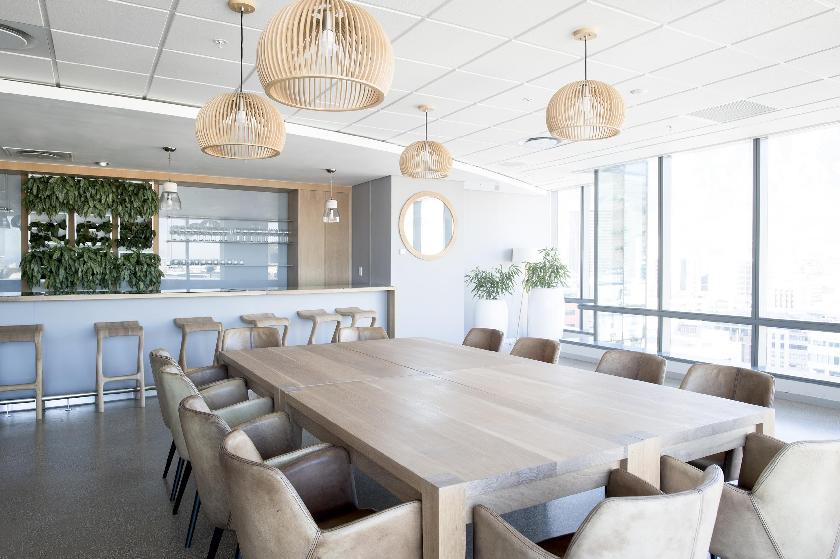
Annual General Meeting
Library Expense or Association Expense?

Slide 22

Spring Dinner
Library Expense or Association Expense?

Slide 23

Pizza at Board Meetings
Library Expense or Association Expense?

Slide 24
Conclusion
Library expenses and association expenses, they’re not write offs!
https://youtu.be/hg1Uk60rBsc

Slide 25
Thank you
Ashley Gibson
ashley@gnrlaw.ca
www.gnrlaw.ca
Mary-Jo Petsche
wcla@execulink.com
www.wcla.ca

