Slide 1
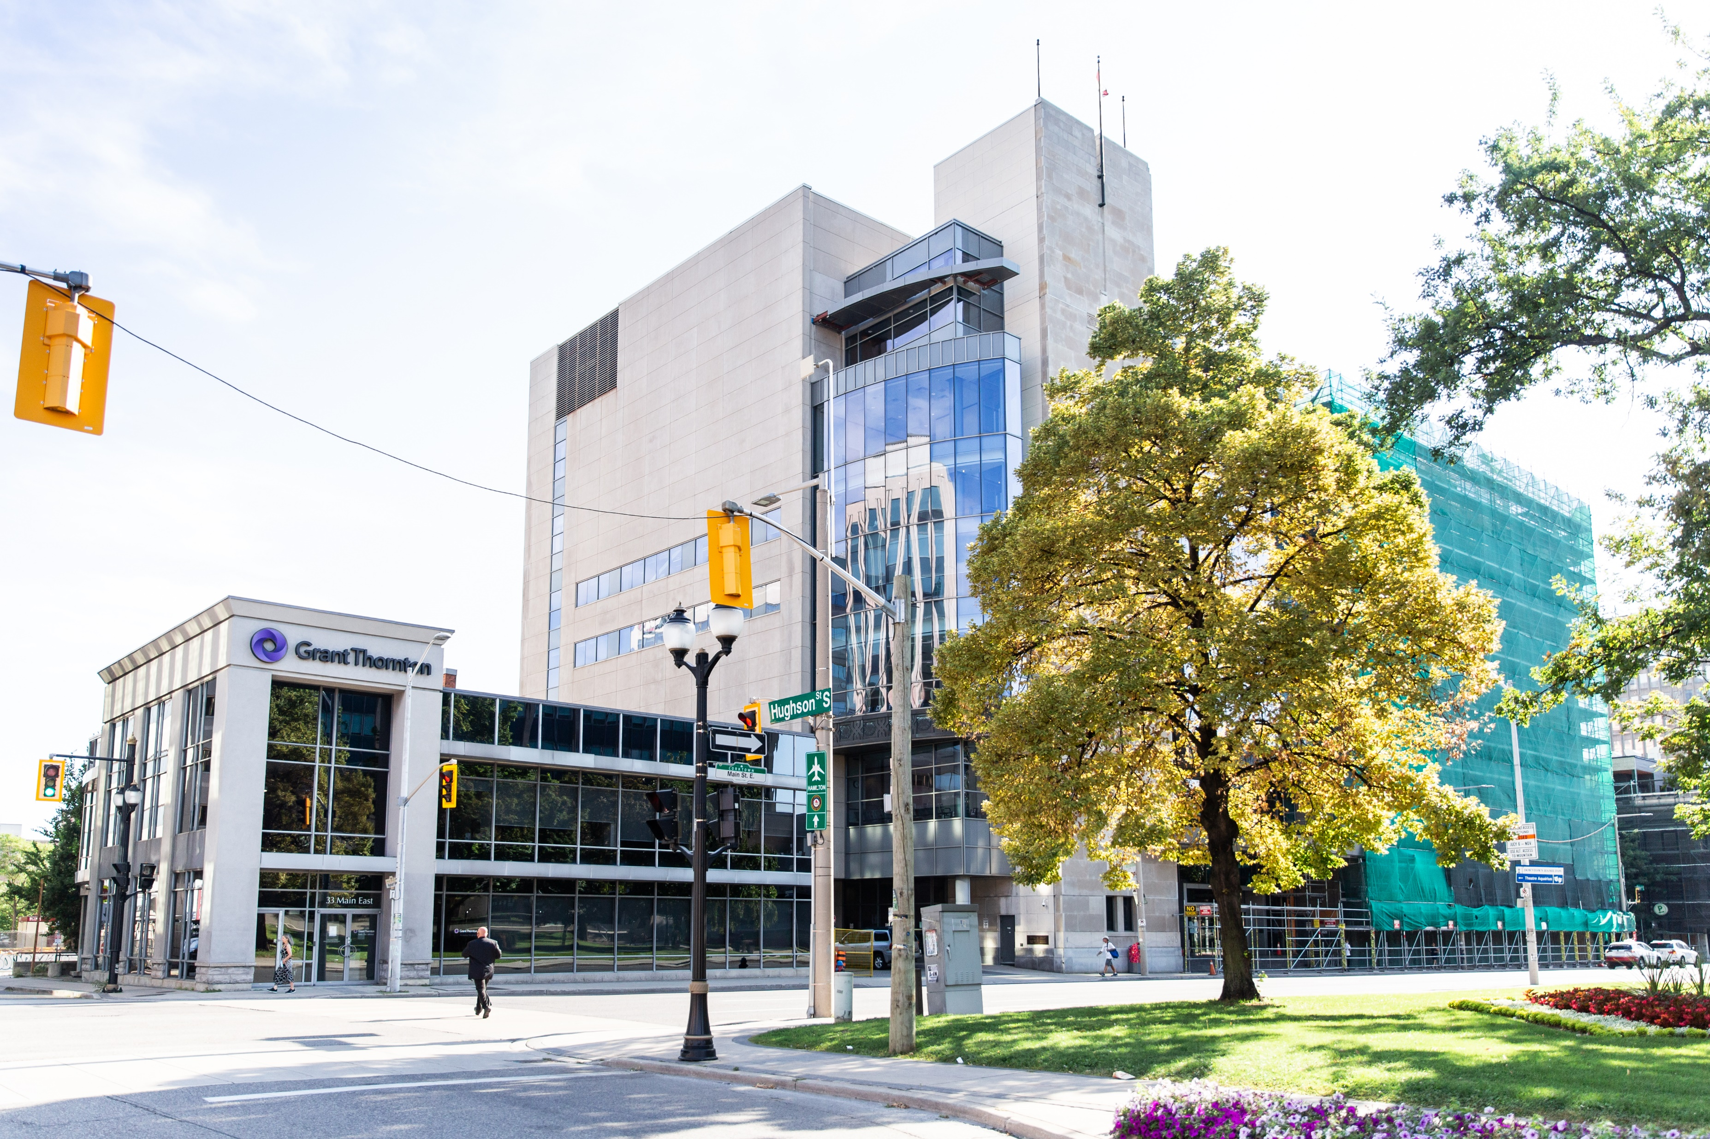
Welcome to the HLA & Anthony Pepe Memorial Library!
Presented By:
Nicole Strandholm Law Librarian
Hamilton Law Association

Slide 2



After today’s session, you will:

Slide 3
Welcome to the HLA & Anthony Pepe Memorial Library!
Suite 500 in the John Sopinka Courthouse 45 Main St E. Hamilton, ON L8N 2B7
Open 8:30am-5:00pm, Monday to Friday (staffed from 8:00am-4:00pm)

Slide 4
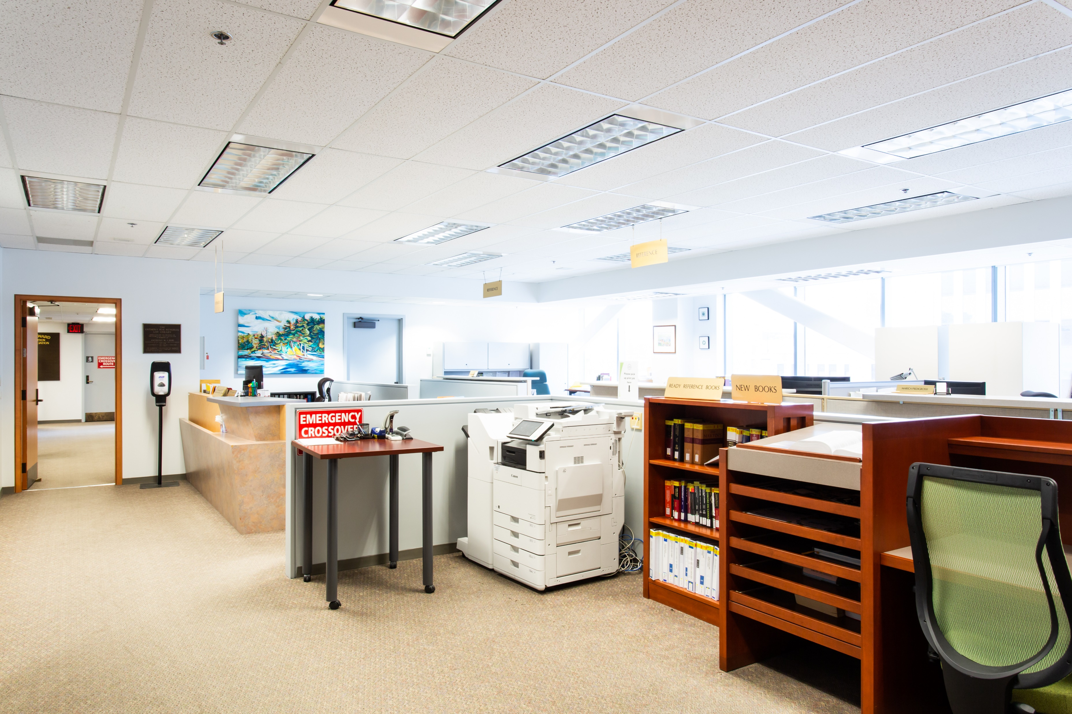
Welcome to the HLA & Anthony Pepe Memorial Library!

Slide 5
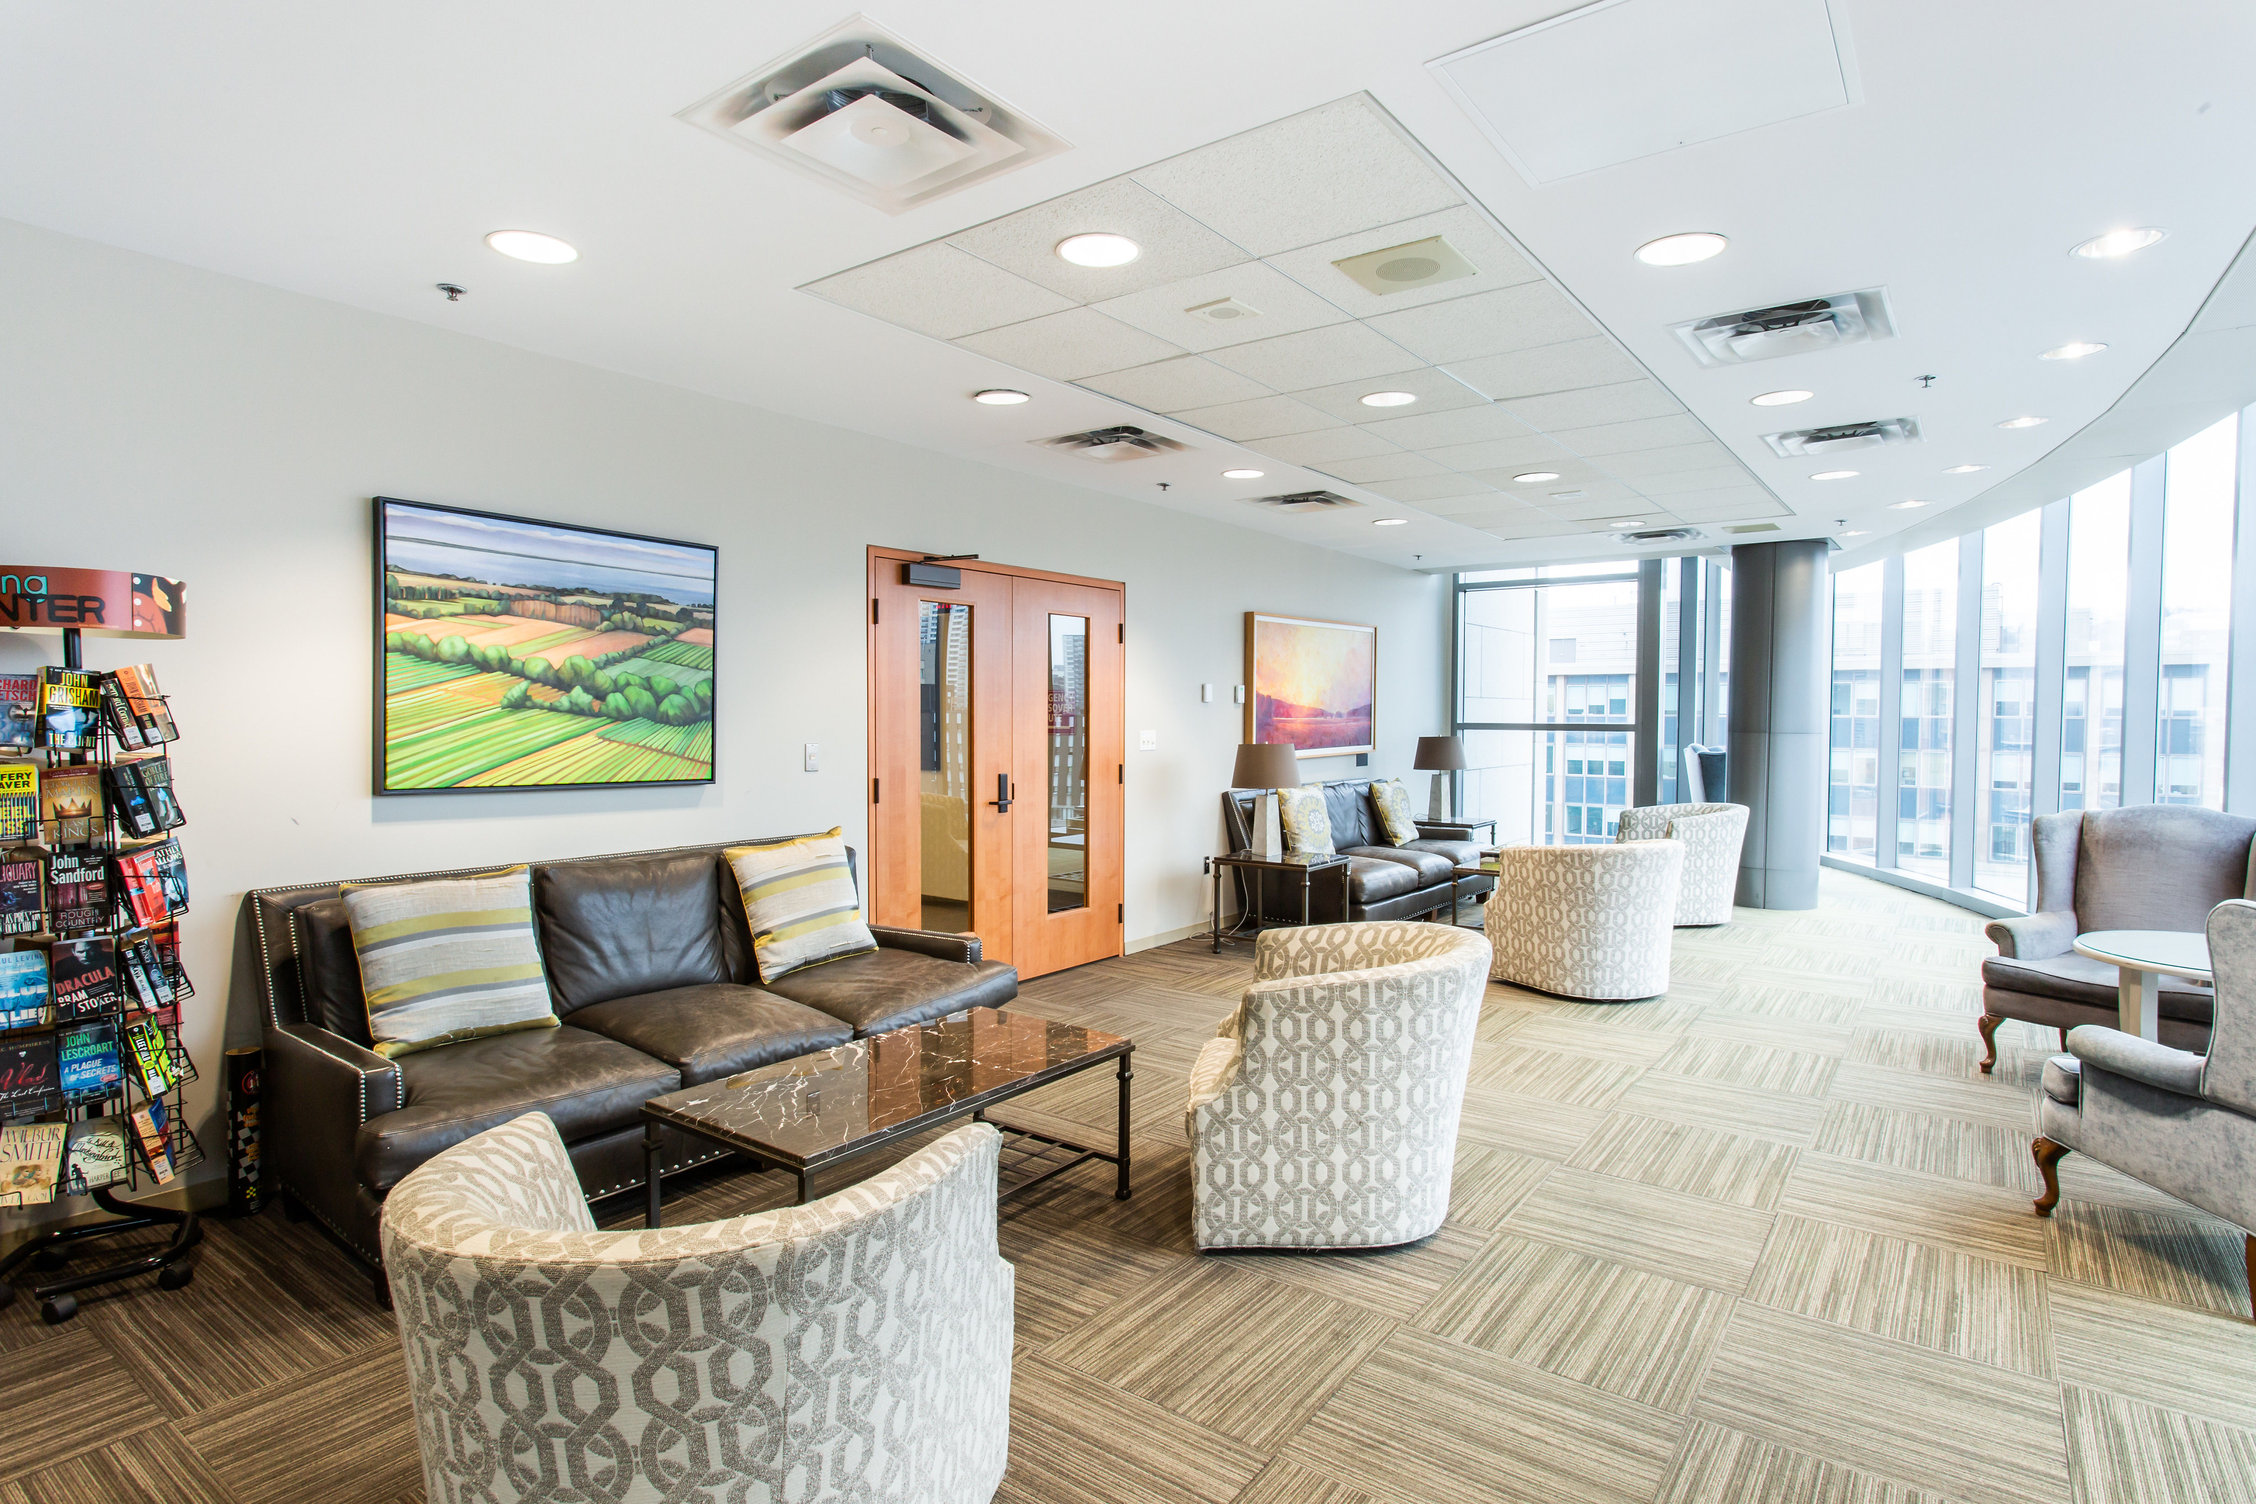
Welcome to the HLA & Anthony Pepe Memorial Library!

Slide 6
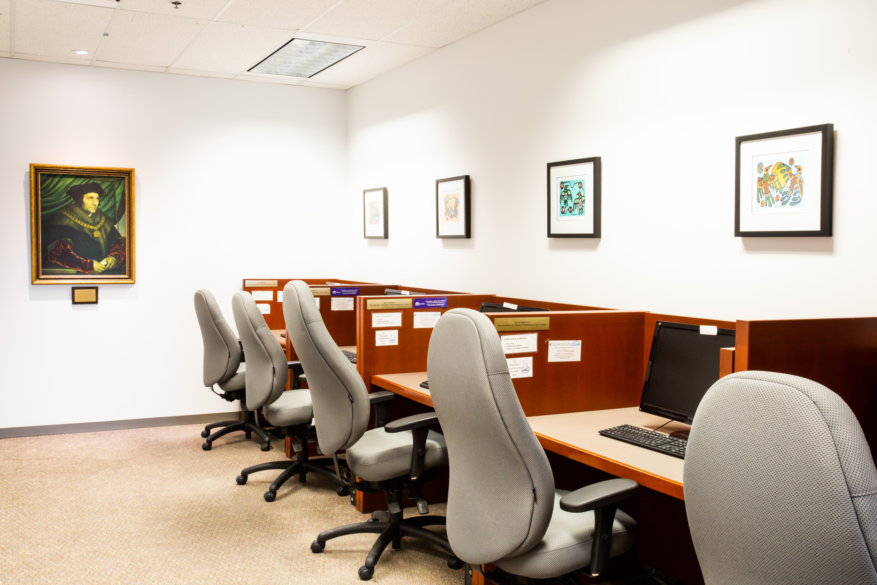
Welcome to the HLA & Anthony Pepe Memorial Library!

Slide 7
Resources
Over 30,000 Titles in All Areas of Canadian Law
Use InfoLocate, the Ontario Courthouse Library Catalogue, to search our collection.
Online Resources:
Lexis Quicklaw | RangeFindr
Lexis Practical Guidance Lexis Context Lexis Pleadings, Motions and Facta | V|lex Westlaw:
O’Brien’s Forms Online DivorceMate HeinOnline | CriminalSource Estates&TrustsSource FamilySource

Slide 8
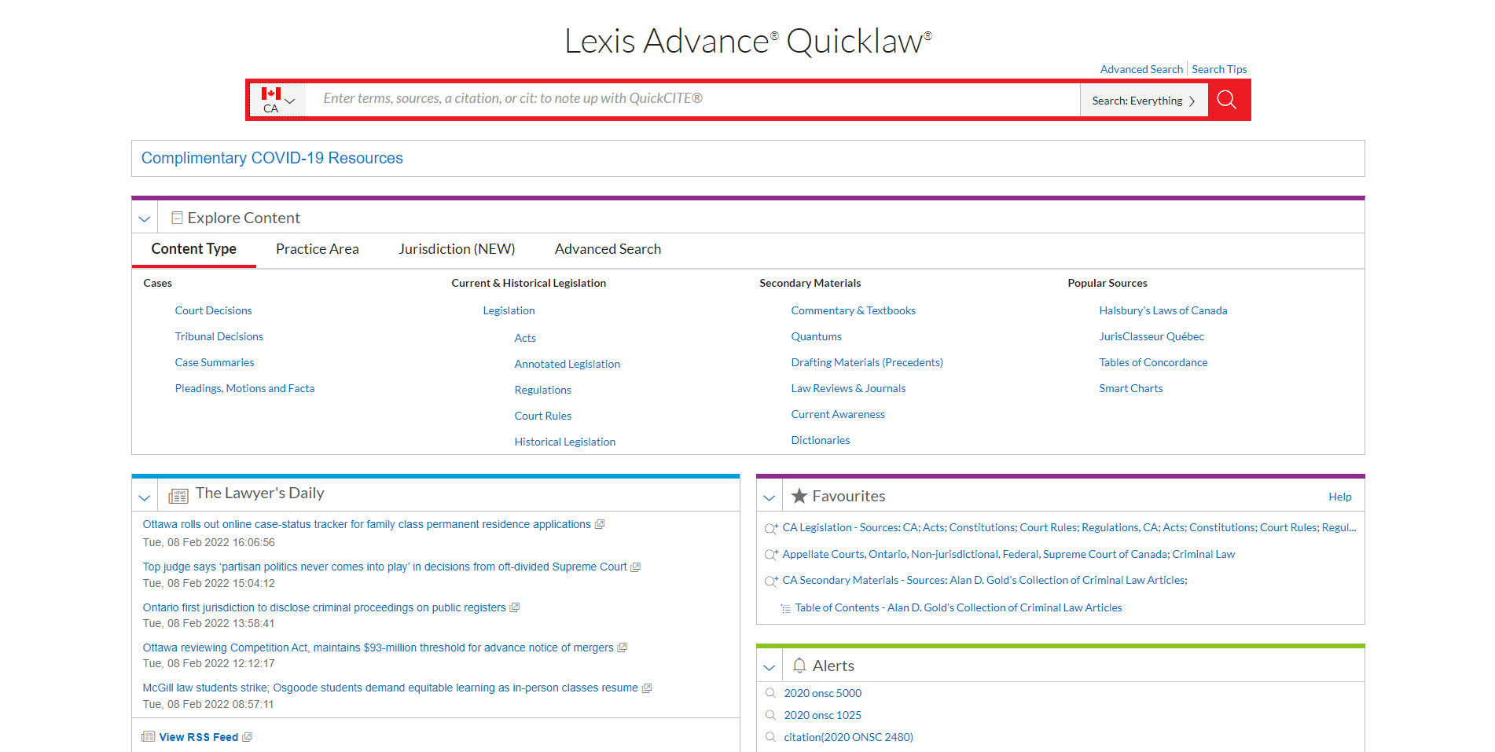
Lexis Quicklaw

Slide 9
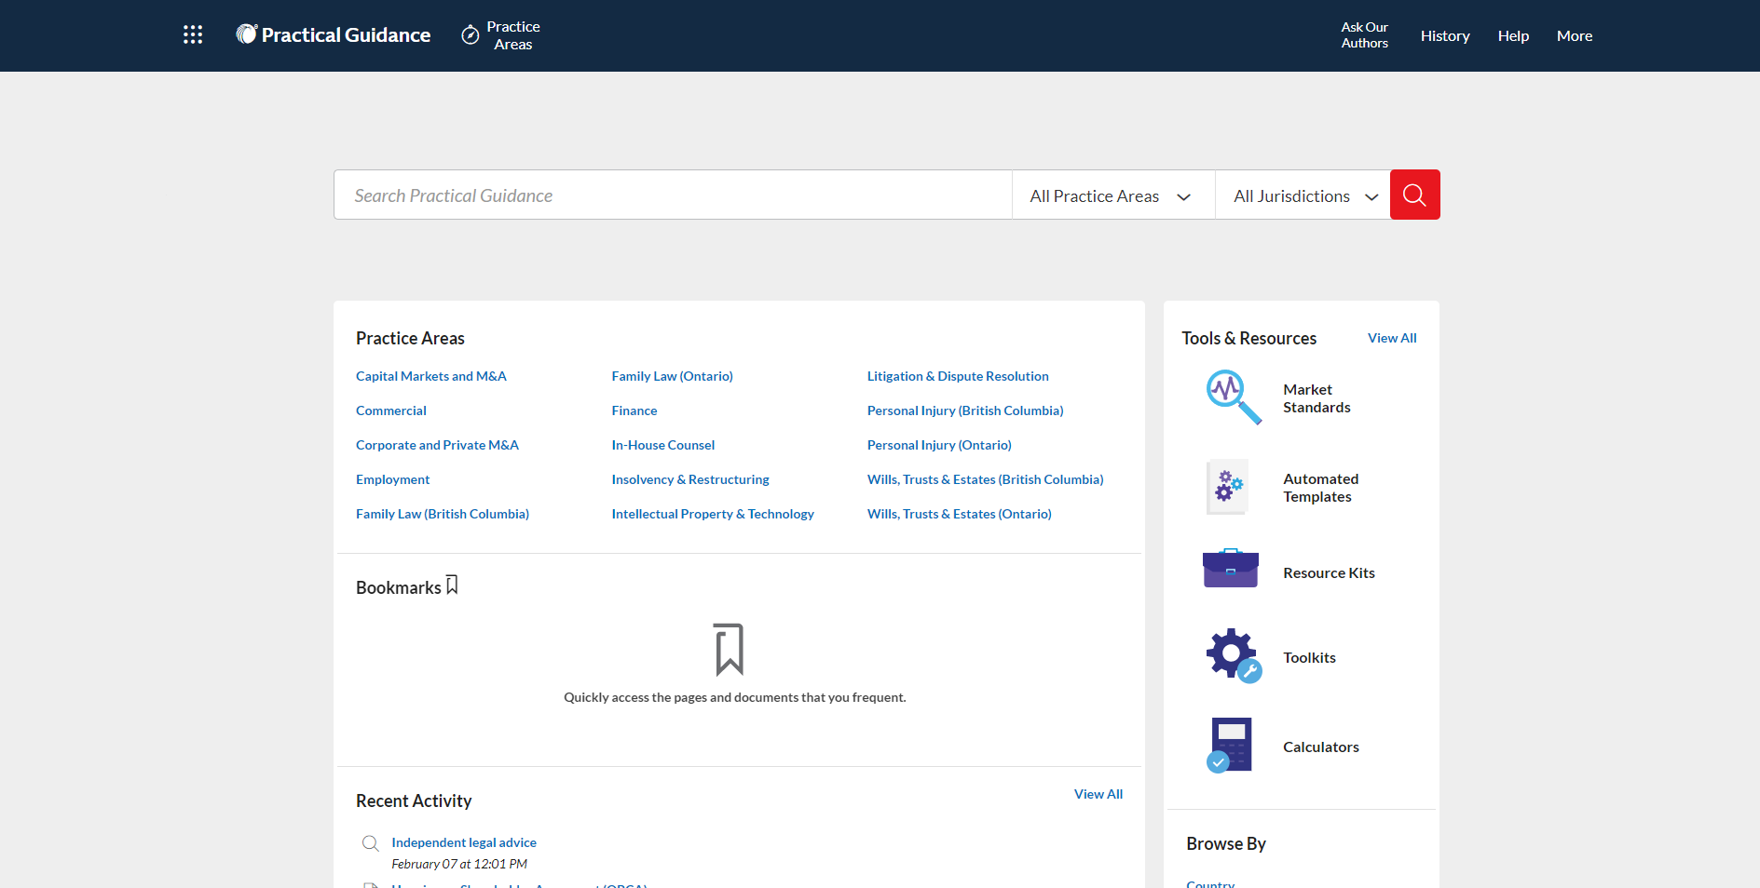
Lexis Practical Guidance

Slide 10
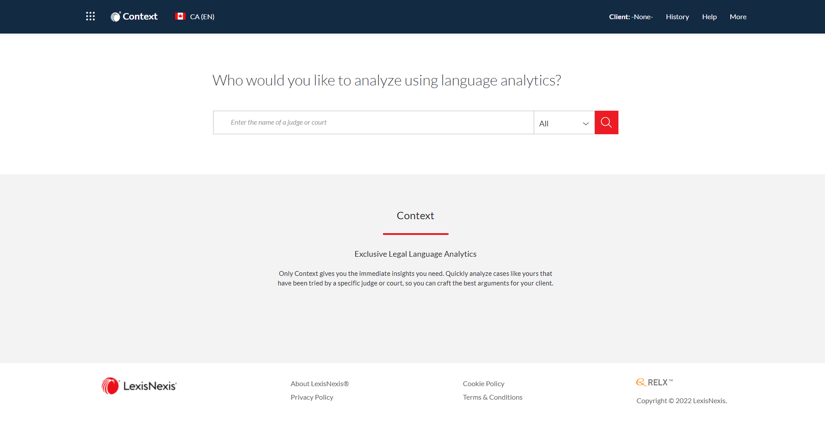
Lexis Context

Slide 11
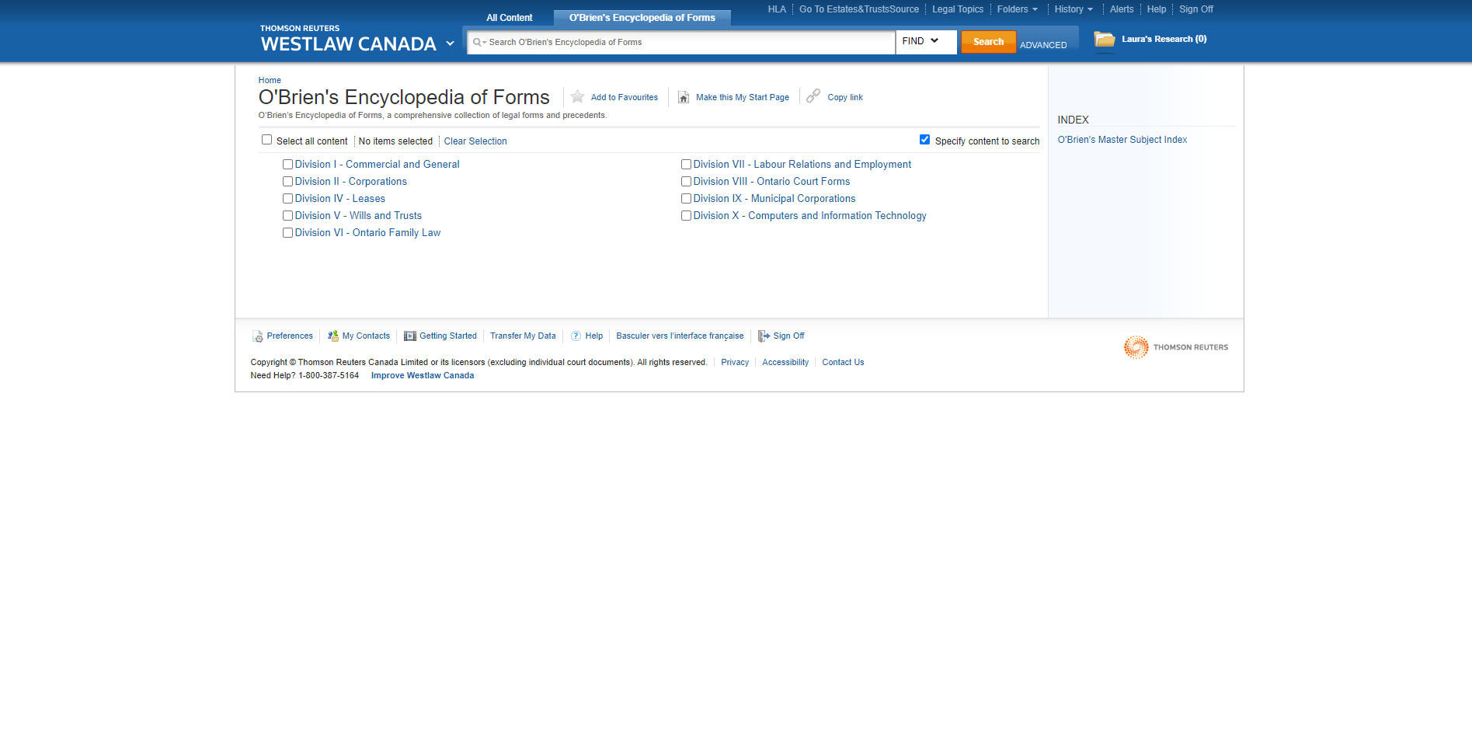
O’Brien’s Forms

Slide 12
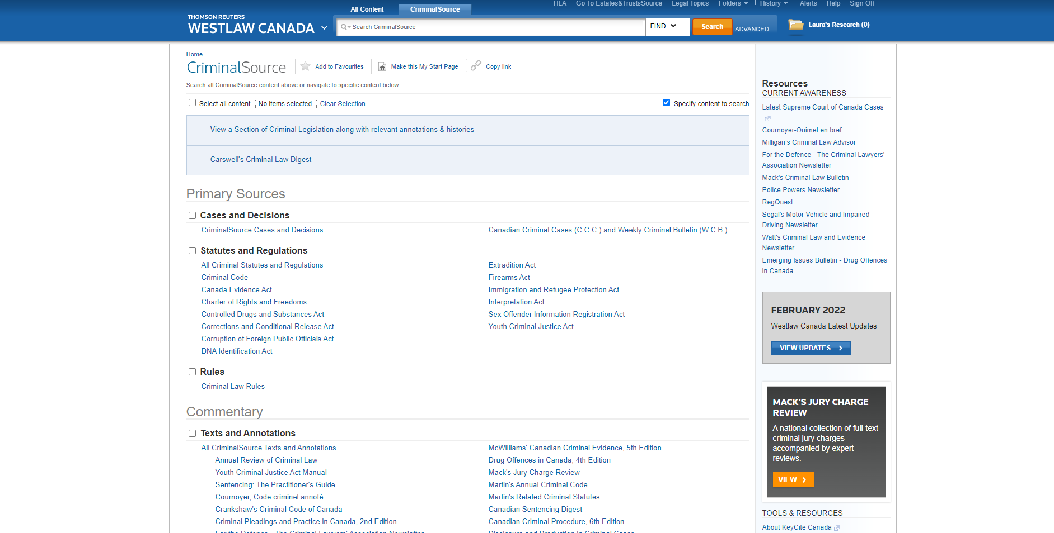
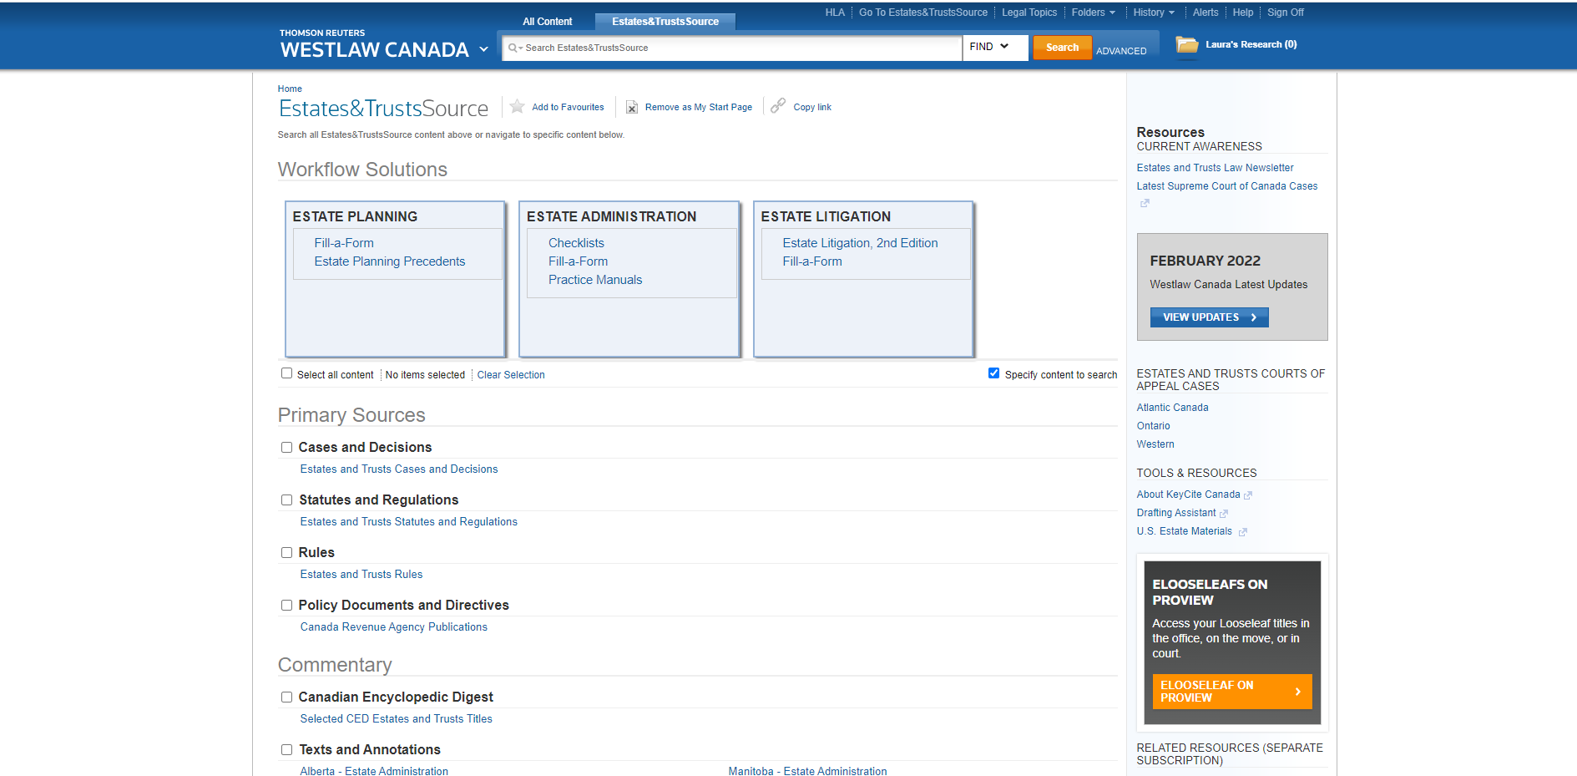
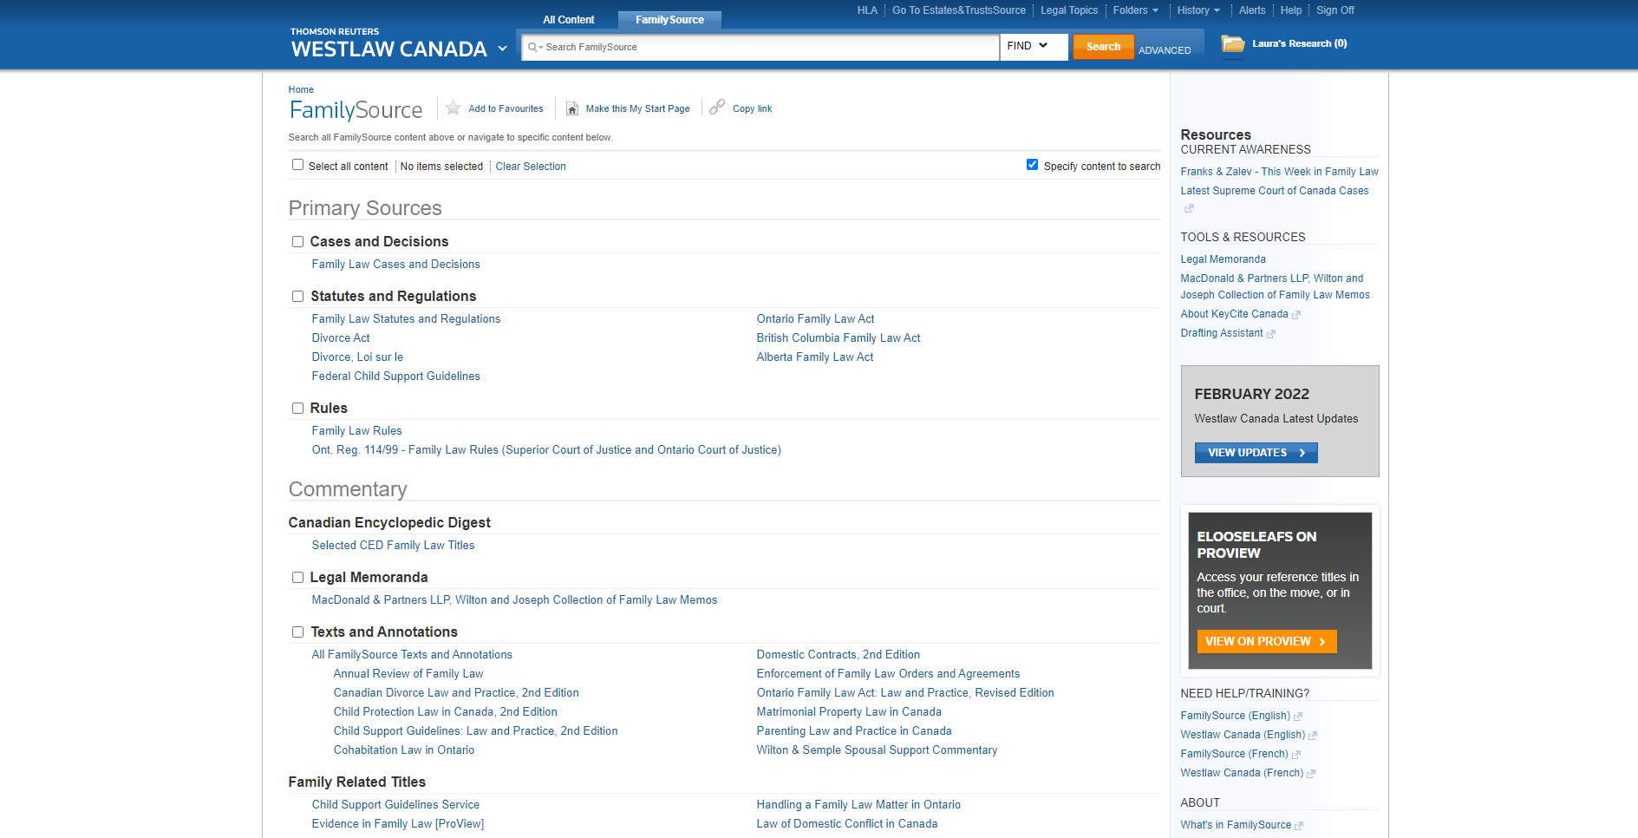
Westlaw Canada

Slide 13
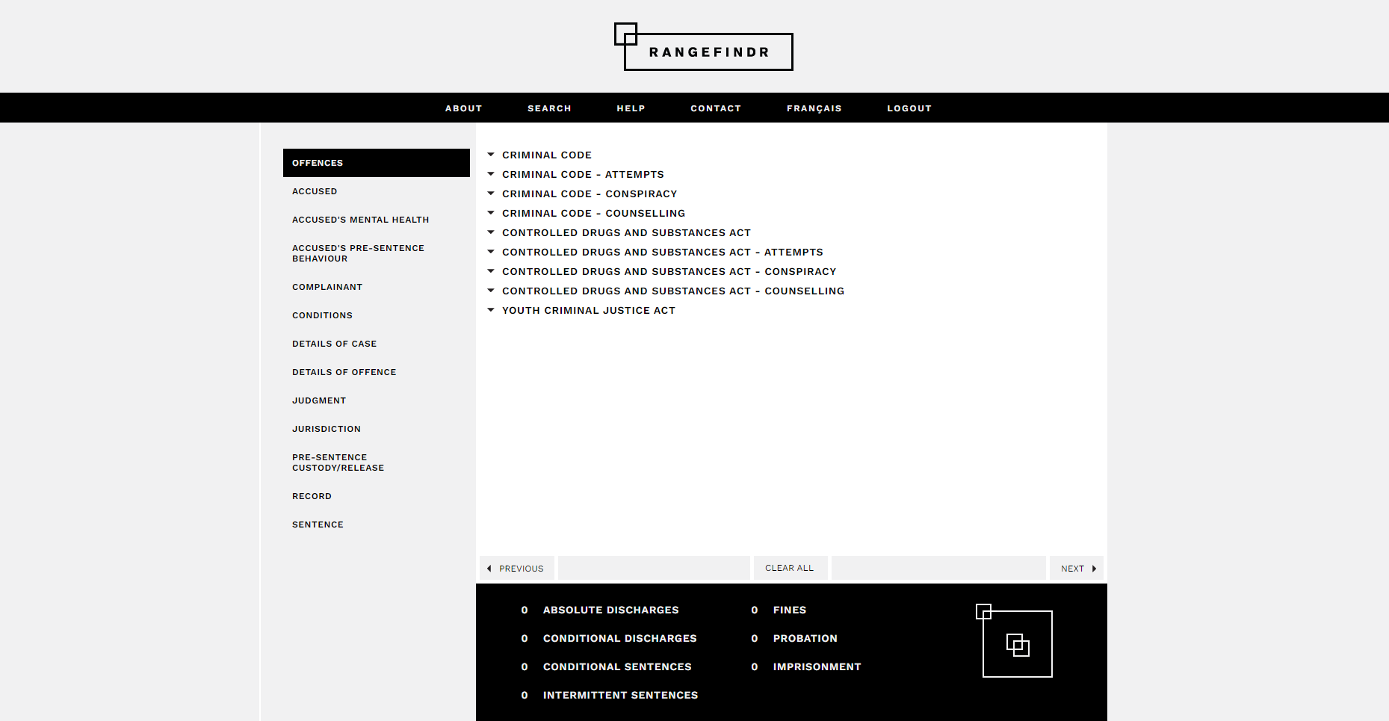
RangeFindr

Slide 14
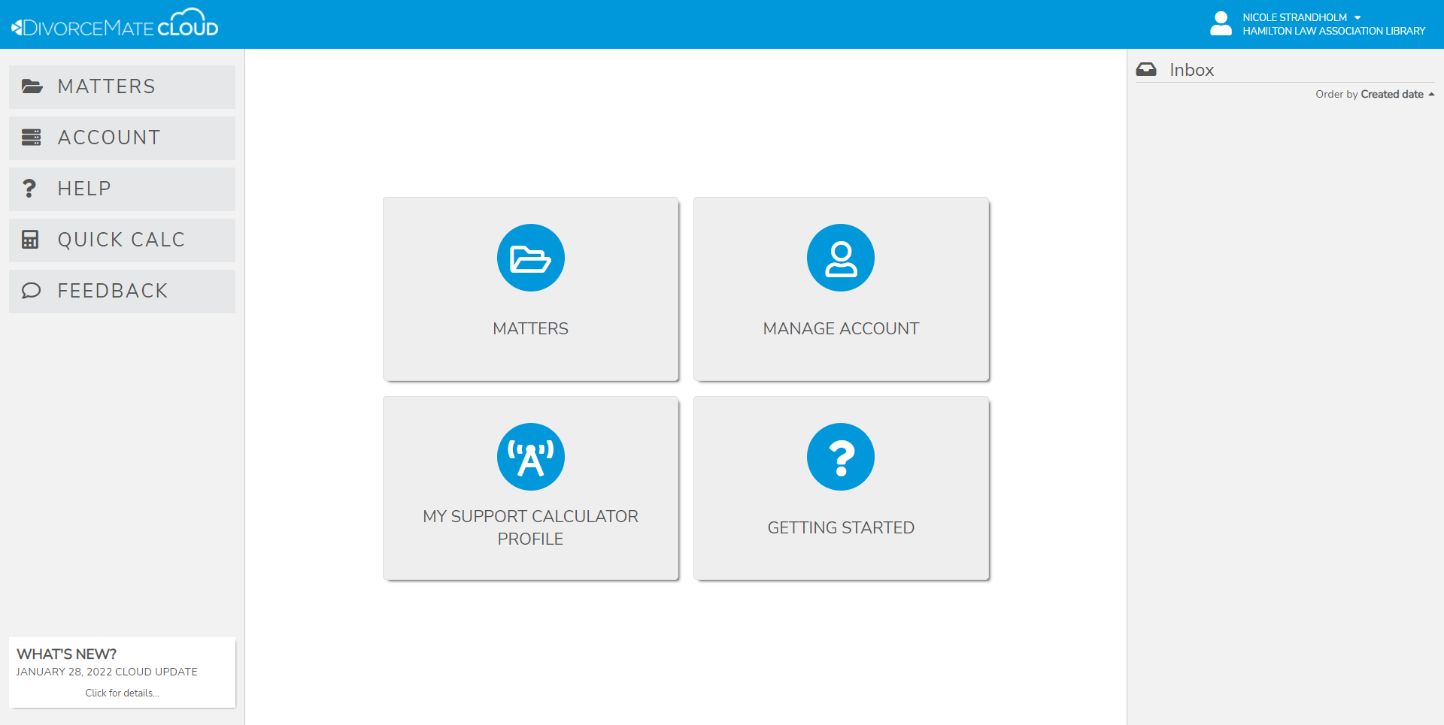
DivorceMate

Slide 15
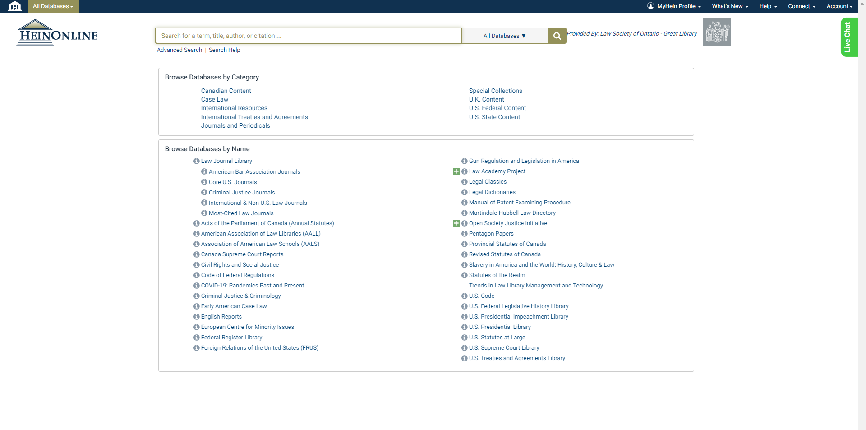
HeinOnline

Slide 16
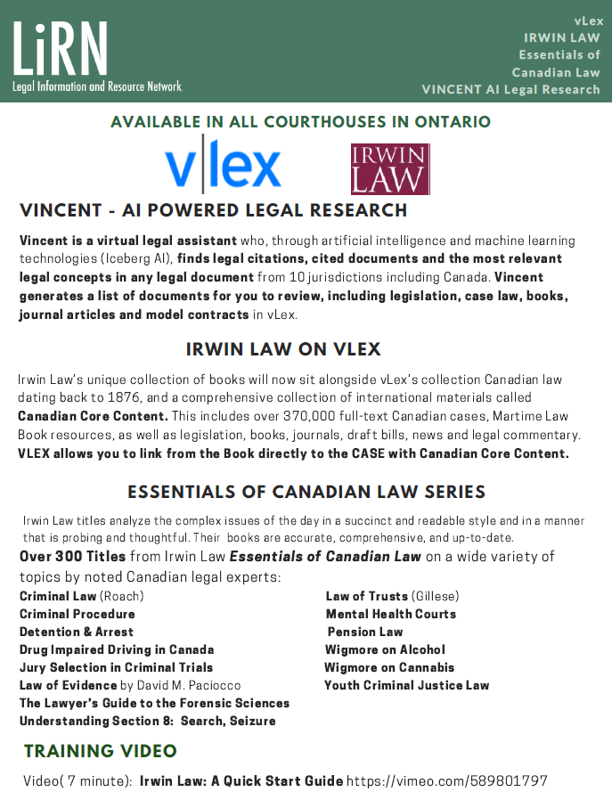
Vlex By Irwin Law

Slide 17
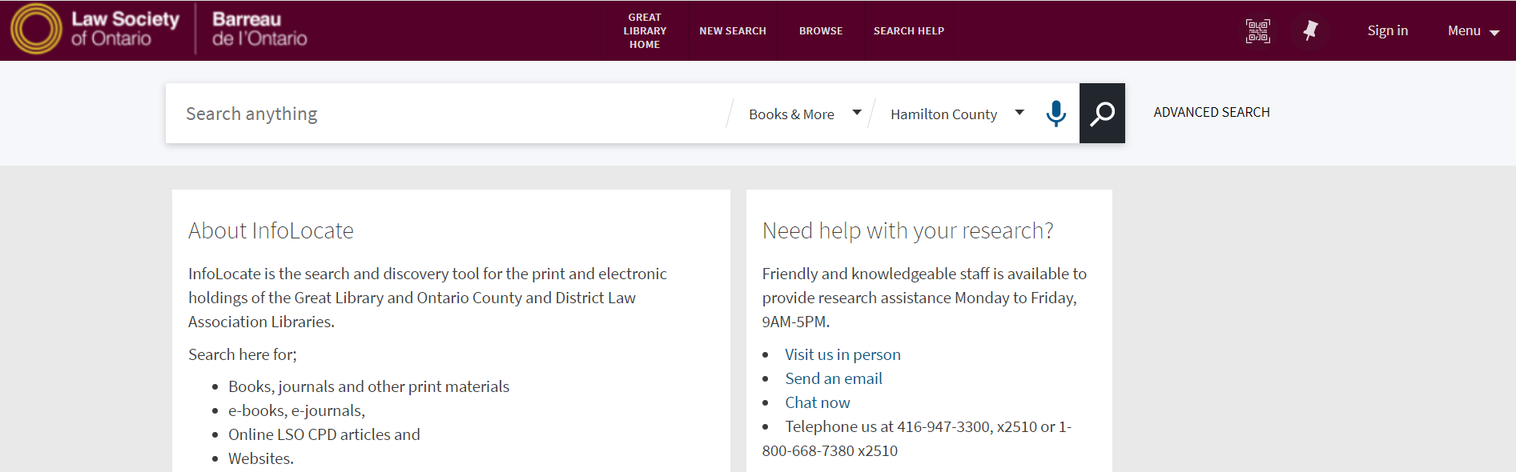
InfoLocate
Online catalogue of all print materials in the Ontario courthouse library system.
Use filters to search/browse the HLA collection
Request an Interlibrary Loan through a librarian

Slide 18
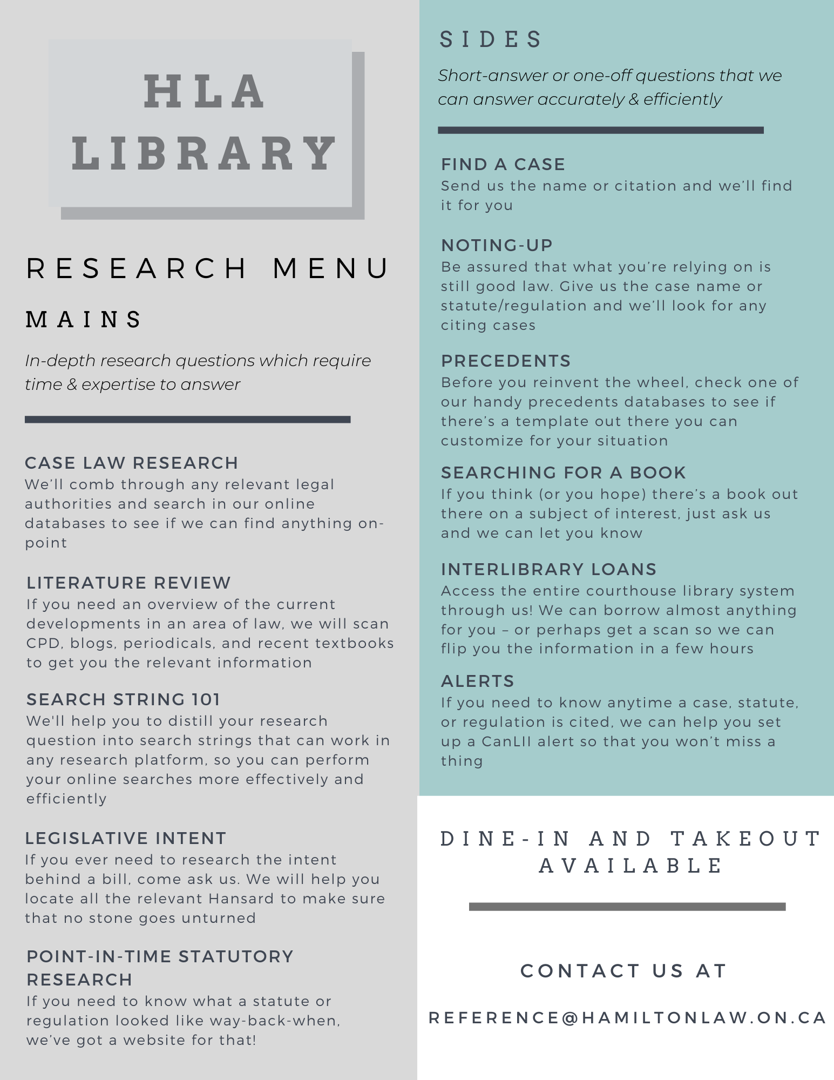
Research Assistance

Slide 19
Contact Us
Suite 500, John Sopinka Courthouse, 45 Main Street East, Hamilton, ON
905-522-1563
reference@hamiltonlaw.on.ca

