Slide 1

Library Surveillance
Access cards, security cameras and more!

Slide 2
Why do we have security cameras?
The PLA Library and Lounge are in a high visibility and highly vulnerable section of the courthouse.
We have a high volume of lawyers using the lounge 7 days a week.
We have had
  incidents of personal injury on the premises,
  incidents of harassment or inappropriate behaviour, and
  thefts, damages and lapses in security

Slide 3
The PLA’s security journey
Lounge cameras were initially installed in 2018.
In late 2019, the PLA began the installation of library cameras with cumbersome archiving tech & unremarkable picture resolution.
In 2022, we had a complete system upgrade, which offered a better archiving platform and higher quality visuals.
The access card system was also updated; this rendered our old software obsolete.
Every card had to be re-entered into the database and we had to get a
new card printer. Staff had to input thousands of profiles.

Slide 4
Concerns
Some board members were concerned that people on computers would have their privacy compromised.
  SOLUTION: cameras are not zoomed in to this level of detail
There were concerns about potential misuse of surveillance footage
  SOLUTION: only the Executive Officer has access to the camera dashboard and archival footage. No information released without board approval or warrant.
There were concerns about surveillance without consent.
  SOLUTION: there is signage throughout our space advising people that they are being monitored.

Slide 5
The details
Our access card system is called Entrapass
Our surveillance system is called ExacqVision
Both are installed and maintained by Johnson Controls (part of Tyco)
Cost of 6 camera installation: $11,687
Cost of system upgrade in 2022: $6,667
Annual plan:
  Access cards: $1630
  CCTV: $1160
Cost of Magicard Pronto printer: $995
Cost of replacement cards: $178 for 100 (from Avon Security)

Slide 6
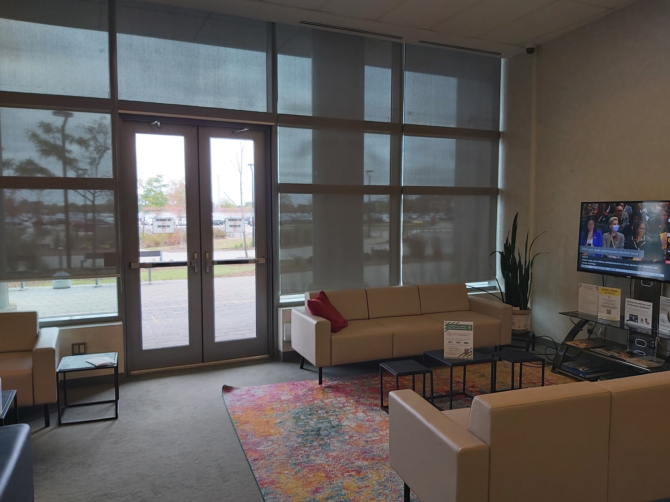
Peel Regional Police measures
Kitchen camera surveillance
Exit alarms
Panic buttons
Daily sweeps

Slide 7
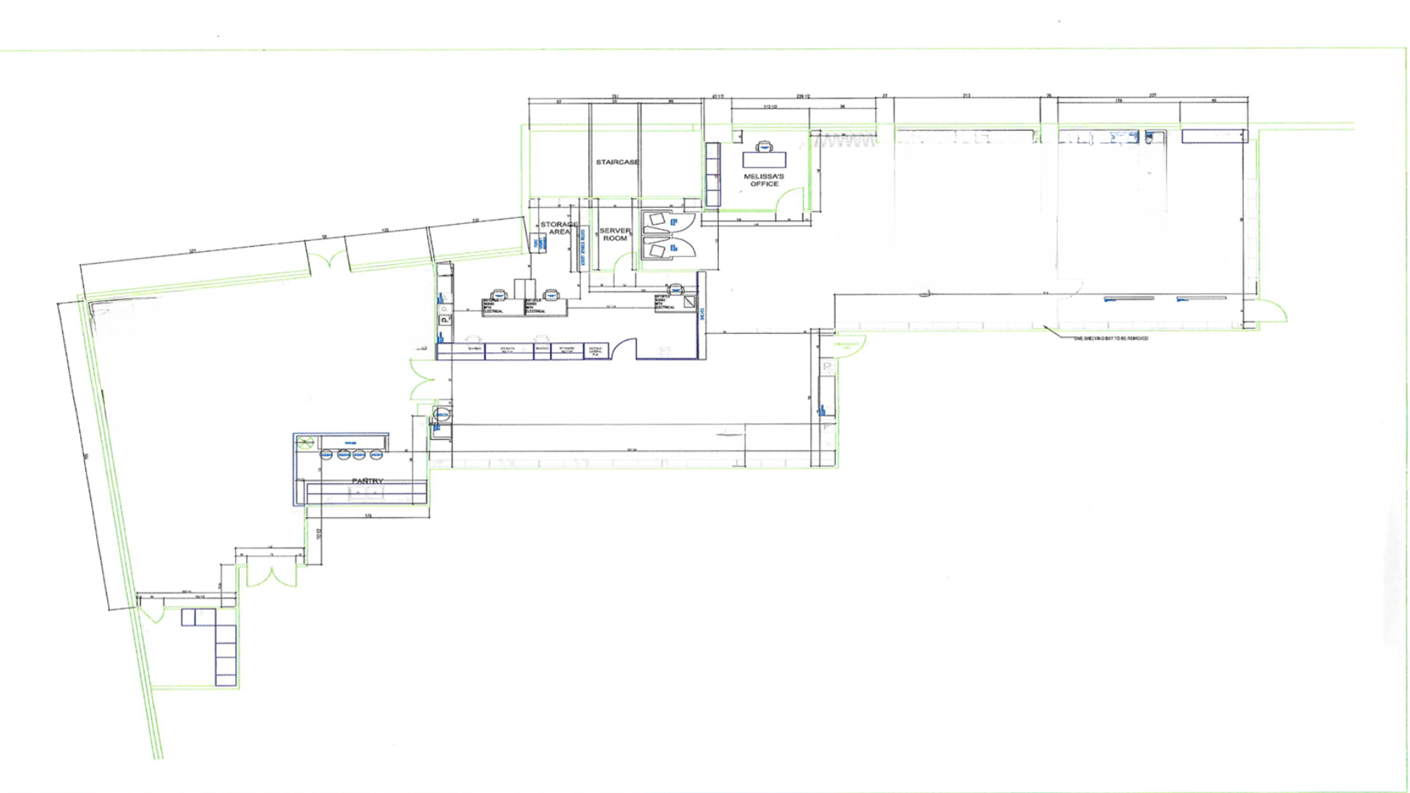

Slide 8
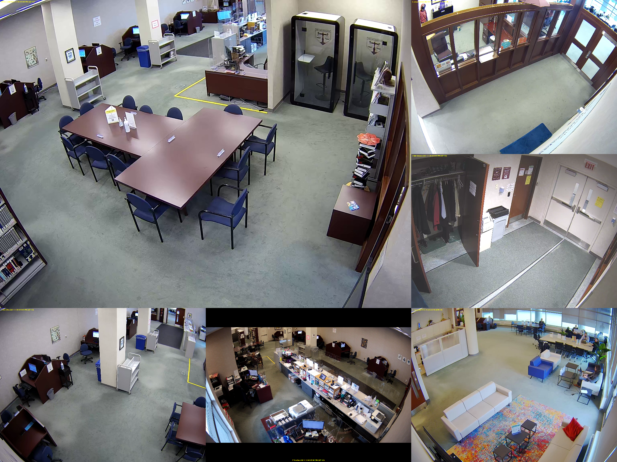

Slide 9
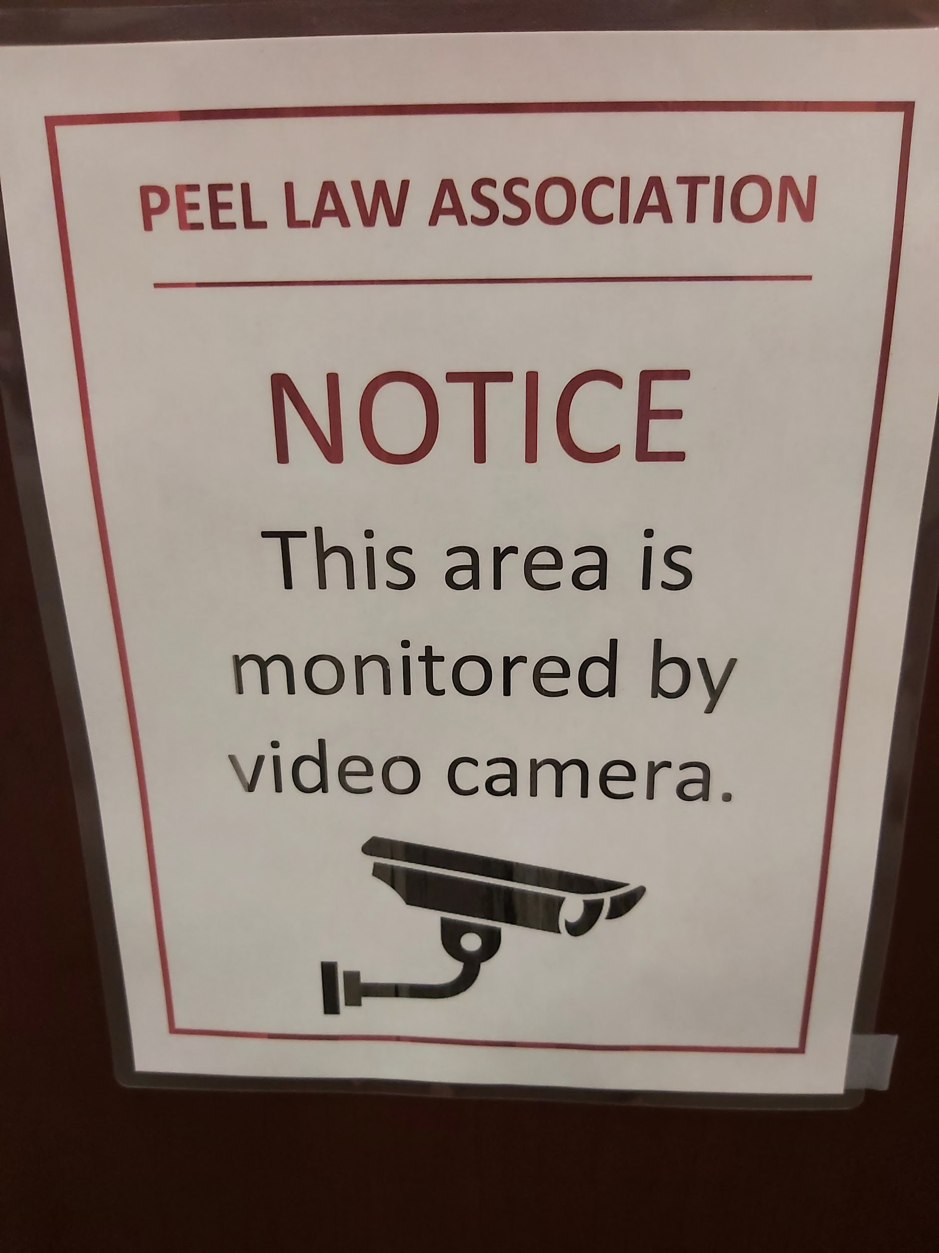
Strengths
Archiving of all feeds in the cloud
Colour recordings
Ability to zoom in
Ability to save videos or stills

Slide 10
Shortcomings
Blind spots
No audio
Time stamp is out of sync

Slide 11
Uses of security footage
Event head counts
Loss of personal property
Damage to PLA property
Disputes
Human Resources
Mysteries
Entertainment
Misuse of access cards

Slide 12
Other security measures
Orientation of stacks
Enthusiastic interaction with patrons
High value resources behind service desk
No access to the library after hours

Slide 13
Cheaper options
Small cameras mounted in optimal fixed positions
  Ring
  Nest
  Apple Eve Cam
Archiving video feed subscriptions
Mirrors
Limiting library access after hours
Guilt-inducing signage

Slide 14
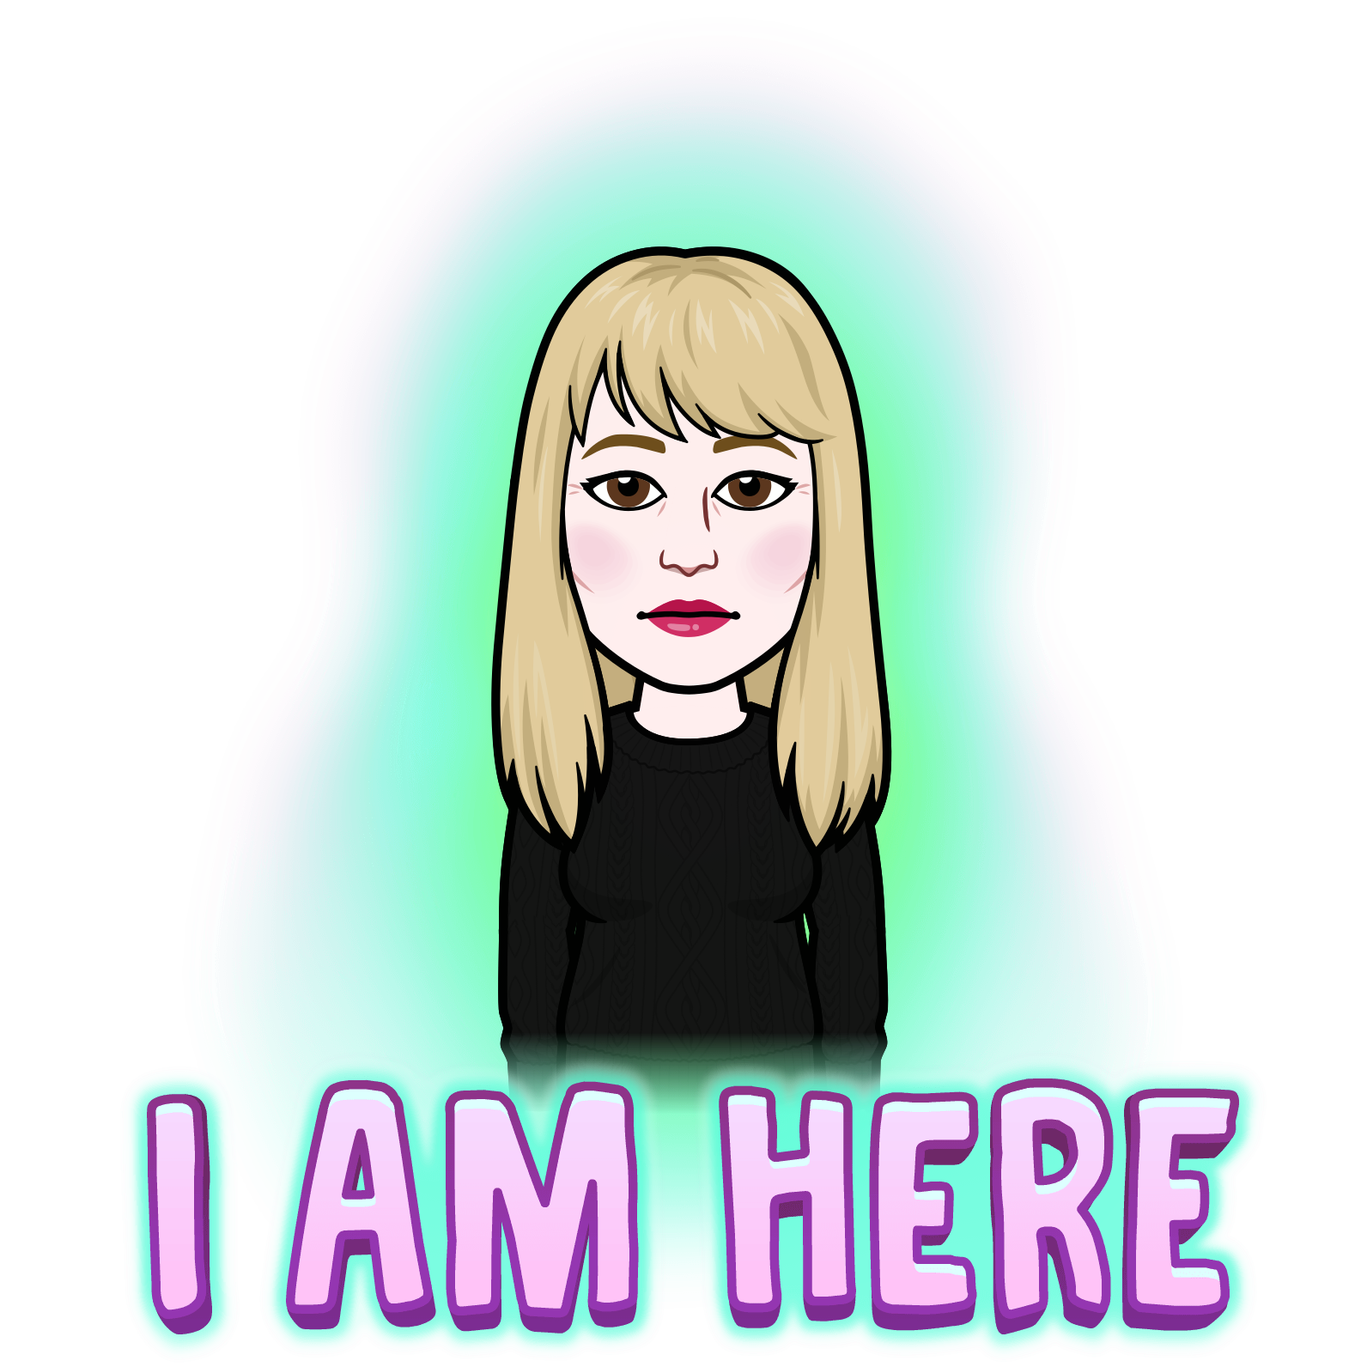
Have more questions?
Contact me any time!
eo@plalawyers.ca

