Slide 1


A George & Betty Presentation
All things
Fall (in place)

Slide 2



Changing attitudes
LSO Webcasts
LSO will provide a 50% discount for over 11 group participants in webcasts - but we have issues......not all of us have a large pool of lawyers to draw from, not all staff work full time, some have too much on their plate already
We, as a system should provide equity - service to all lawyers, not just our members
Collaboration - stop thinking locally but rather provincially

Slide 3


Harvest time
Any gardener will know that you reap what you sow, but it also takes a little bit of nurturing and testing to get a great harvest
The original seed was planted when York and Waterloo collaborated when they each found that they did not quite have enough participants for the 50%
So... they combined their registrants and when that worked out, they thought a bit bigger and put out some feelers to a few others. And so the garden grows

Slide 4

The test model
Ground Rules
Each participant has their own way of doing things and we try to respect that. Waterloo does not charge an admin fee but offers an out of county fee for non WRLA members. York and Simcoe charge an admin fee to every participant. We have different ideas of deadlines and whomever is taking ownership gets to set that deadline..

Slide 5

Feast or Famine
There will always be programs that will be sellouts - for York it is the Family Law Summit (71), but others we get requests but not enough participants. For example, the Estates and Trusts Summit had 4 participants from York, 6 from Waterloo, 2 from Simcoe, 2 from Durham, 1 from Muskoka, 1 from Peterborough. This new “group” had 16 happy participants.
It is mutually beneficial as not one of us on our own would be able to provide the discount to our members. How do we know how many are participating......

Slide 6
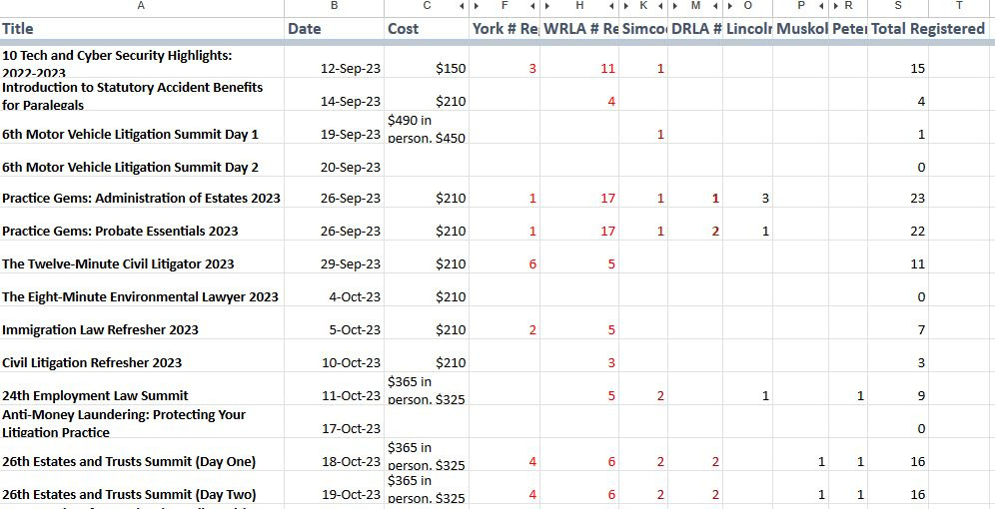
Coordinating the Group
with special thanks to Pia

Slide 7


Explaining the process to internal stakeholders
Getting lawyer buy in for something that was not offered before
Working out the little details - who takes charge of the registration (who has a credit card)
What to do if you do not get enough registrants within the whole group
Problem solving on the fly
Scary Stuff

Slide 8


Win - legitimate benefit that you can offer members and use as a selling point for membership - winner Association
Win - additional service provided with evidence based info - winner LiRN
Win - admin fees for your budget/replace copy revenue, stats - winner - Library/Staff
Win - good cpd at great price - winner - Your Members (and they are the ones who really matter)
Win -some equity within the group - winner - all of us
Final Thoughts

